Slide 1
Psychology Club & Workshop
Dr.T.Kumuthavalli
Assistant Professor and Head
Department of Lifelong Learning, Bharathidasan University, Khajamalai Campus, Tiruchirappalli - 23

Slide 2
Psychology Club
Psychology is the scientific study of the mind and behavior.
Wilhelm Wundt 1832-1920
Father of Psychology/ First Psychological Laboratory
Sigmund Freud – Psychoanalysis
Jean Piaget – Father of Child Psychology

Slide 3
Field of Psychology
Behavioural
Abnormal
Clinical
Comparative
Counseling
Cross Cultural
Dental
Industrial
Health
Forensic
Experimental
School
Social
Personality
Sports
HRM

Slide 4
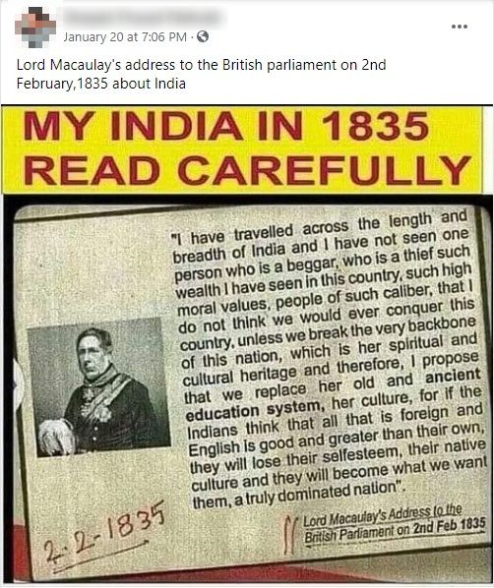
Lord Thomas Babington Macaulay

Slide 5
SWOT Analysis
Strengths | Weaknesses
Opportunities | Threats

Slide 6
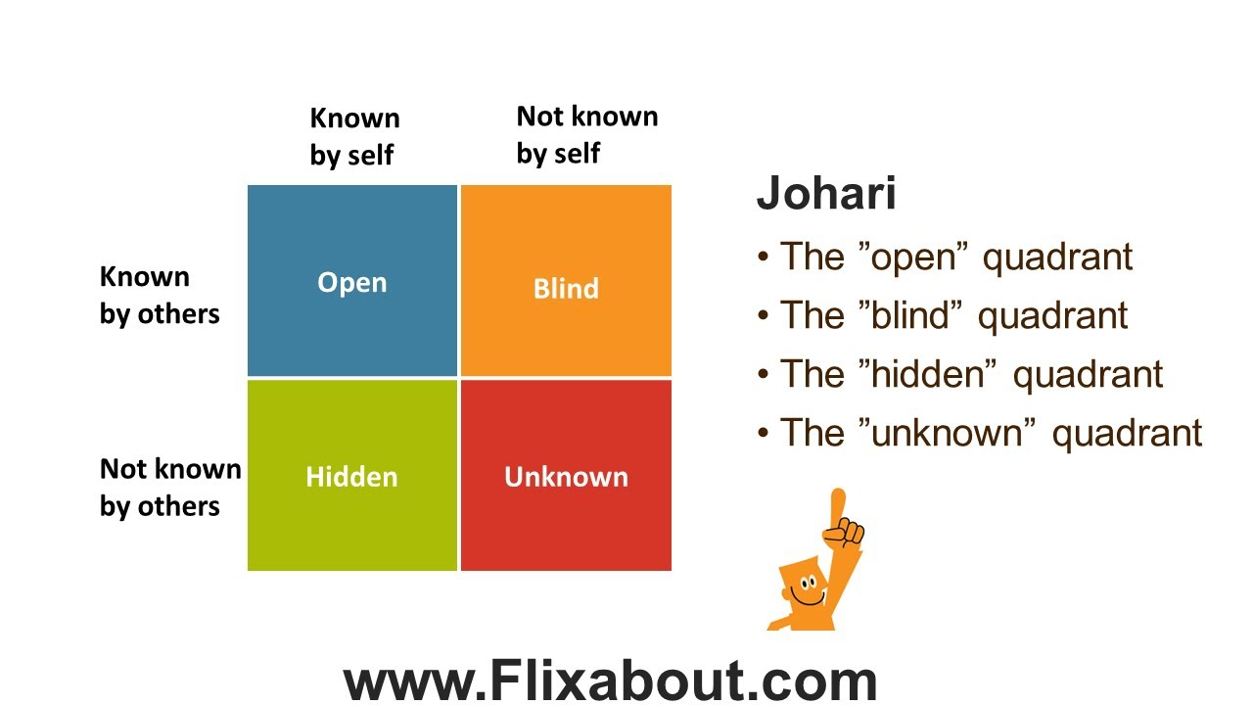
Johari Window

Slide 7
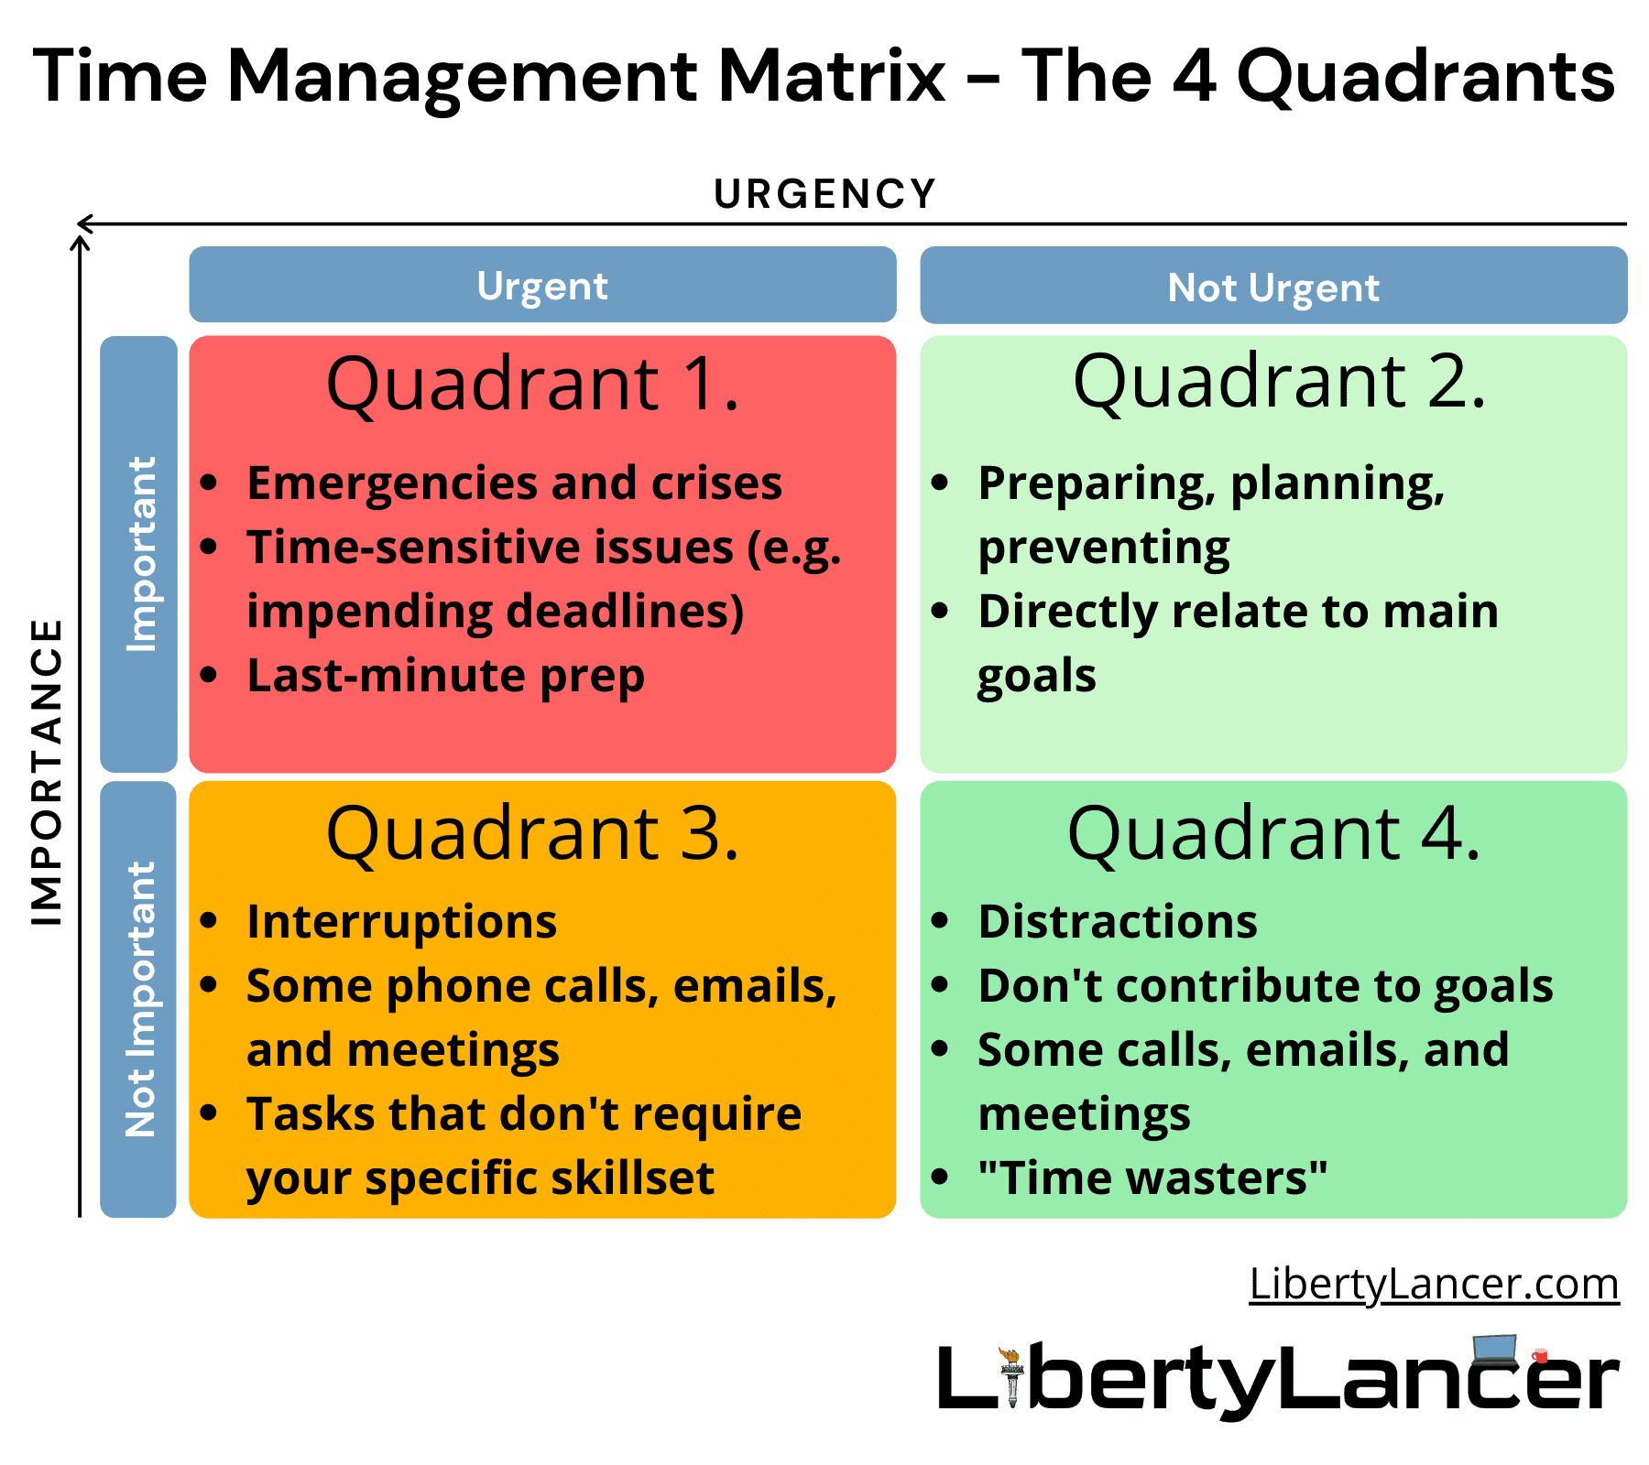

Slide 8
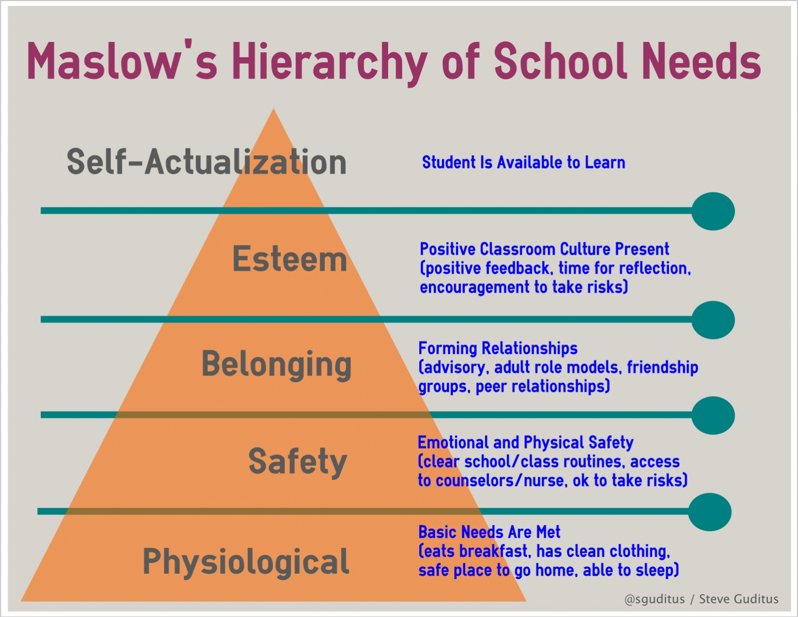
Maslow’s Hierarchy of Needs
self-actualization include realizing your dreams, being true to yourself, and achieving inner peace

Slide 9
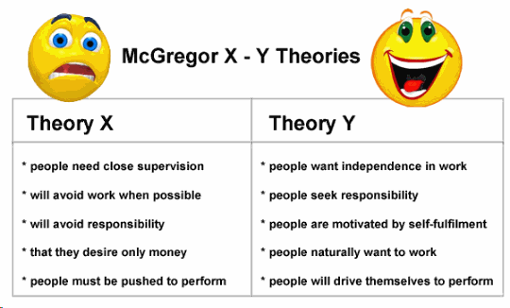

Slide 10

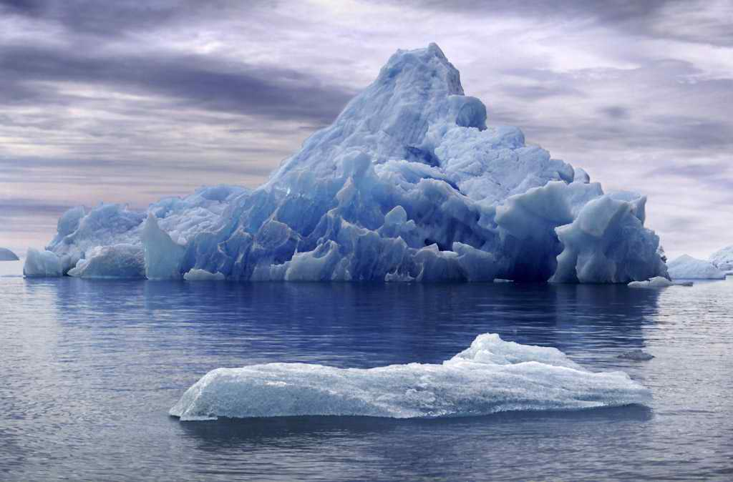
THE ICEBERG
HOW MUCH DO YOU SEE OF AN ICEBERG?

Slide 11
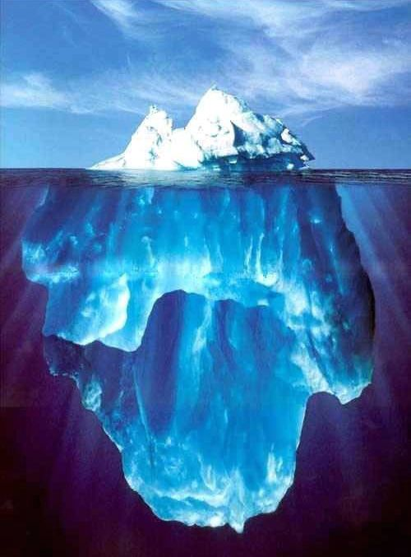
THE ICEBERG
ONLY 10% OF ICEBERG IS VISIBLE.
THE REMAINING 90%
IS BELOW SEA LEVEL.

Slide 12
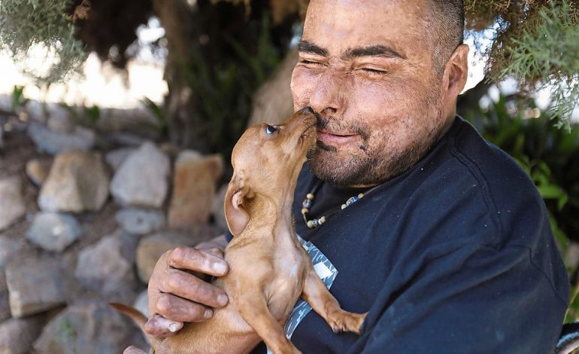
Burn victim stays positive after coma and over 70 operations

Slide 13
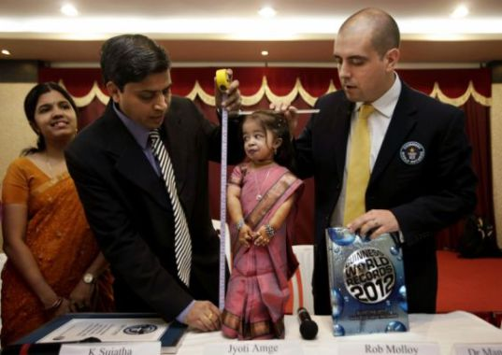
JyotiAmge of Nagpur, India
Record breaking height of 24.7 inches

Slide 14
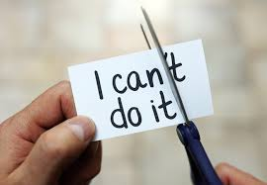
Cut the can’ts, have cans

Slide 15

Tear the impossibles

Slide 16
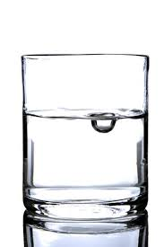
A class with water

Slide 17
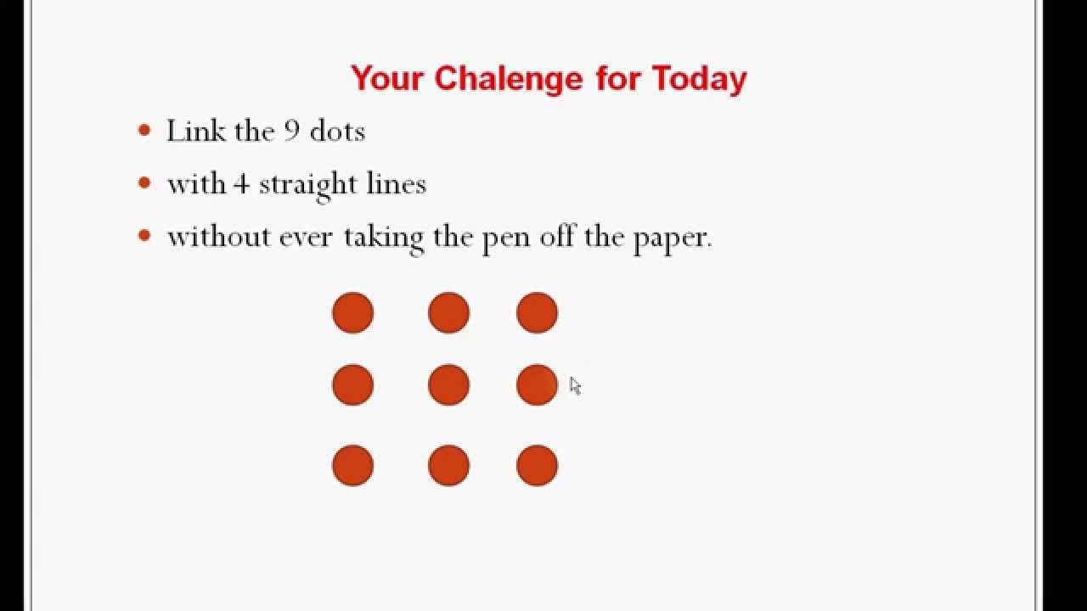

Slide 18
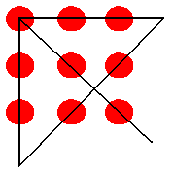
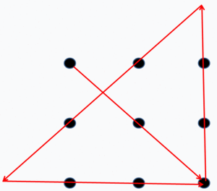
Answer in Either Ways

Slide 19
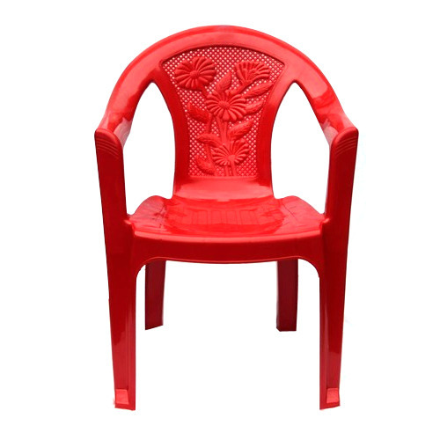
Chair Activity

Slide 20
Thanks

