Slide 1
Unit – V: Stress
Stress and Coping with Stress -Introduction to Perception, Attitude towards Life, Assertiveness, Achievement Motivation - Techniques for Managing Stress and Time.

Slide 2
Stress
Stress is a reaction to a situation where a person feels threatened or anxious.
Common reactions to a stressful event can include:
disbelief, shock, and numbness
feeling sad, frustrated, and helpless
difficulty concentrating and making decisions
headaches, back pains, and stomach problems
smoking or use of alcohol or drugs

Slide 3
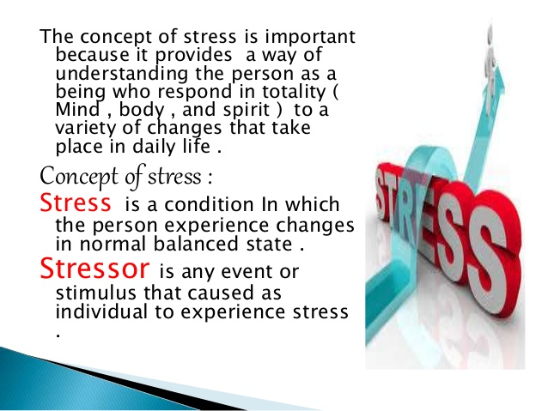

Slide 4
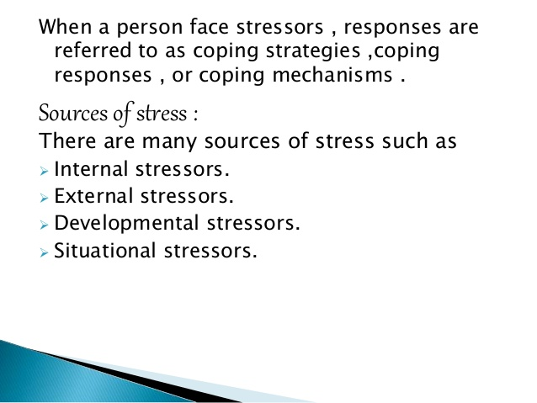

Slide 5
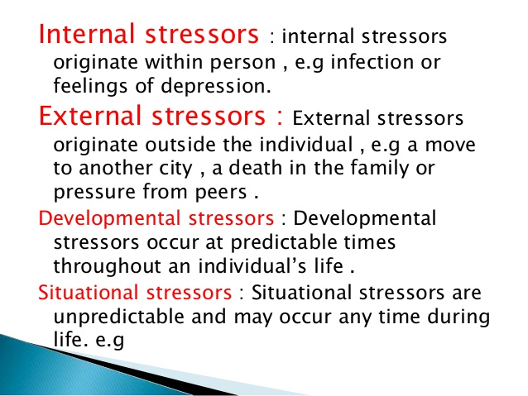

Slide 6
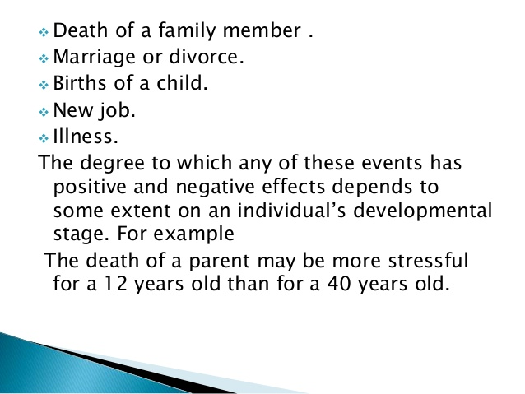

Slide 7
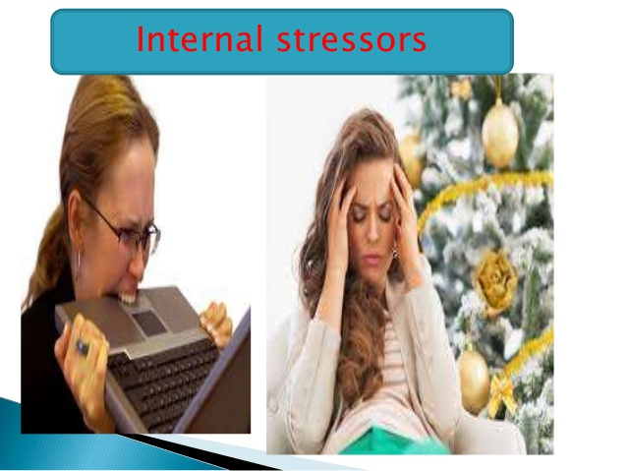

Slide 8
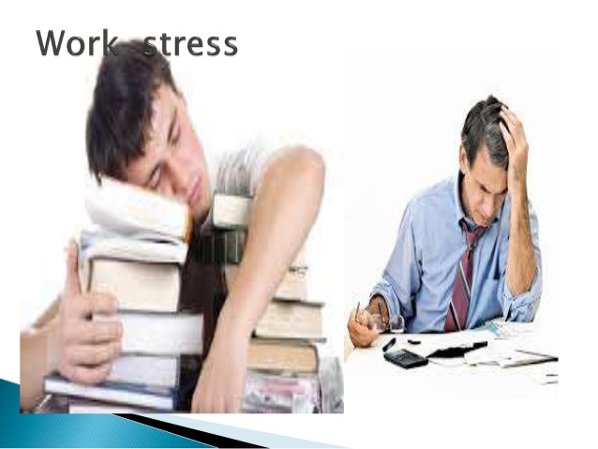

Slide 9


Slide 10
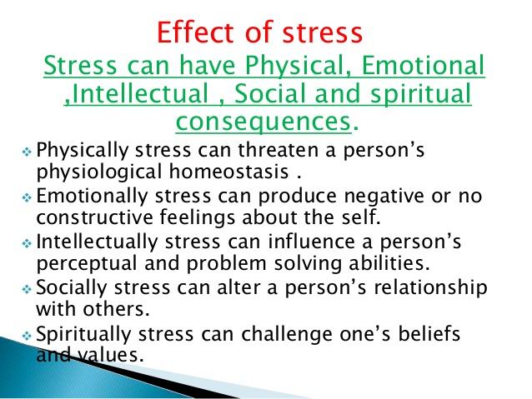

Slide 11
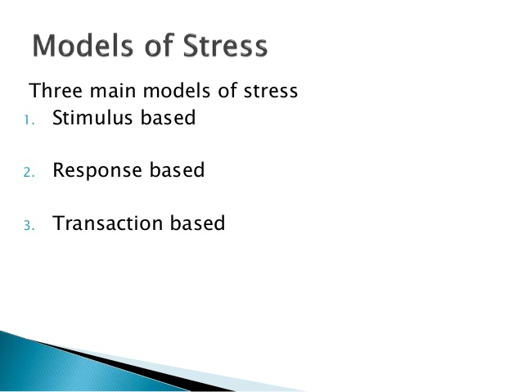

Slide 12
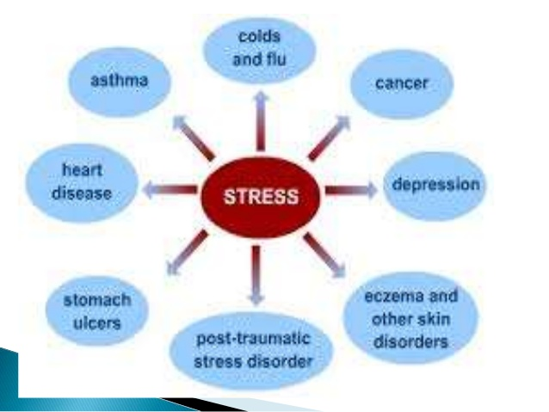

Slide 13
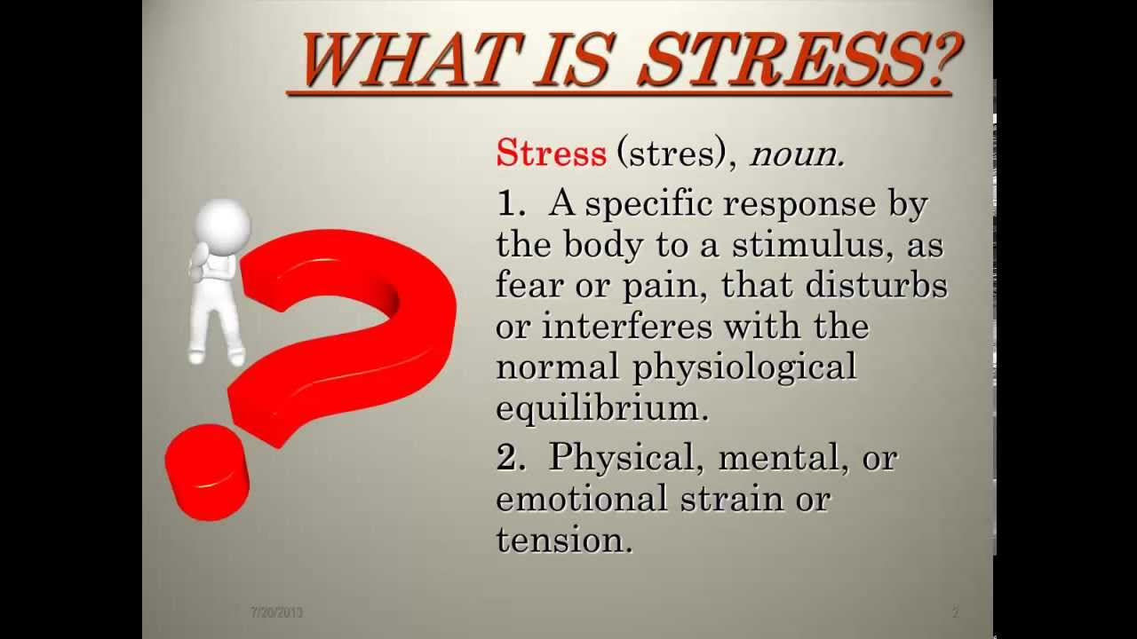

Slide 14
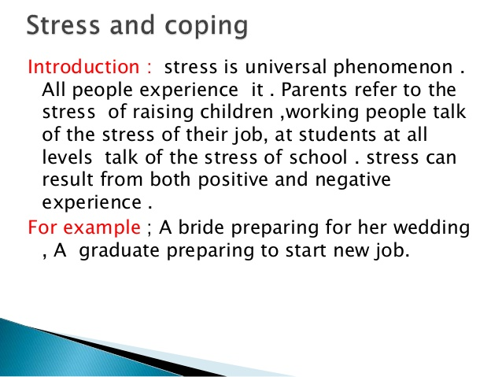

Slide 15
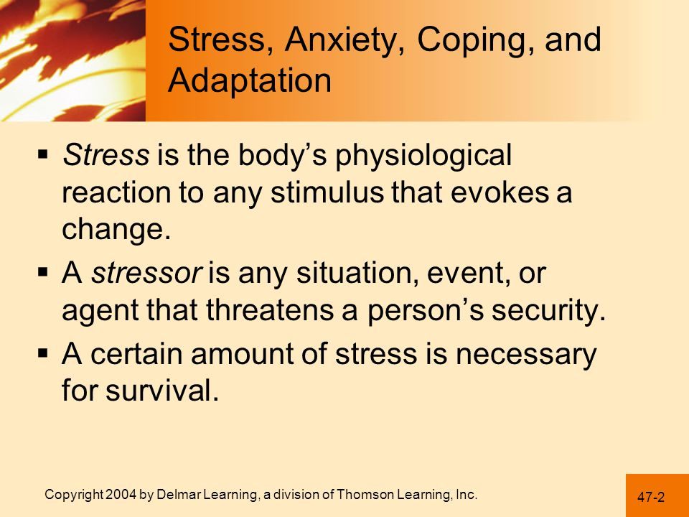

Slide 16
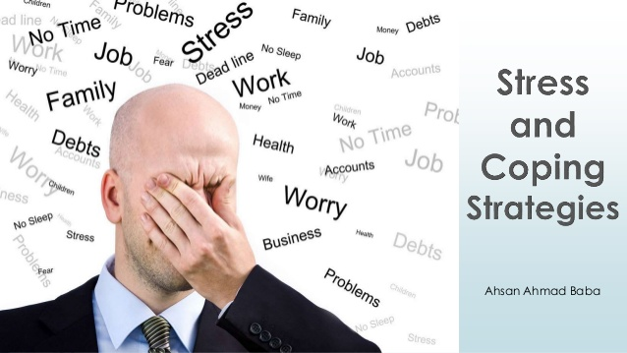

Slide 17
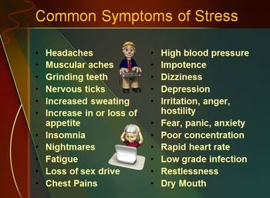

Slide 18
What are some common coping strategies?
Some common coping mechanisms may challenge you to:
Lower your expectations.
Ask others to help or assist you.
Take responsibility for the situation.
Engage in problem solving.
Maintain emotionally supportive relationships.
Maintain emotional composure or, alternatively, expressing distressing emotions.
Challenge previously held beliefs that are no longer adaptive.
Directly attempt to change the source of stress.
Distance yourself from the source of stress.
View the problem through a religious perspective.

Slide 19
Engage in stress-reducing activities
Get enough good quality sleep.
Eat a well-balanced diet.
Exercise on a regular basis.
Take brief rest periods during the day to relax.
Take vacations away from home and work.
Engage in pleasurable or fun activities every day.
Practice relaxation exercises such as yoga, prayer, meditation or progressive muscle relaxation.
Avoid use of caffeine and alcohol.

Slide 20
Healthy Ways to Cope with Stress
Feeling emotional and nervous or having trouble sleeping and eating can all be normal reactions to stress. Here are some healthy ways you can deal with stress:
Take care of yourself. Eat healthy, exercise, get plenty of sleep, and give yourself a break if you feel stressed out.
Talk to others. Share your problems and how you are feeling and coping with a parent, friend, counselor, doctor, or pastor.
Avoid drugs and alcohsol. These may seem to help, but they can create additional problems and increase the stress you are already feeling.
Take a break. If news events are causing your stress, take a break from listening or watching the news.
Recognize when you need more help. If problems continue or you are thinking about suicide, talk to a psychologist, social worker, or professional counselor.

Slide 21
Perception
Perception refers to the way sensory information is organized, interpreted, and consciously experienced. Perception involves both bottom-up and top-down processing. Bottom-up processing refers to the fact that perceptions are built from sensory input. On the other hand, how we interpret those sensations is influenced by our available knowledge, our experiences, and our thoughts. This is called top-down processing.

Slide 22
Perception
Perception includes the five senses; touch, sight, sound, smell, and taste. It also includes what is known as proprioception, a set of senses involving the ability to detect changes in body positions and movements. It also involves the cognitive processes required to process information, such as recognizing the face of a friend or detecting a familiar scent

Slide 23
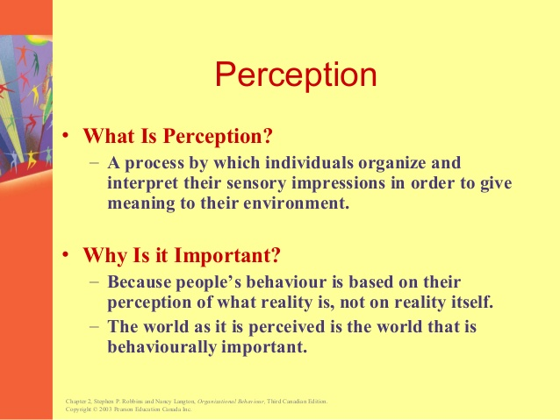

Slide 24
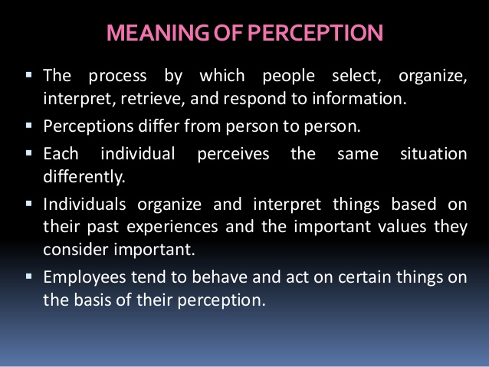

Slide 25
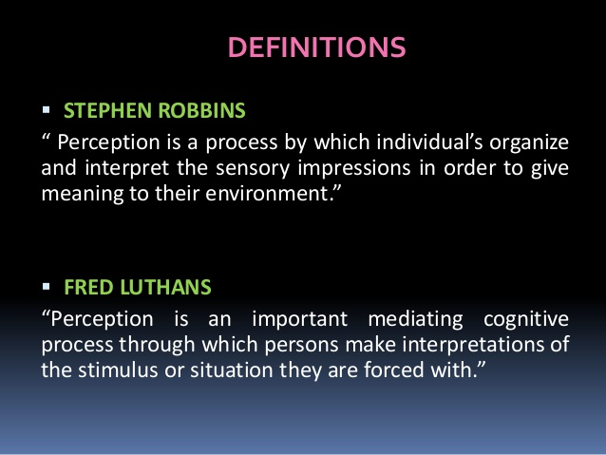

Slide 26
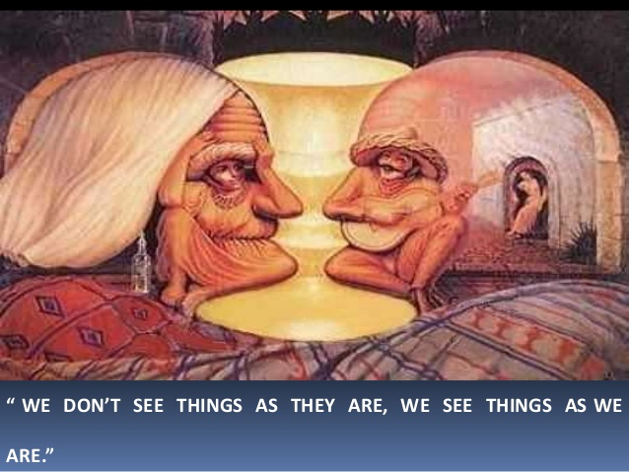

Slide 27
Types of Perception
Some of the main types of perception include:
Vision
Touch
Sound
Taste
Smell

Slide 28
Steps in the Perceptual Process
The Environmental Stimulus
The Attended Stimulus
The Image on the Retina
Transduction
Neural Processing
Perception
Recognition
Action

Slide 29
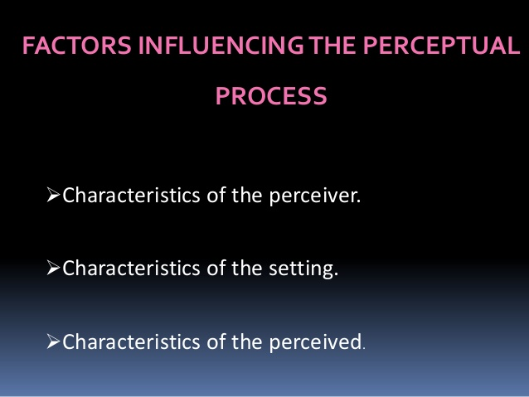

Slide 30
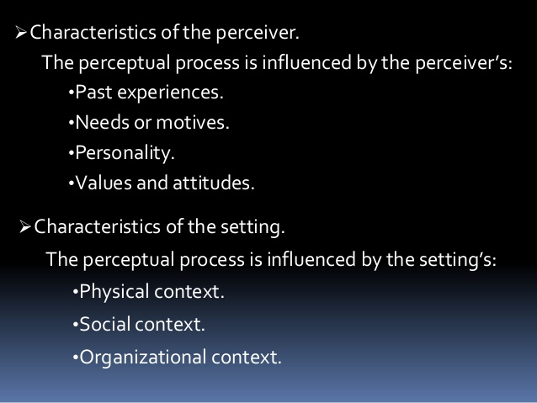

Slide 31
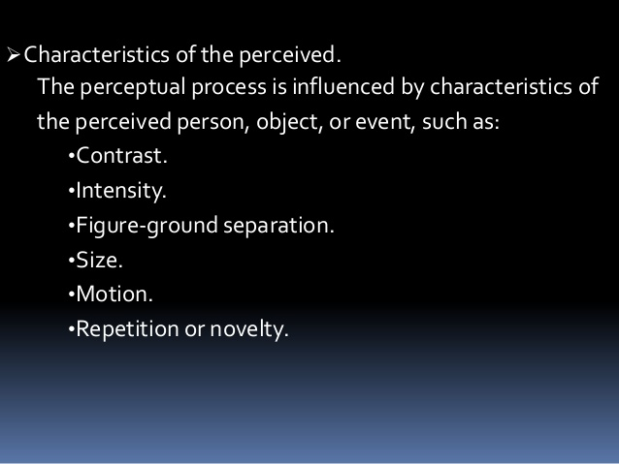

Slide 32
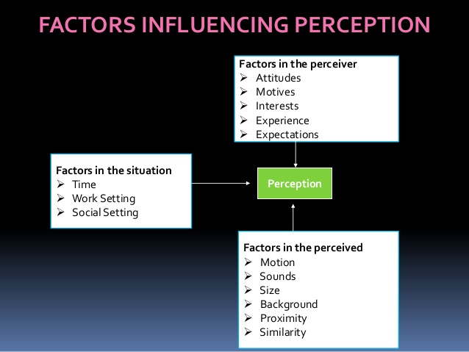

Slide 33
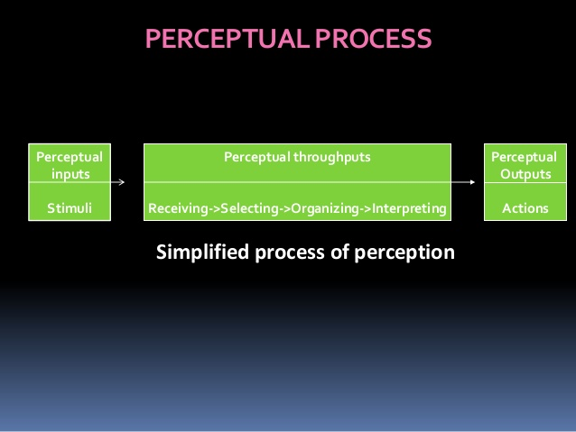

Slide 34
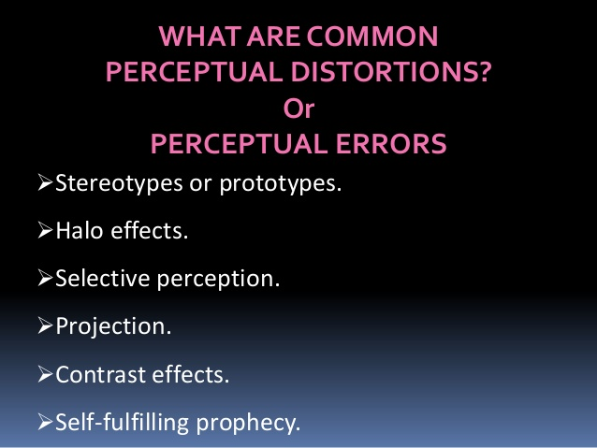

Slide 35
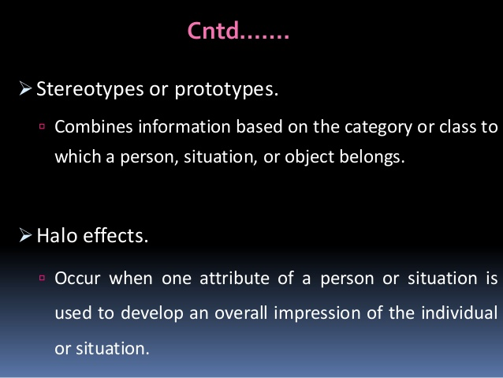

Slide 36
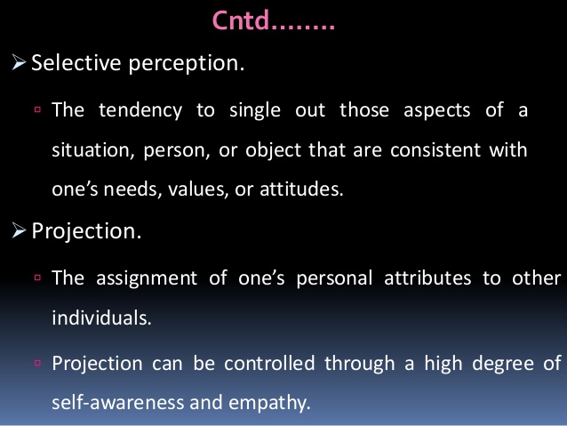

Slide 37
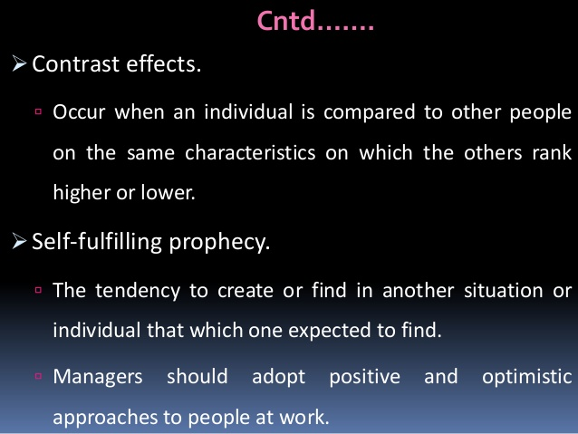

Slide 38
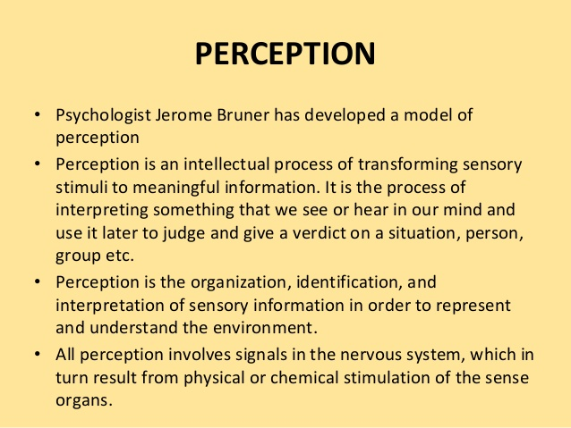

Slide 39
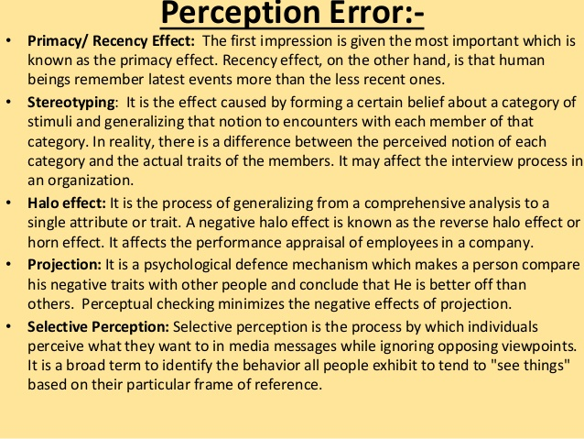

Slide 40
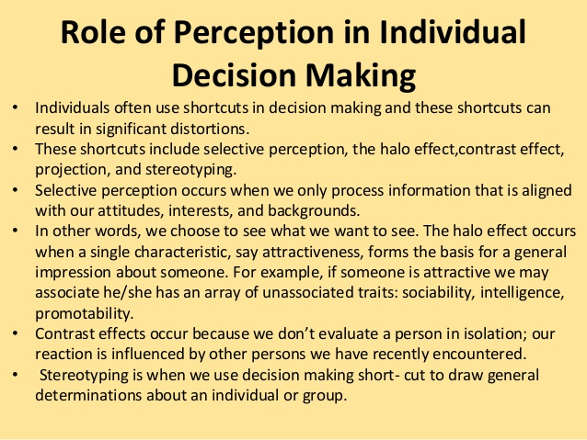

Slide 41


Slide 42
!
ATTITUDE
IS
EVERY THING

Slide 43
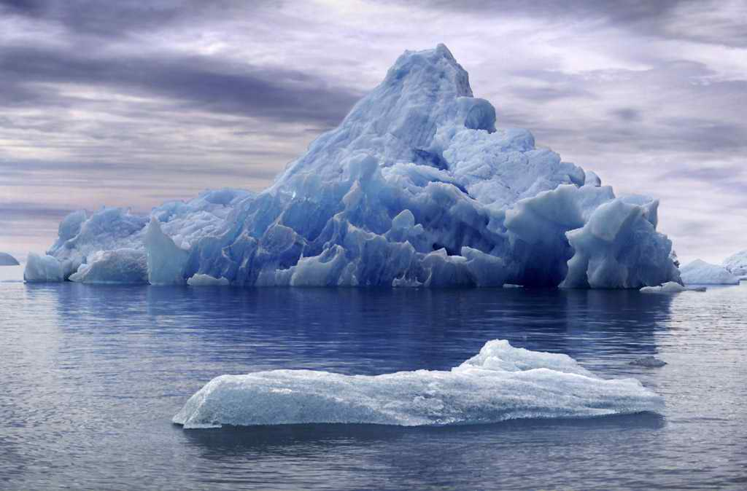

THE ICEBERG
HOW MUCH DO YOU SEE OF AN ICEBERG?

Slide 44

THE ICEBERG
ONLY 10 OF ANY ICEBERG IS VISIBLE.
THE REMAINING 90% IS BELOW SEA LEVEL.

Slide 45
THE ICEBERG
10 %
VISIBLE
ABOVE SEA LEVEL
SEA LEVEL
INVISIBLE
BELOW SEA LEVEL
90 %

Slide 46
THE ICEBERG
The Iceberg phenomena is also applicable on human beings …

Slide 47
THE ICEBERG
KNOWLEDGE
&
SKILLS
KNOWN
TO OTHERS
SEA LEVEL
UNKNOWN
TO OTHERS
ATTITUDE

Slide 48
THE ICEBERG
BEHAVIOR
KNOWN
TO OTHERS
SEA LEVEL
UNKNOWN
TO OTHERS
IMPACT
VALUES – STANDARDS – JUDGMENTS
ATTITUDE
MOTIVES – ETHICS - BELIEFS

Slide 49
WHAT MAKES YOUR LIFE 100% ?
Let each letter of the alphabetic has a value equals to it sequence of the alphabetical order:
A | B | C | D | E | F | G | H | I | J | K | L | M | N | O | P | Q | R | S | T | U | V | W | X | Y | Z
1 | 2 | 3 | 4 | 5 | 6 | 7 | 8 | 9 | 10 | 11 | 12 | 13 | 14 | 15 | 16 | 17 | 18 | 19 | 20 | 21 | 22 | 23 | 24 | 25 | 26
S | K | I | L | L | S
19 | 11 | 9 | 12 | 12 | 19
=
82
K | N | O | W | L | E | D | G | E
11 | 14 | 15 | 23 | 12 | 5 | 4 | 7 | 5
=
96
H | A | R | D |  | W | O | R | K
8 | 1 | 12 | 4 |  | 23 | 15 | 18 | 11
=
98
A | T | T | I | T | U | D | E
1 | 20 | 20 | 9 | 20 | 21 | 4 | 5
=
100

Slide 50
THE CAN DO ATTITUDE
You CAN DO everything, but not all at once.
You CAN DO everything, if it’s important enough for you to do.
You CAN DO everything, but you may not be the best at everything.
You CAN DO everything, but there will be limitations.
You CAN DO everything, but you’ll need help.

Slide 51
BEST QUOTES ON POSITIVE ATTITUDE
A positive thought is the seed of a positive result.
If you don’t like something, change it. If you can’t change it, change your attitude. Don’t complain.
The most significant change in a person’s life is a change of attitude. Right attitudes produce right actions.
If you really want to be happy, nobody can stop you except God.

Slide 52
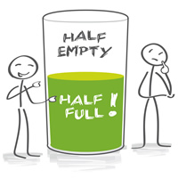
BEST QUOTES ON POSITIVE ATTITUDE
Whether a glass if half-full or half-empty, depends on the attitude of the person looking at it.
There is a better way for everything. Find it.
A positive attitude is not a destination. It is a way of life.
The difference between a successful person and others is not a lack of knowledge, but rather a lack of will.

Slide 53
BEST QUOTES ON POSITIVE ATTITUDE
The positive thinker sees the invisible, feels the intangible, and achieves the impossible.
The man with confidence in himself gains the confidence of others.
You will only go as far as you think you can go.
The biggest mistake of all is to avoid situations in which you might make a mistake.

Slide 54
BEST QUOTES ON POSITIVE ATTITUDE
A positive attitude is like a magnet for positive results.
Our life is a reflection of our attitudes.
Positive attitudes create a chain reaction of positive thoughts.
Attitude, not aptitude, determines your altitude.
No man fails if he does his best.

Slide 55
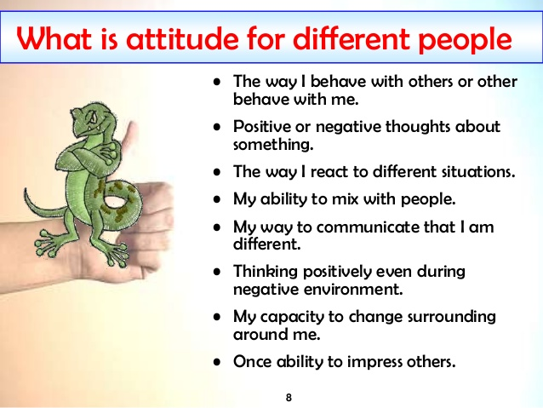

Slide 56
BEST QUOTES ON POSITIVE ATTITUDE
Sooner or later, those who win are those who think they can.
A creative attitude is the fuel of progress and growth.
Either I will find a way, or I will make one.
Be the change you want to see in this world.
Forgive others and you will be forgiven.

Slide 57
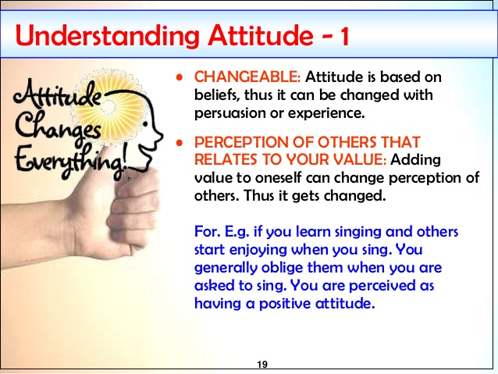

Slide 58
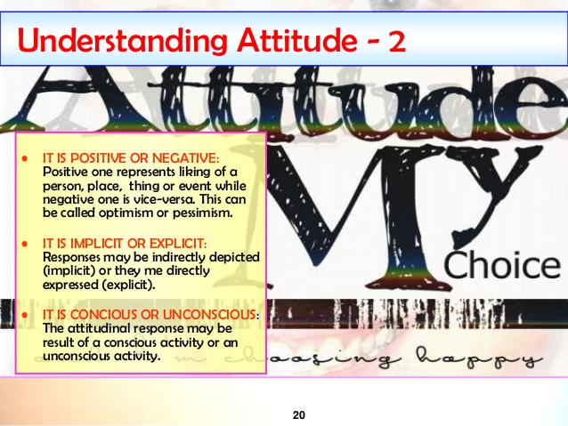

Slide 59
Assertiveness
Assertiveness means encouraging others to be open and honest about their views, wishes and feelings, so that both parties act appropriately.
Assertive behaviour includes: Being open in expressing wishes, thoughts and feelings and encouraging others to do likewise. See our page on Managing Emotions.

Slide 60
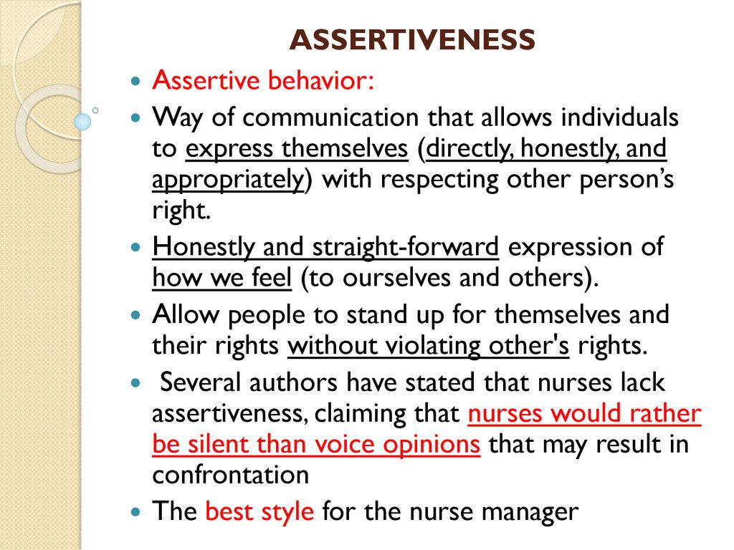
Assertiveness

Slide 61
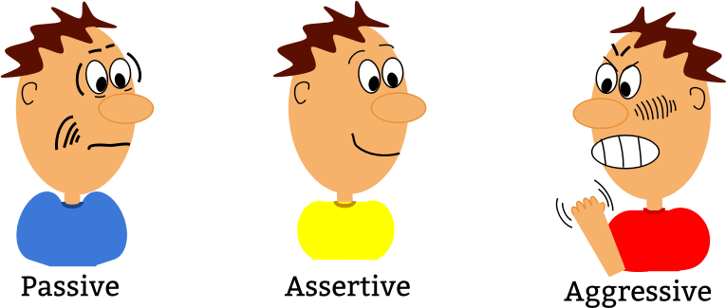

Slide 62
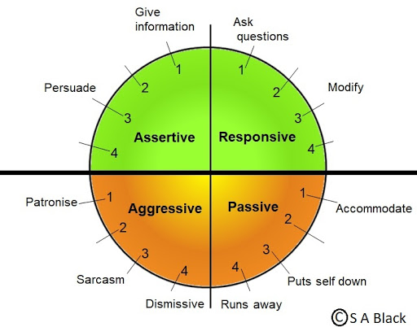

Slide 63
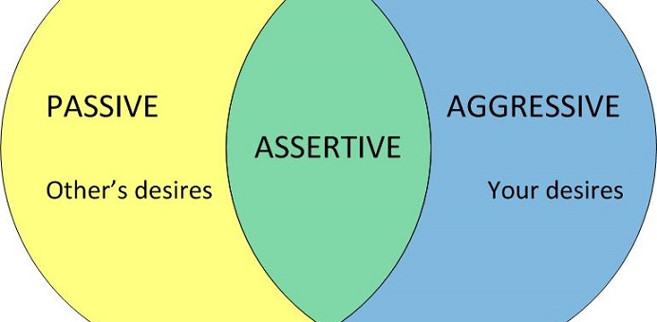

Slide 64
Achievement Motivation
Achievement motivation typically refers to the level of one's motivation to engage in achievement. behaviors, based on the interaction of such parameters as need for achievement, expectancy of success, and the incentive value of success.

Slide 65
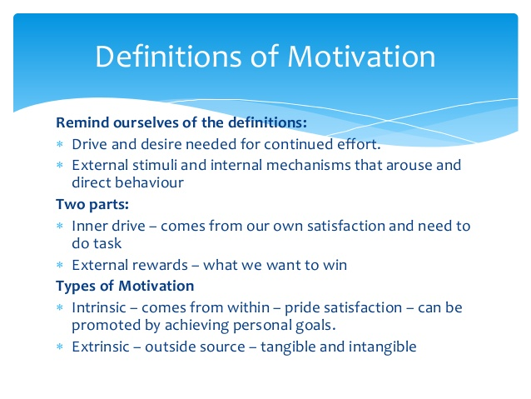

Slide 66
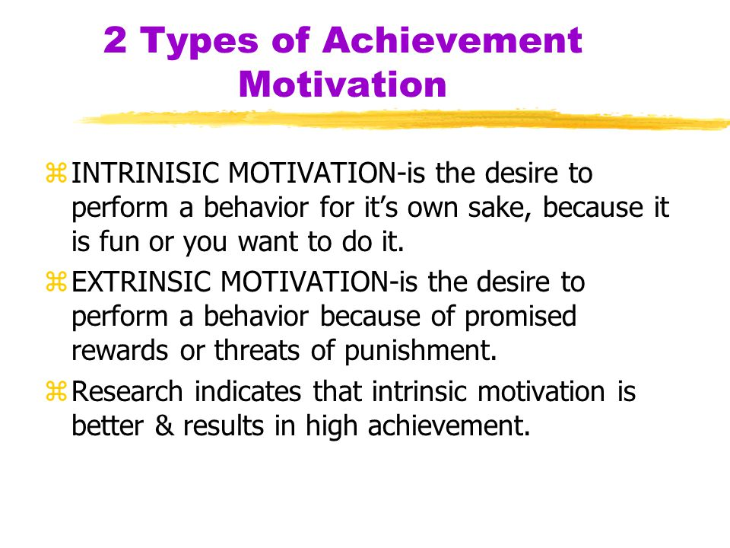

Slide 67
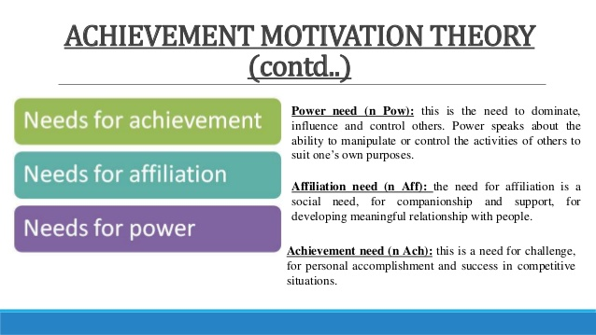

Slide 68
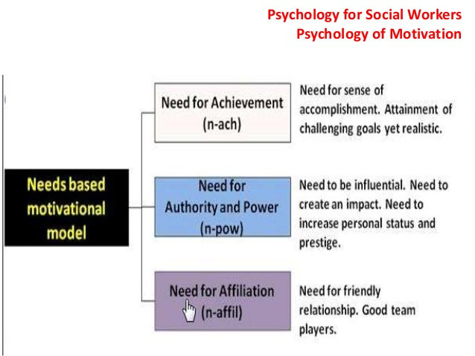

Slide 69
Techniques for Managing Stress
What is stress?
Stress is the “psychological, physiological and behavioural response by an individual when they perceive a lack of equilibrium between the demands placed upon them and their ability to meet those demands, which, over a period of time, leads to ill-health”
(Palmer, 1989).

Slide 70
Symptoms of stress
Difficulty sleeping;
Weight gain or weight loss;
Stomach pain;
Irritability;
Teeth grinding;
Panic attacks;
Headaches;
Difficulty concentrating;
Sweaty hands or feet;
Heartburn;
Excessive sleeping;
Social isolation;
Fatigue;
Nausea;
Feeling overwhelmed;
and obsessive or compulsive behaviors.

Slide 71
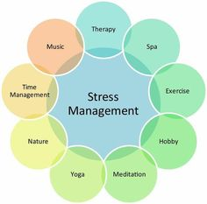

Slide 72
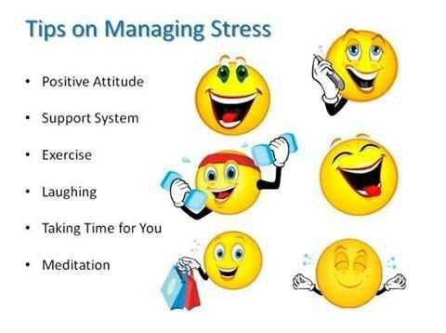

Slide 73
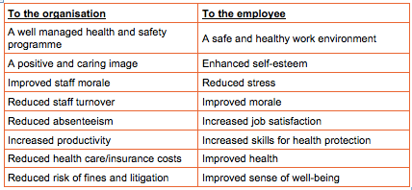

Slide 74
Stress relief Practices
1. Exercise
2. Relax Your Muscles
3. Deep Breathing
4. Eat Well
5. Slow Down
6. Take a Break
7. Make Time for Hobbies
8. Talk About Your Problems
9. Go Easy On Yourself
10. Eliminate Your trigger
Running
Swimming
Dancing
Cycling
Aerobics
Use the stairs instead of the elevator.
Park as far as you can from the door.
Hand-wash your car.
Clean your house.
Walk on your lunch break.
Diet

Slide 75
Personal strategies for stress management are to
Set realistic deadlines;
Take a lunch break;
Go home on time;
Take your holiday leave;
Leave work at work;
Participate in work functions;
Establish open and professional communication;
Respect other employees;
Do not tolerate discrimination of any sort, report any instances;
Sign up for workplace training programs to develop and improve your skills;
If required, seek therapy to manage and develop skills to cope with workplace stressors;
and develop a healthy work-life balance, creating time for exercise.

Slide 76
Techniques for Managing Time
Plan your day in advance. Planning is the first, the best, and most proven of all time management techniques. ...
Limit e-mail intake. ...
Find your productivity zone. ...
Eat the frog. ...
Take regular breaks. ...
Say “no” and delegate. ...
Focus and block distractions. ...
Set goals.

Slide 77
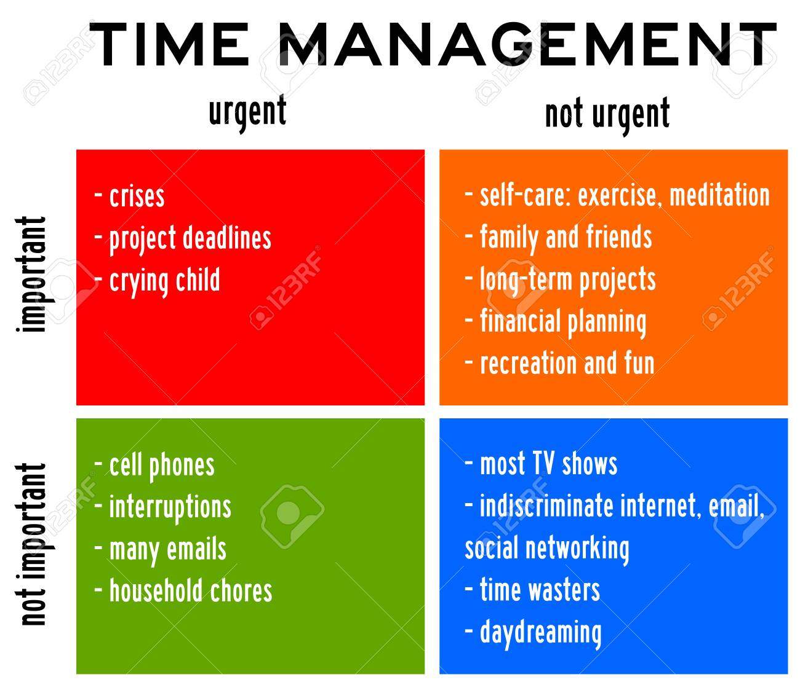

Slide 78
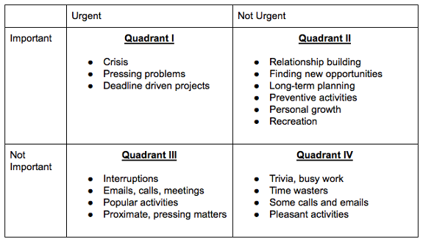

Slide 79
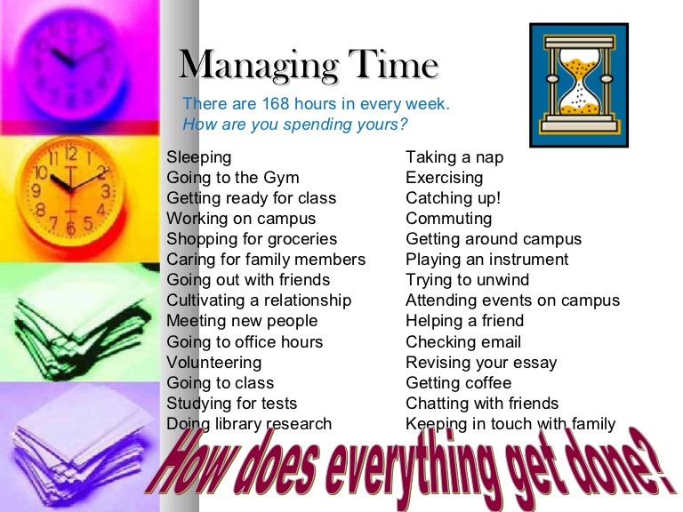

Slide 80
? & Doubts
Thank you

