Slide 1
Unit - II - Interpersonal Relationships
Interpersonal Relationships – Introduction to Interpersonal Relationships & Social Psychology, Types of Relationships and Locations of Persons in Relationships – Human Behaviour and Relationship : Evolution and Human Relationship and Satisfaction and Commitment.

Slide 2
Defining the interpersonal relationship
Interpersonal relationships are the strong connections we feel with those closest to us. This could be:
friends
colleagues
family members
romantic partners
They’re built on mutual respect, trust, and loyalty and they can provide us with support, care, and even love.

Slide 3
Interpersonal relationship
Interpersonal relationships make up every relationship that fulfills a range of physical and emotional needs for you. These are the people who you’re closest with in your life.
While romantic relationships are interpersonal, family members and intimate friends are, too. There’s also such a thing as secondary interpersonal relationships. These include acquaintances, neighbors, and others who you interact with on a regular basis.
In short, you have some kind of interpersonal relationship with everyone you know.
Given the importance of relationships to our emotional and physical well-being, it’s necessary to learn how to develop and maintain them.

Slide 4
Interpersonal relationship
A strong bond between two or more people refers to interpersonal relationship. Attraction between individuals brings them close to each other and eventually results in a strong interpersonal relationship.
Forms of Interpersonal relationship
An interpersonal relationship can develop between any of the following:
Individuals working together in the same organization.
People working in the same team.
Relationship between a man and a woman (Love, Marriage).
Relationship with immediate family members and relatives.
Relationship of a child with his parents.
Relationship between friends.
Relationship can also develop in a group (Relationship of students with their teacher, relationship of a religious guru with his disciples and so on)

Slide 5
Stages of relationships
Stages of relationships
Relationships don’t develop suddenly. One psychologist, George Levinger, identified five stages of interpersonal relationships in a 1980 study. He called this stage theory, which includes:
acquaintance
buildup
continuation
deterioration
ending (termination)
A successful interpersonal relationship will only go through the first three stages. A relationship that ends in a breakup with a friend or romantic partner will go through all five of these stages.

Slide 6
Stages of relationships
According to famous psychologist George Levinger, every relationship goes through following five stages.
First Stage – Acquaintance
Acquaintance refers to knowing each other. To start relationship individuals need to know each other well.
Two individuals might meet at some place and instantly hit it off. People feel attracted to each other and decide to enter into a relationship.
Common friends, social gatherings, same organizations also help people meet, break the ice, get acquainted with each other and start a relationship.
Second Stage – The Build up Stage
This is the stage when the relationship actually grows. Individuals are no longer strangers and start trusting each other.
Individuals must be compatible with each other for the relationship to continue for a longer period of time. Individuals with similar interests and backgrounds tend to gel with each other more as compared to individuals from diverse backgrounds and different objectives.
The build up stage in a relationship is often characterized by two individuals coming close, being passionate and feeling for each other.

Slide 7
Stages of relationships
Third Stage – Continuation Stage
This is the stage when relationship blossoms into lasting commitments. It is when people after knowing each other well decide to be in each other’s company and tie the knot.
Trust and transparency is essential for the charm to stay in relationship forever.
Fourth Stage – Deterioration
Not all relationships pass through this stage. Lack of compatibility, trust, love and care often lead to misunderstandings and serious troubles in relationship.
Individuals sometimes find it extremely difficult to adjust with each other and eventually decide to bring their relationship to an end.
Compromise is an integral part of every relationship.Individuals failing to compromise with each other find it difficult to take the relationship to the next level.
Fifth Stage – The Termination Stage
The fifth and the last stage is the end of a relationship.
Relationship terminates due to any of the following reasons
  Death of any one partner
  Divorce
  Separation
An ideal relationship results in lasting commitments and marriages whereas there are some relationships which do start on a positive note but end abruptly.

Slide 8
Key Interpersonal Communication Skills
Verbal communication
Verbal communication skills are important for the majority of occupations because they help you interact effectively and build rapport.
Tips:
Tailor your speech to the audience by, for example, avoiding technical terminology.
Ask questions to show your interest in what is being said.
Match what you're saying with your voice and your body language.
Reflect on what someone has said by summarising and paraphrasing.
Actively listening.

Slide 9
Active listening
Active listening is listening beyond the words being spoken - understanding the message being communicated. During conversations, a lot of the time the "listener" is thinking about how they're going to respond rather than concentrating on what the speaker is saying.

Slide 10
To develop active listening you should practice the following:
Pay attention - give the speaker your complete attention rather than thinking about your response.
Show the speaker that you're listening and that you're interested - body language is especially helpful for this.
Clarify your understanding - you need to ensure that you understand what the speaker is saying without your judgments and beliefs getting in the way so ensure you reflect and ask questions.
Don't interrupt or redirect the conversation.
Provide a suitable response that is honest but polite.

Slide 11
Body language
The impression others form of you is roughly split by:
Body (visuals) 55%
Voice (sound) 38%
Words (content) 7%

Slide 12
Openness
Don't just speak with people who have similar views to your own, you should also speak to those who have opposing opinions. Show an interest in what they say with the aim of understanding how they think. This will help with your own development as it challenges you and people will admire you for this because it shows a willingness to learn from others even if you are in disagreement.

Slide 13
Negotiation skills
Negotiation is important in a variety of situations, for example, you may need it to resolve a conflict or create a contract. You must be able to come to mutual agreements that keep everyone satisfied even if there is compromise. Being able to negotiate leads to respect and people will trust you as they know you look out for everyone's best interests.

Slide 14
Decision making and problem-solving skills
Most jobs have elements of problem-solving - this is where you think of solutions to deal with a problem. This type of creative thinking can help maintain harmony within a team. The general structure to problem-solving is:
Identifying the problem
Exploring all of the solutions
Deciding on which solution to implement
Implementing the solution
Reviewing the outcome

Slide 15
Conflict resolution
It's likely that you'll need to resolve a conflict at some point. Active listening and problem-solving are useful for this as you'll need to hear from all sides objectively and you'll need to come to a positive resolution.
Resolving conflict is not always a negative experience - it can be very constructive and provide you with an understanding of underlying problems, for example, perhaps a team member is having difficulties at home which is making them more irritable.
By forming a plan with those involved, you can help them move forward and manage their difficulties. They may have never experienced this constructive help before your mediation.

Slide 16
Assertiveness
Assertiveness is when you confidently express your needs and opinions in a fair, honest and calm way whilst considering the needs and views of other people. People are more likely to like and respect you if you're assertive in your communication rather than passive or aggressive.
Tips:
Tell the other person how you feel.
Listen to what the other person says and empathise.
Speak at a normal conversational volume.
Maintain eye contact.
Avoid words that exaggerate, such as, "always" and never".
Use facts rather than judgements.

Slide 17
Positive Attitude and Team Work
Positive attitude
People want to be around others that are friendly and have a positive outlook even when the company may be in a difficult situation. You don't have to be incredibly sociable but you must develop some type of positive rapport with your team so that the workplace is pleasant for everybody.
Teamwork
For a business to function effectively people must work well together in order to achieve a common goal. Some people struggle with teamwork because they believe that they know how to do the job better than anyone else and they do not trust others to do their roles. This can create conflict and hurt the overall effectiveness of the team.

Slide 18
Empathy
To be empathetic means that you are able to identify and understand others' emotions i.e. imagining yourself in someone else's position. Being empathetic shows your team that you care. For example, if a manager reacts angrily after finding out that an employee has been arriving to work late because their child is unwell, the team is likely to react negatively towards the manager.

Slide 19
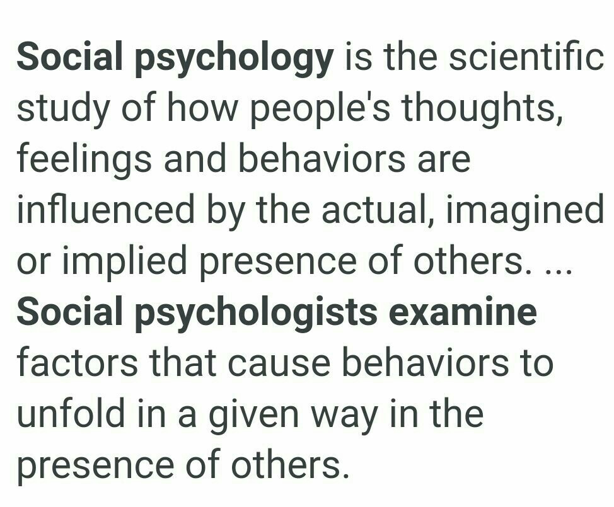
Social Psychology

Slide 20
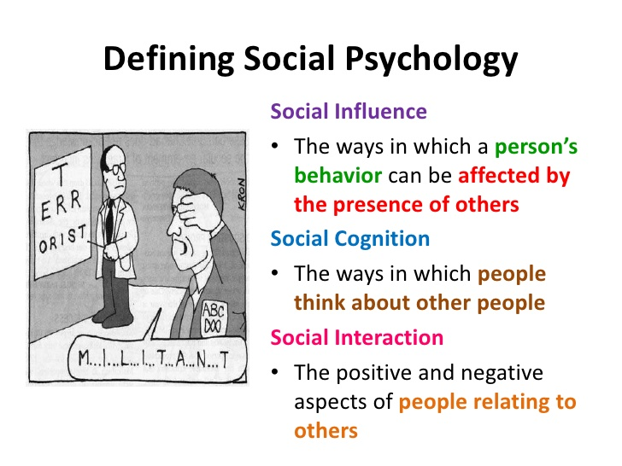

Slide 21
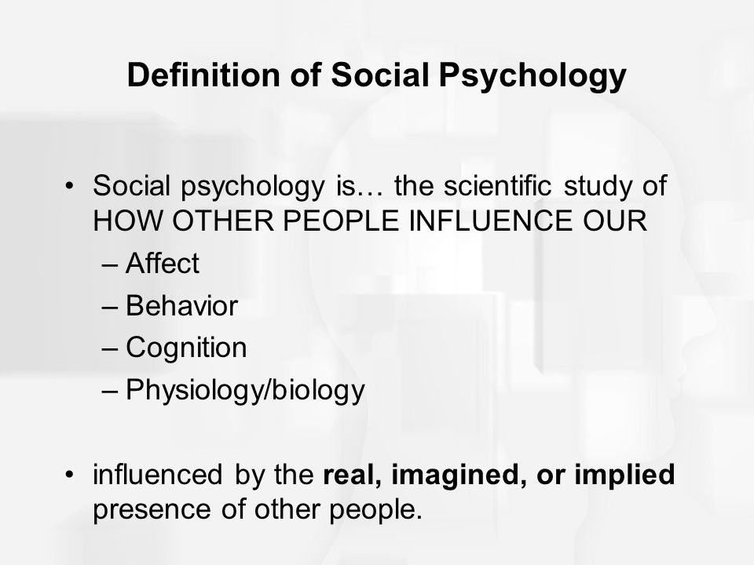

Slide 22
Types of Relationship
Different Types of Interpersonal Relationships
Friendship. Friendship is an unconditional interpersonal relationship where individuals enter into by their own sweet will and choice. ...
Love. ...
Platonic Relationship. ...
Family Relationship. ...
Professional Relationship (Work Relationship)

Slide 23
Types of Relationship
Competitive/Controlling. ...
Active/Passive. ...
Aggressive/Accommodating. ...
Disconnected/Parallel Lives. ...
Accepting/Balanced.

Slide 24
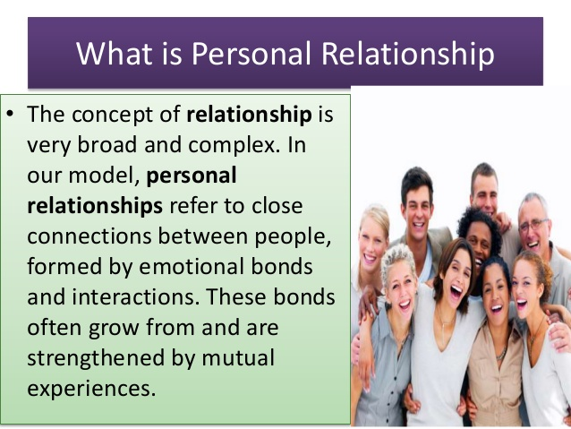
Types of Relationships

Slide 25
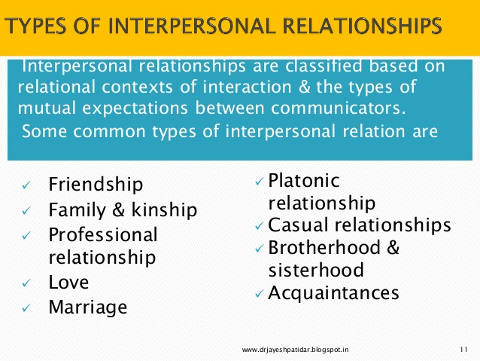
Types of Relationships

Slide 26
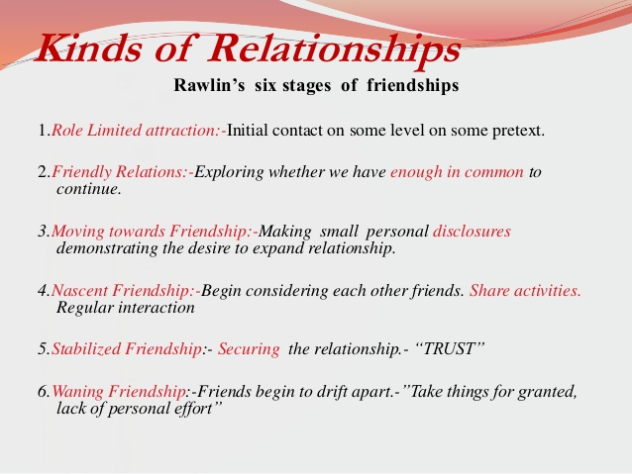
Locations of Relationship

Slide 27
Locations of Relationship
Family
Workplace
Society

Slide 28
Human Behaviour and Relationship
Human behavior is the potential and expressed capacity (mentally, physically, and socially) of human individuals or groups to respond to internal and external stimuli throughout their life. ... Human behavior is studied by the social sciences, which include psychology, sociology, economics, and anthropology.

Slide 29
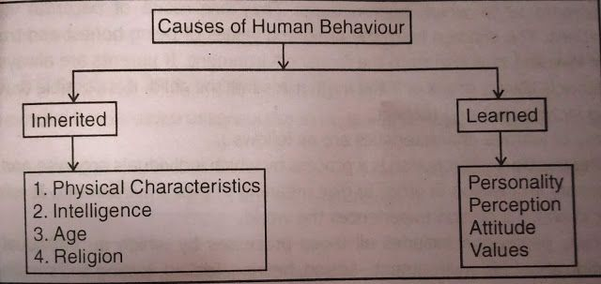
Human Behaviour and Relationship

Slide 30
Human Behaviour and Relationship
human behavior has revealed that 90% of the population can be classified into four basic personality types: Optimistic, Pessimistic, Trusting and Envious. Jealous

Slide 31
Commitment and Satisfation
What Is a Committed Relationship? A committed relationship occurs when a couple agrees upon a certain level of commitment to one another. ... For example, one person might believe in open relationships, and for them, commitment means honesty about sexual partners but not necessarily sexual exclusivity

Slide 32
Commitment and Satisfation
Organizational commitment is defined as a view of an organization’s member’s psychology towards his/her attachment to the organization that he/she is working for. Organizational commitment plays a pivotal role in determining whether an employee will stay with the organization for a longer period of time and work passionately towards achieving the organization’s goal.
If an organizational commitment is determined it helps predict employee satisfaction, employee engagement, distribution of leadership, job performance, job insecurity, and similar such attributes. An employee’s level of commitment towards his/her work is important to know from a management’s point of view to be able to know their dedication to the tasks assigned to them on a daily basis.

Slide 33
Commitment and Satisfation
an act of satisfying; fulfillment; gratification. the state of being satisfied; contentment. the cause or means of being satisfied. confident acceptance of something as satisfactory, dependable, true, etc. reparation or compensation, as for a wrong or injury.

Slide 34
Satisfaction factors
(i) Personal Factors:
They include workers’ sex, education, age, marital status and their personal characteristics, family background, socio-economic background and the like.
(ii) Factors Inherent in the Job:
These factors have recently been studied and found to be important in the selection of employees. Instead of being guided by their co-workers and supervisors, the skilled workers would rather like to be guided by their own inclination to choose jobs in consideration of ‘what they have to do’. These factors include- the work itself, conditions, influence of internal and external environment on the job which are uncontrolled by the management, etc.
(iii) Factors Controlled by the Management:
The nature of supervision, job security, kind of work group, and wage rate, promotional opportunities, and transfer policy, duration of work and sense of responsibilities are factors controlled by management. All these factors greatly influence the workers. These factors motivate the workers and provide a sense of job satisfaction.

Slide 35
Thank you
Doubts and ?

