Slide 1
Unit - I –Foundations of Personality Development
Foundations of Personality Development - Definition, Structure, Scope and Types of Personality; Knowing Self – SWOT Analysis & Scope, Self-Esteem and Self- Knowledge.

Slide 2
Personality
characteristic pattern of thinking,
feeling and acting
totality or whole of the person.
Expression of the person in various situations
It is a person’ s “true” inner nature
Personality is not static but dynamic
person‘s character, temperament, intellect, and physique

Slide 3
Personality
patterns of behaviour (including thoughts
and emotions)
individual‘s unique and relatively stable patterns of behaviour, thoughts and emotions. (Baron, 1993).

Slide 4
THE PSYCHOANALYTIC PERSPECTIVE
Sigmund Freud, discovered that mind is like an iceberg
Conscious level: The thoughts, feelings, and sensations that one is aware of at the present moment.

Slide 5
THE PSYCHOANALYTIC PERSPECTIVE
Preconscious level: It contains information of which one is not currently aware, however, they can easily enter conscious mind.
Unconscious level: It consists of thought, feelings, wishes, drives etc. of which we are not aware.

Slide 6
Personality Structure
Id:
It is the unconscious,
irrational part of personality.
It is the primitive part
morality and demands of the external world.
It operates on the pleasure principle.
It seeks immediate satisfaction.

Slide 7
Personality Structure
Ego:
workings of the real world.
It operates on the reality principle.
It is the conscious
and rational part of personality
It regulates thoughts and behaviors.
It teaches the person to balance demands of external world and needs of the person.

Slide 8
Personality Structure
Super Ego: It is the internal representation of parental and societal values.
It works as the voice of conscience,
that compels ideal.
It judges one’ s behaviors as right or wrong, good or bad.
Failing up to moral ideals bring about the shame,
guilt, inferiority and anxiety in the person.

Slide 9
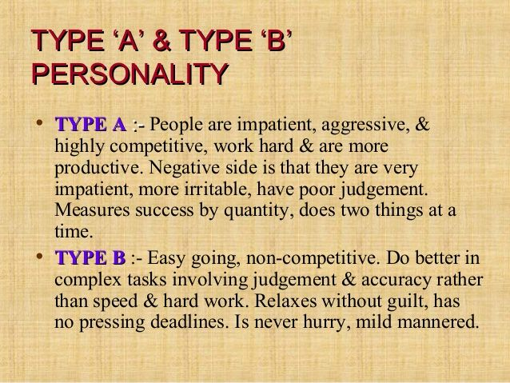

Slide 10
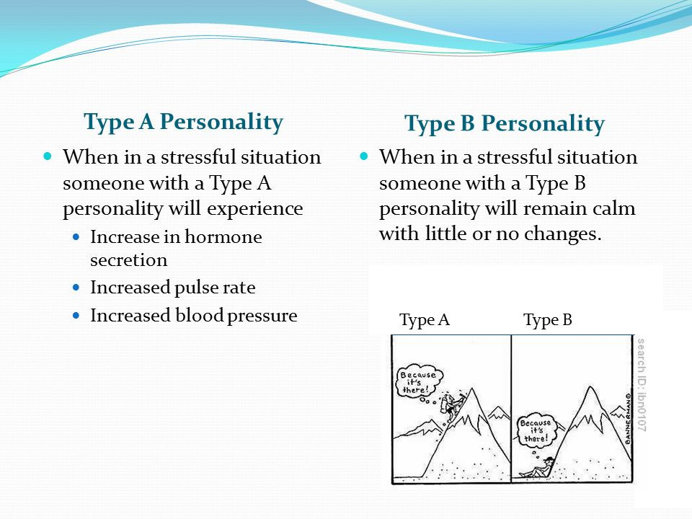

Slide 11
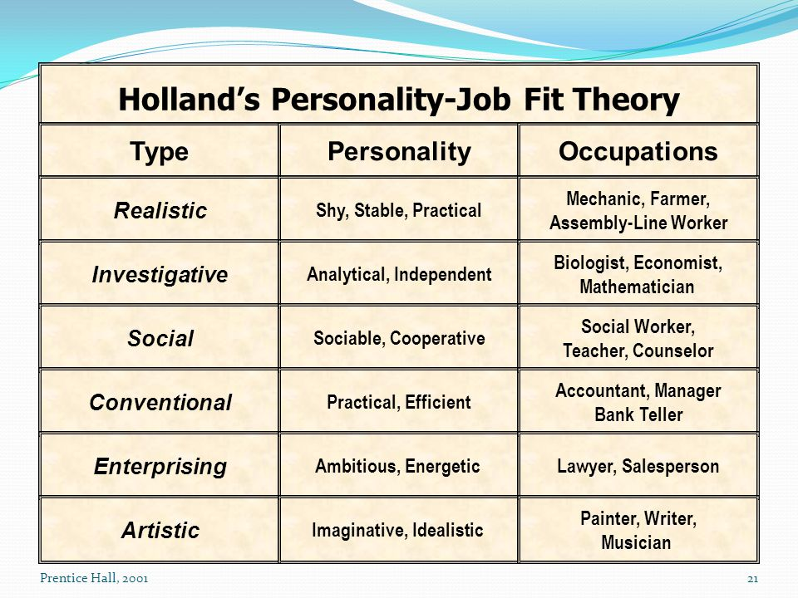

Slide 12
Knowing Self
“Knowing yourself is the beginning of all wisdom.” ―Aristotle. To truly know yourself is the most important skill you can ever possess. When you know who you are, you know what you need to do.
JOHARI window
Attitude
SWOT

Slide 13
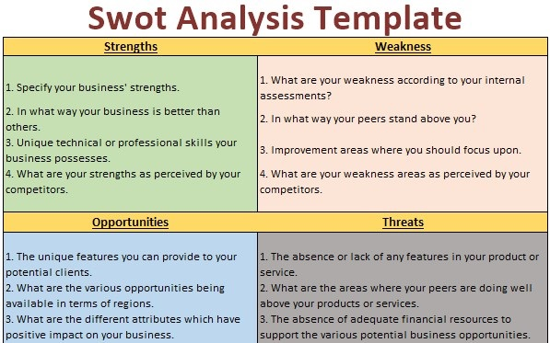
SWOT Analysis

Slide 14
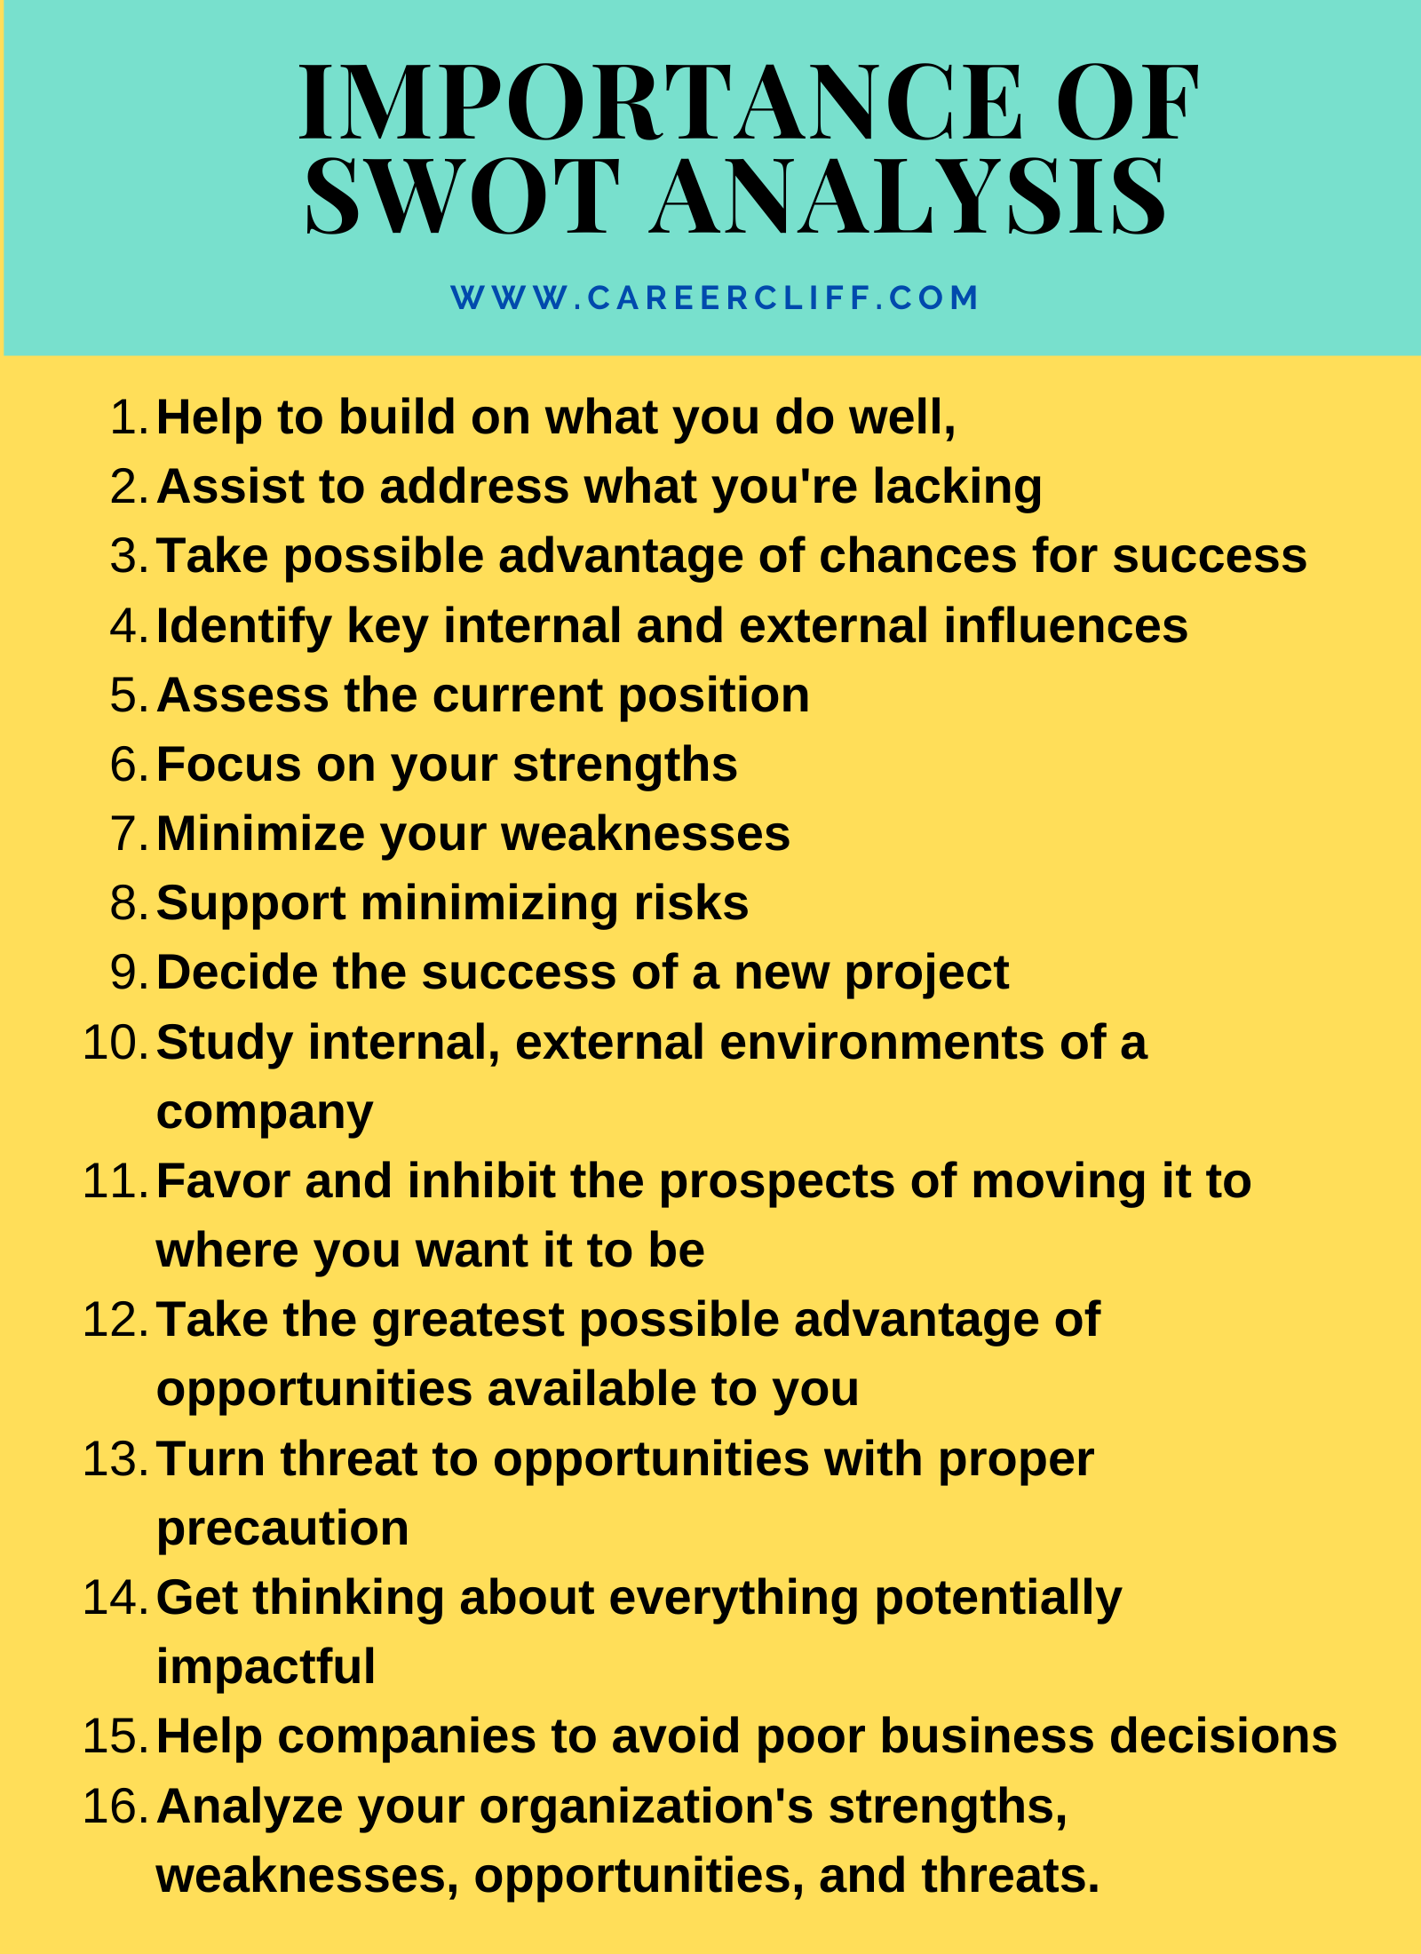

Slide 15
SWOT ANALYSIS
SWOT is an abbreviation for Strengths, Weaknesses, Opportunities and Threats.
SWOT analysis is an important tool for auditing the overall strategic position of a business and its environment.

Slide 16
SWOTs are defined precisely as follows:
Strengths are attributes of the organization that are helpful to the achievement of the objective.
Weaknesses are attributes of the organization that are harmful to the achievement of the objective.
Opportunities are external conditions that are helpful to the achievement of the objective.
Threats are external conditions that are harmful to the achievement of the objective.

Slide 17
SWOT Analysis Format
Strengths | Weaknesses
Opportunities | Threats

Slide 18
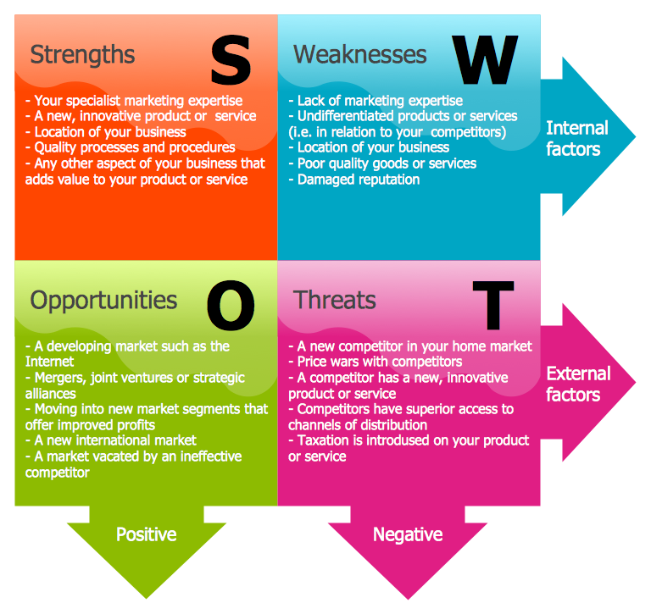

Slide 19
SWOT analysis
Why use it?
To develop a plan or find a solution that takes into consideration many different internal
and external factors, and maximizes the potential of the strengths and opportunities while
minimizing the impact of the weaknesses and threats.
When to use it?
While developing a strategic plan or planning a solution to a problem, after you have
analyzed the external environment (for example, the culture, economy, competition,
technical ability, sources of funding, demographics, etc.).
SWOTs can be performed by managers, designers or by the entire project team. Group
techniques are particularly effective in providing structure, objectivity, clarity and tend to
focus discussions about strategy that might otherwise tend to wander.

Slide 20
SELF-ESTEEM

Slide 21
Self-Esteem…What is it?
Self-esteem refers to the way we see and think about ourselves.

Slide 22
Self-Esteem…What’s it made of?
Your self-esteem is made up of all the experiences and interpersonal relationships you’ve had in your life. Everyone you’ve ever met has added to or taken away from how you see yourself!

Slide 23
The Effects of High Self-Esteem
People with high self-esteem possess the following characteristics:
-They like to meet new people.
-They don’t worry about how others will judge them.
-They have the courage to express themselves.
-Their lives are enriched with each new encounter.

Slide 24
-They are nicer to be around.
-Their ideas are met with interest because others want to hear what they have to say.
-They are magnets to positive opportunities!
People with high self-esteem have an “I think I can” attitude!

Slide 25
The Effects of Low Self-Esteem
People with low self-esteem possess the following characteristics:
-They don’t believe in themselves.
-They see themselves failing before they begin.
-They have a hard time forgiving their mistakes and make themselves pay the price forever.
-They believe they can never be as good as they should be or as others.

Slide 26
-They are afraid to show their creativity because they will be ridiculed.
-They are dissatisfied with their lives.
-They spend most of their time alone.
-They complain and criticize.
-They worry about everything and do nothing.
People with low self-esteem have an “I can’t do it” attitude.

Slide 27
12 Steps to High Self-Esteem
Step 1
-Forgive yourself for past mistakes.
Step 2
-Focus on your positive attributes.
Step 3
-Follow the example of successful people.
Step 4
-Become a self talker.

Slide 28
Step 5
-Exhibit a good attitude.
Step 6
-Get plenty of rest.
Step 7
-Make your work skills your own
Step 8
-Practice your talents

Slide 29
Step 9
-Become physically fit.
Step 10
-Learn new things.
Step 11
-Improve your personal relationships.
Step 12
-Dress well!

Slide 30
Factors that develop High and Low Self-Esteem
High Self-Esteem
If you are being praised
If you are listened to
If you are being spoken to respectively
If you are getting attention
Experiencing success
Having trust worthy friends
Low Self Esteem
Experiencing continuous Failure
Being expected to perfect all the time
Being ignored or made fun of
Having Physical or emotional punishment
Being criticized

Slide 31
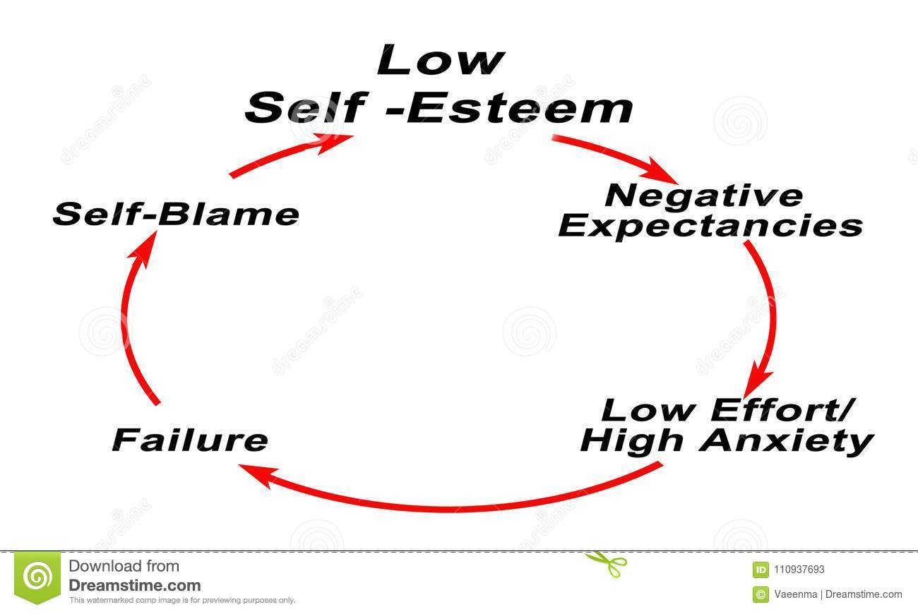

Slide 32
Lets Review
Self-esteem comes from every experience of your life.
How you view yourself affects everything you do in life.
High self-esteem gives you a GOOD feeling about yourself.
Low self-esteem distorts your view of yourself.
Self-esteem can me improved!

Slide 33
Final Thought
You are a unique individual. No one else is like you in the whole world. This makes you special already!
Our time in this world is limited. Make it happen for you so you leave your mark in history!

Slide 34
No one can
Make you feel
inferior Without
your Consent.
Eleanor Roosevelt

Slide 35
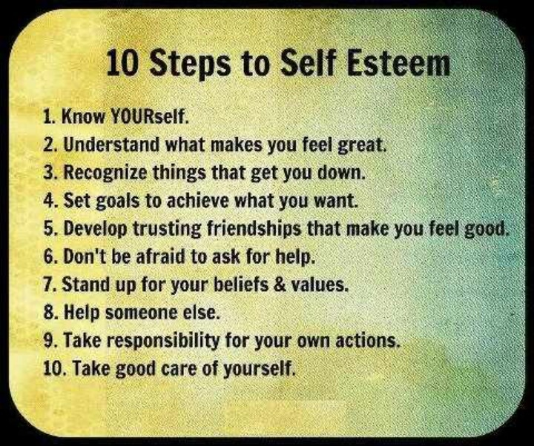

Slide 36
Self- Knowledge
Self-knowledge” standardly refers to knowledge of one’s own sensations, thoughts, beliefs, and other mental states.
knowledge or understanding of one's own capabilities, character, feelings, or motivations : self-understanding.

Slide 37
Self- Knowledge
Self-knowledge requires a new perspective of “seeing yourself with eyes other than your own” and understanding how your body-mind reacts to the experiences of life. “Observe without analysis the way in which you react physically, emotionally and mentally in the different circumstances of everyday life.”

Slide 38
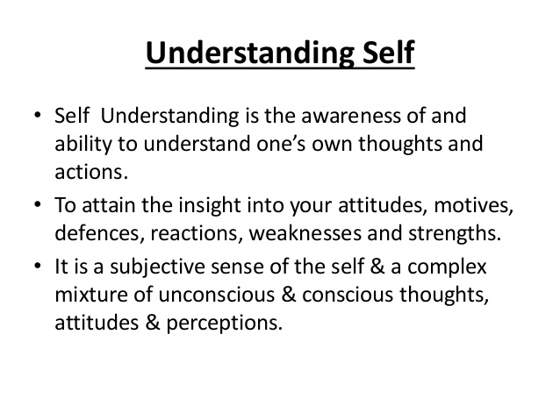

Slide 39
Thank you
Doubts and ?

