Slide 1
Unit – III - Communication Skills
Communication Skills – Definition – Types of Communication and its Relevance to Different Situations – Active Listening and Oral Communication Skills -Resume writing, Nonverbal communication- Numerical ability, Test of reasoning-assertion, reasoning and logical deduction.

Slide 2
Communication Skills
Communication is derived from the Latin word communicare, which means "to make common". This can be taken to mean 'to share'. Communication is therefore generally defined as the process of understanding and sharing meaning. Communication is considered a process because it is an activity, an exchange or a set of behaviours - not an unchanging product.
Communication is a complicated process. It is variable, active and dynamic. It starts long before the words begin to flow and can last long after the words stop.
Communication is a process that requires understanding - perceiving, interpreting, and comprehending the meaning of the verbal and nonverbal behaviour of others. Understanding the meaning of another person's message does not occur unless the two communicators can elicit common meanings for words, phrases and non-verbal codes.
In addition to understanding, communication involves sharing and interaction between people in order to exchange meaning. Regardless of the context, communication involves sharing.

Slide 3
Definition of CS
Communication skills are abilities you use when giving and receiving different kinds of information. While these skills may be a regular part of your day-to-day work life, communicating in a clear, effective and efficient way is an extremely special and useful skill.
Communication is the process of exchanging ideas between two or more than two persons, objects, or persons and objects, with the desired feedback as to their objective.
Effective communication is a process of exchanging ideas, thoughts, knowledge and information such that the purpose or intention is fulfilled in the best possible manner. In simple words, it is nothing but the presentation of views by the sender in a way best understood by the receiver.

Slide 4
Definition of CS
In the words of R.W. Griffin, "Effective communication is the process of sending a message in such a way that the message received is as close in meaning as possible to the message intended".
American Management Association (AMA) has defined effective communication based on the following ten points −
Clear idea regarding topics and receiver of communication.
Determination of purpose.
Understanding the environment of communication.
Planning for communication with consulting others.
Consider the content of the message.
To make the receiver aware about the value of communication.
There must be feedback from the receiver.
To define properly whether communication messages are of short-run or long-run importance.
All actions must be suitable with communication.
Good listening.

Slide 5
Definition of CS
Effective Communication is defined as the ability to convey information to another effectively and efficiently. Business managers with good verbal, nonverbal and written communication skills help facilitate the sharing of information between people within a company for its commercial benefit.

Slide 6
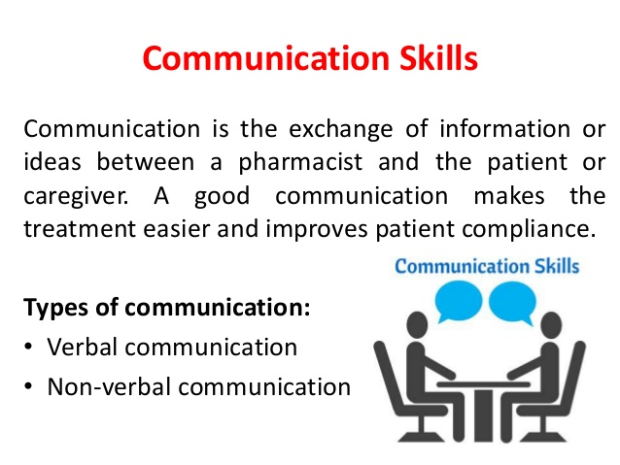

Slide 7
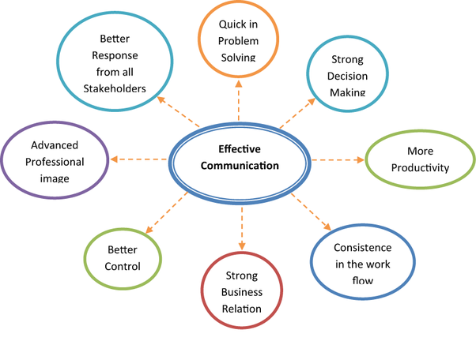

Slide 8
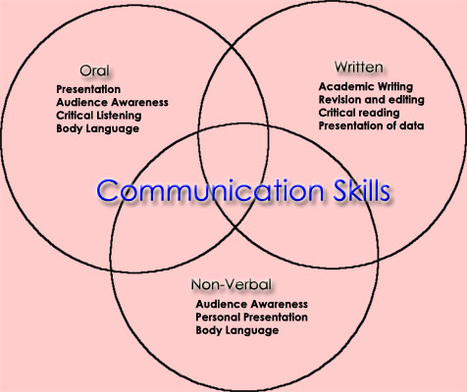

Slide 9
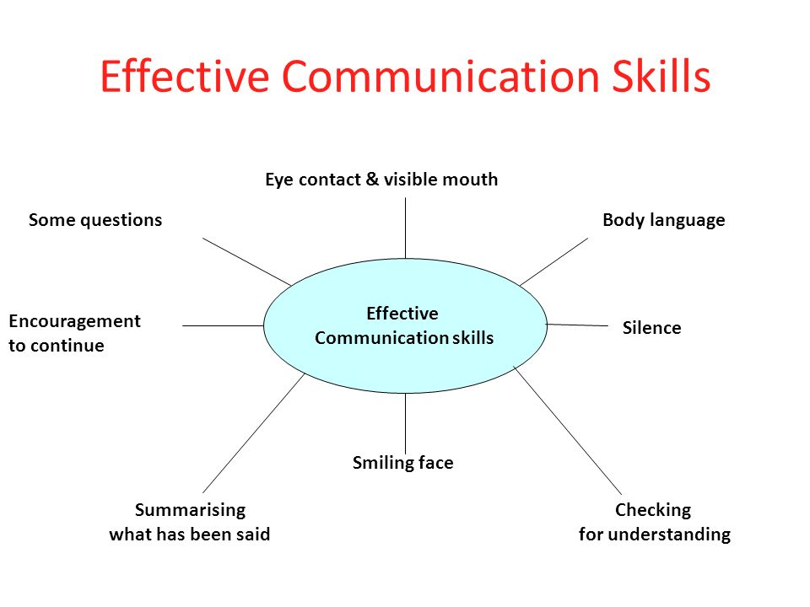

Slide 10
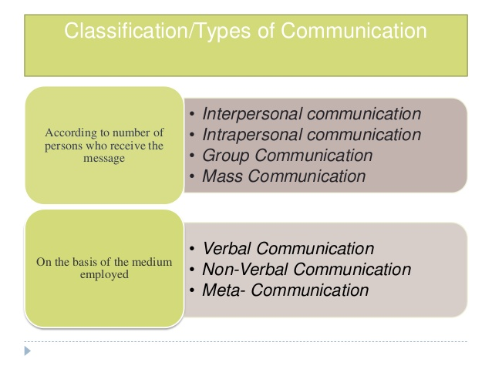
Types of Communication

Slide 11
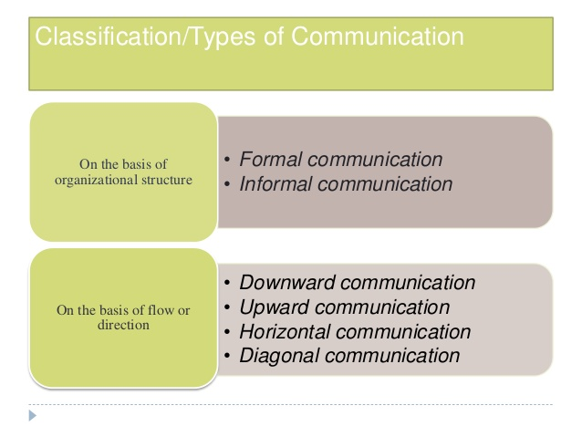

Slide 12
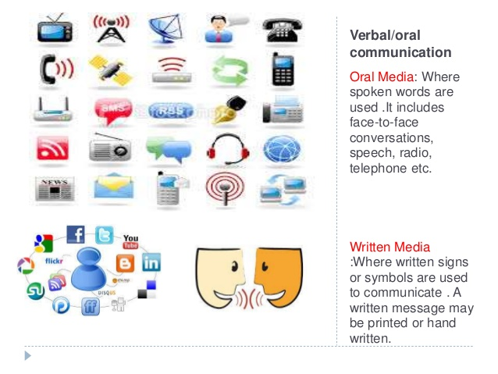

Slide 13
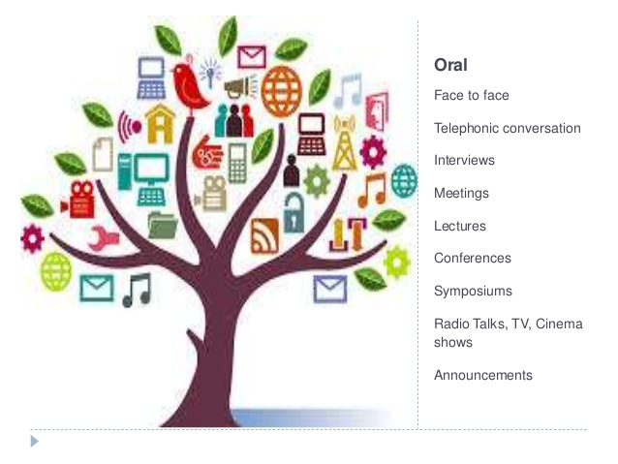

Slide 14
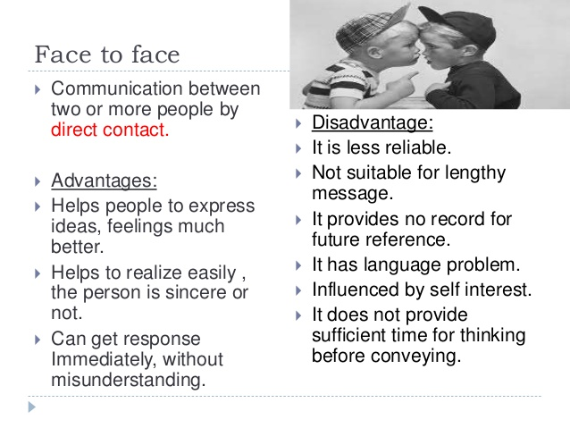

Slide 15
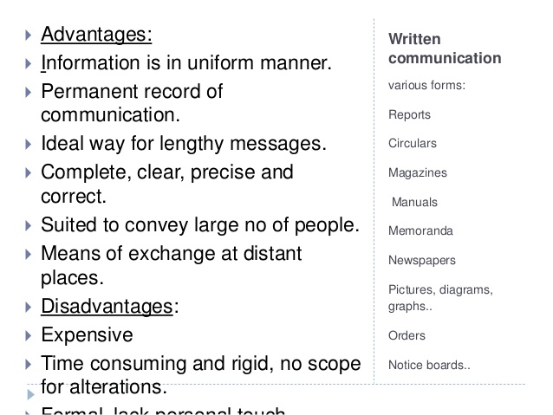

Slide 16
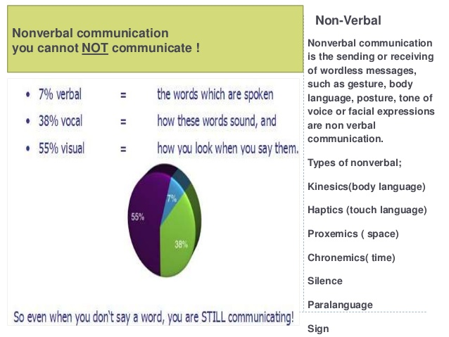

Slide 17
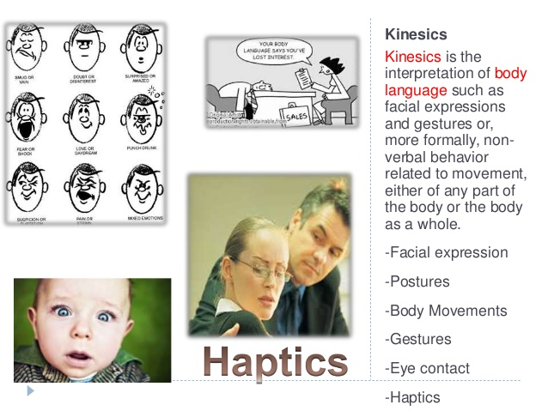

Slide 18
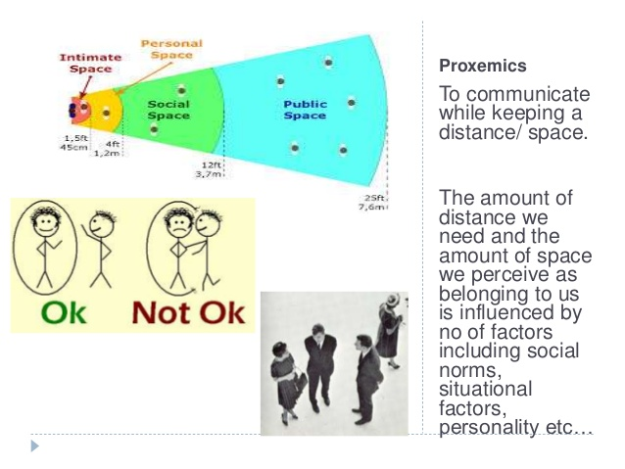

Slide 19
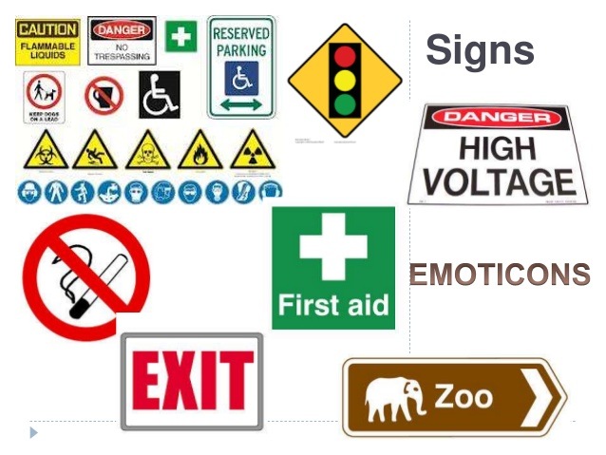

Slide 20
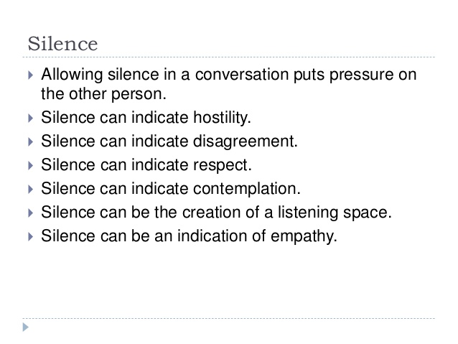

Slide 21
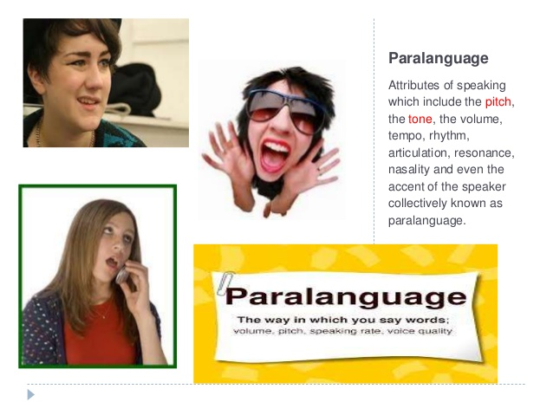

Slide 22
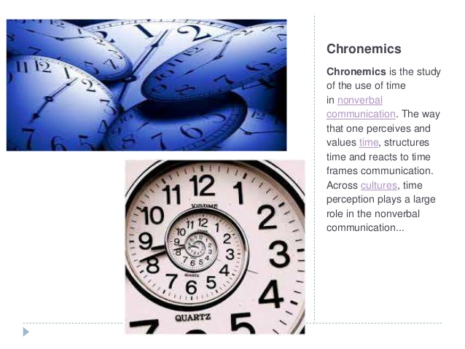

Slide 23
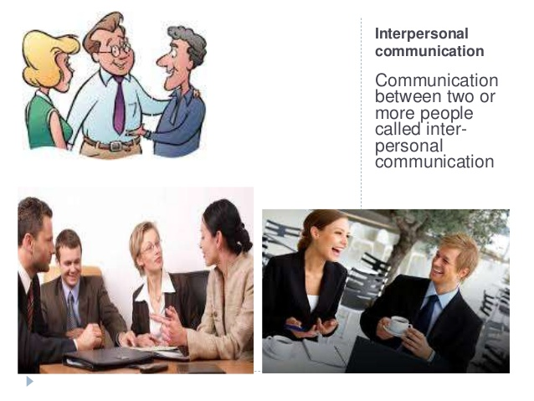

Slide 24
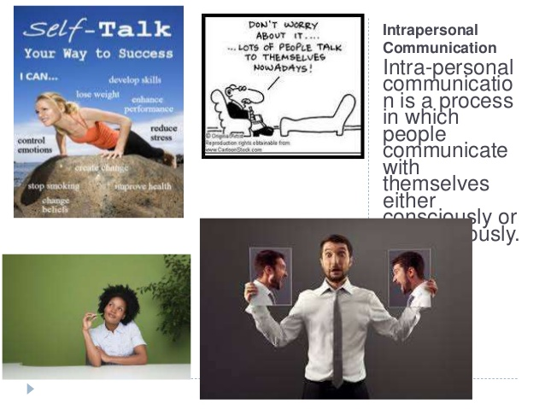

Slide 25
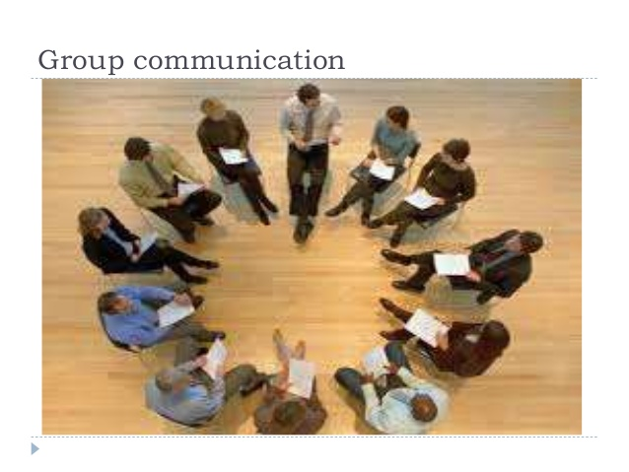

Slide 26
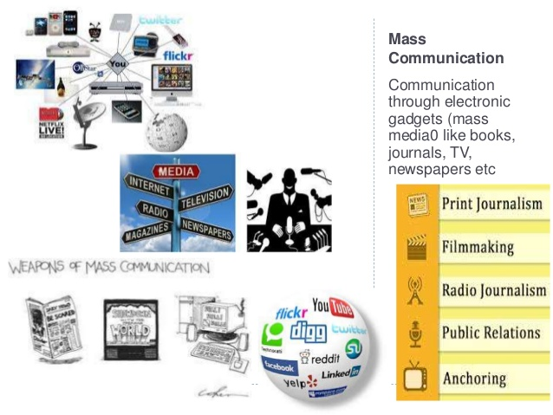

Slide 27
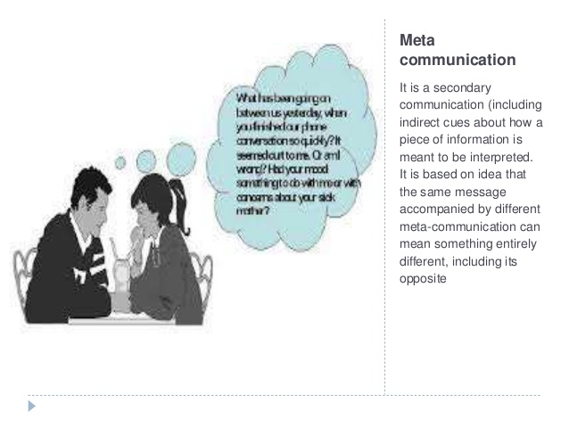

Slide 28
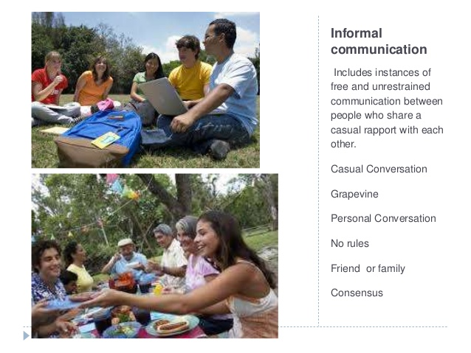

Slide 29
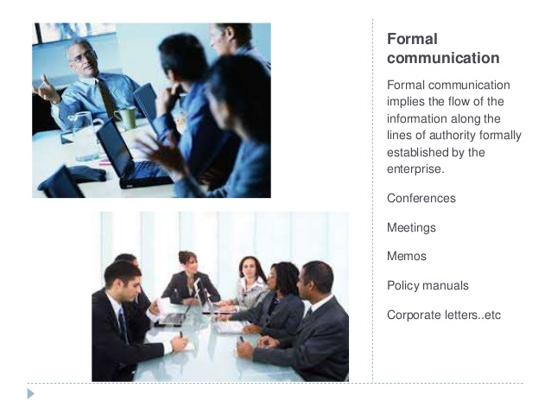

Slide 30
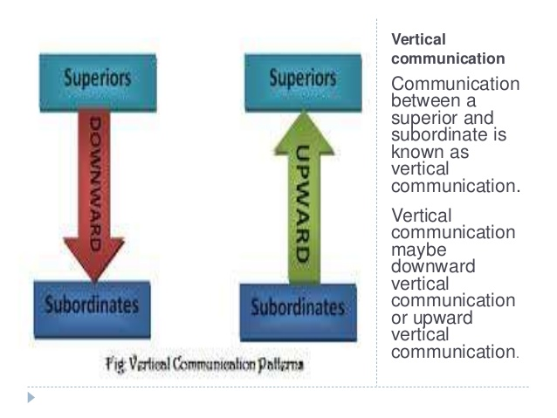

Slide 31
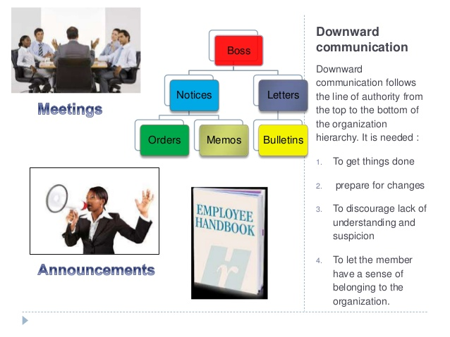

Slide 32
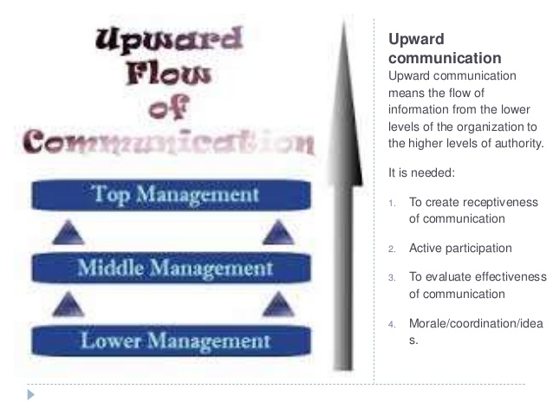

Slide 33
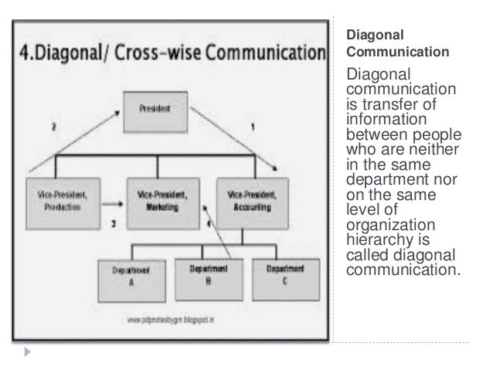

Slide 34
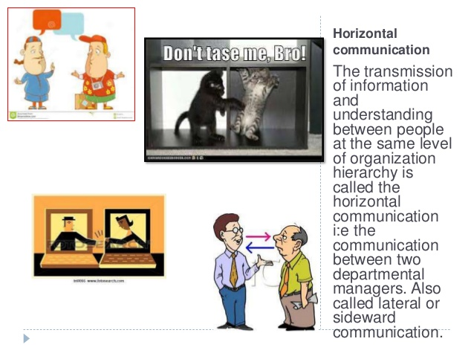

Slide 35
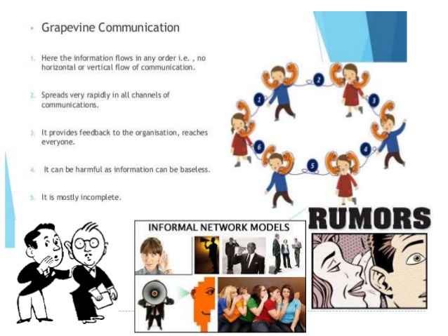

Slide 36
Its Relevance to Different Situations
Communication skills are needed to speak appropriately with a wide variety of people whilst maintaining good eye contact, demonstrate a varied vocabulary and tailor your language to your audience, listen effectively, present your ideas appropriately, write clearly and concisely, and work well in a group

Slide 37
Different Situations
Highly valued in the workplace
Helps your career progression
Allows you to speak concisely
Build better rapport with customers
Enhances your professional image
Highly skilled communicators make more money
Good communicators have higher self-esteem
Most important skill For people entering the workforce
Communication is among the top traits of successful entrepreneurs
Effective communication skills aid in development of leadership skills
Gives you the tools to participate in society

Slide 38
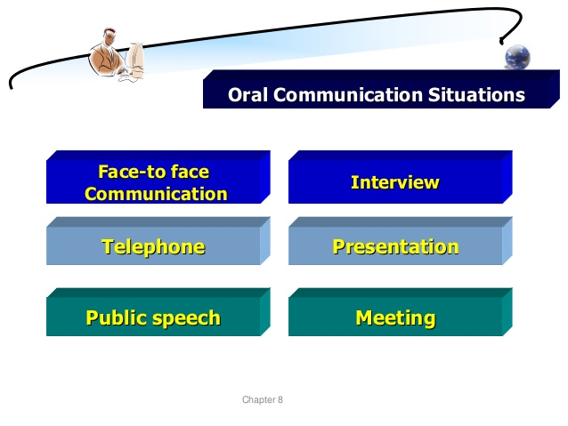

Slide 39
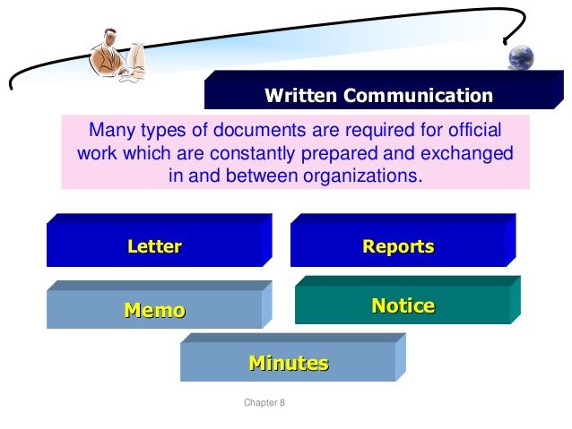

Slide 40
Active Listening
Active listening
Active listening means paying close attention to who you’re communicating with by engaging with them, asking questions and rephrasing. Practicing active listening can build respect with your coworkers and increase understanding in the workplace. As you actively listen, focus on the speaker, avoiding distractions like cell phones, laptops or other projects, and by preparing questions, comments or ideas to thoughtfully respond.
Improve your active listening abilities by paying attention to other people’s facial expressions, body language and tone. Instead of preparing what you will say, focus on what the other person is saying and how they are saying it. If you need to clarify something, ask followup questions or rephrase what they’ve said to confirm that you understood them correctly.

Slide 41
Pay Attention. Give the speaker your undivided attention, and acknowledge the message. ...
Show That You're Listening. Use your own body language and gestures to show that you are engaged. ...
Provide Feedback. ...
Defer Judgment. ...
Respond Appropriately.

Slide 42
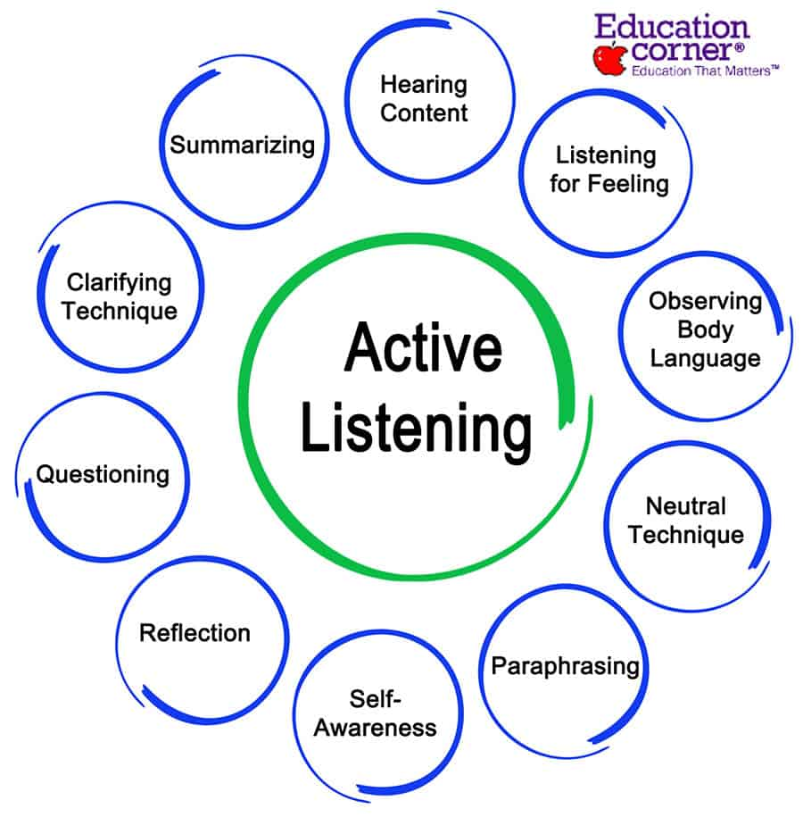

Slide 43
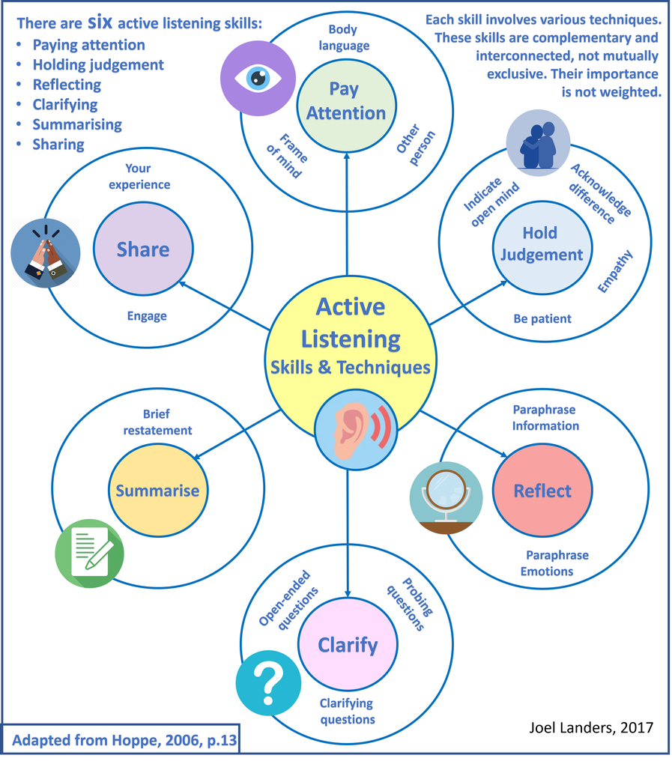

Slide 44
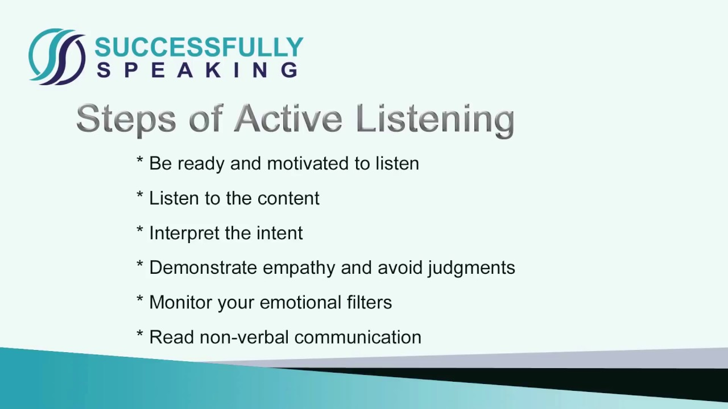

Slide 45
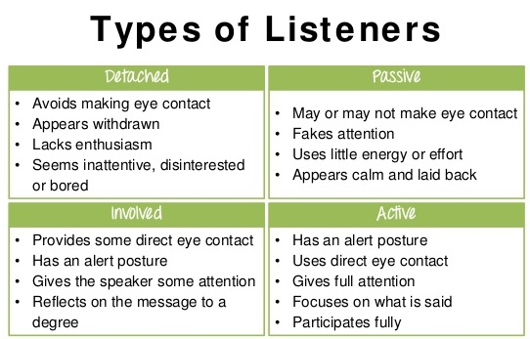

Slide 46
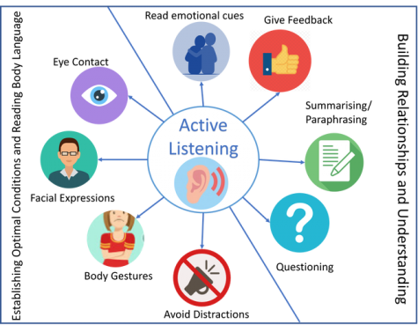

Slide 47
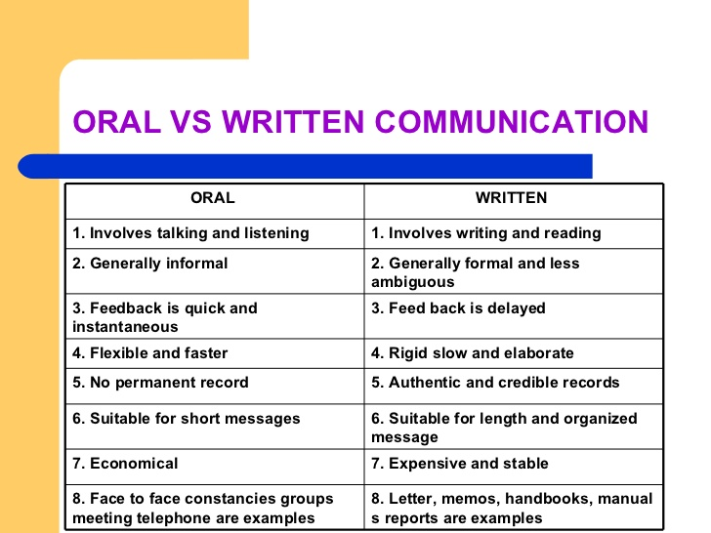
Oral Communication Skills

Slide 48
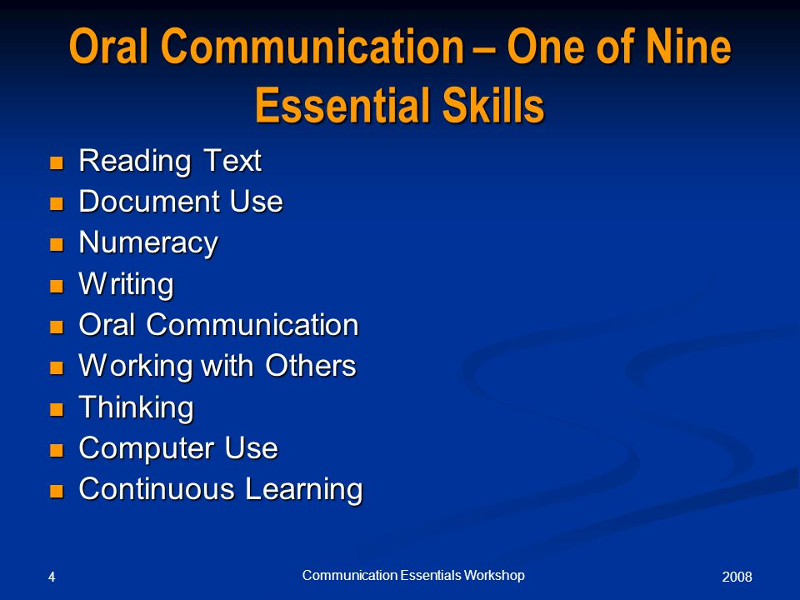

Slide 49
Resume writing
Resume writing, Nonverbal communication- Numerical ability, Test of reasoning -assertion, reasoning and logical deduction.

Slide 50
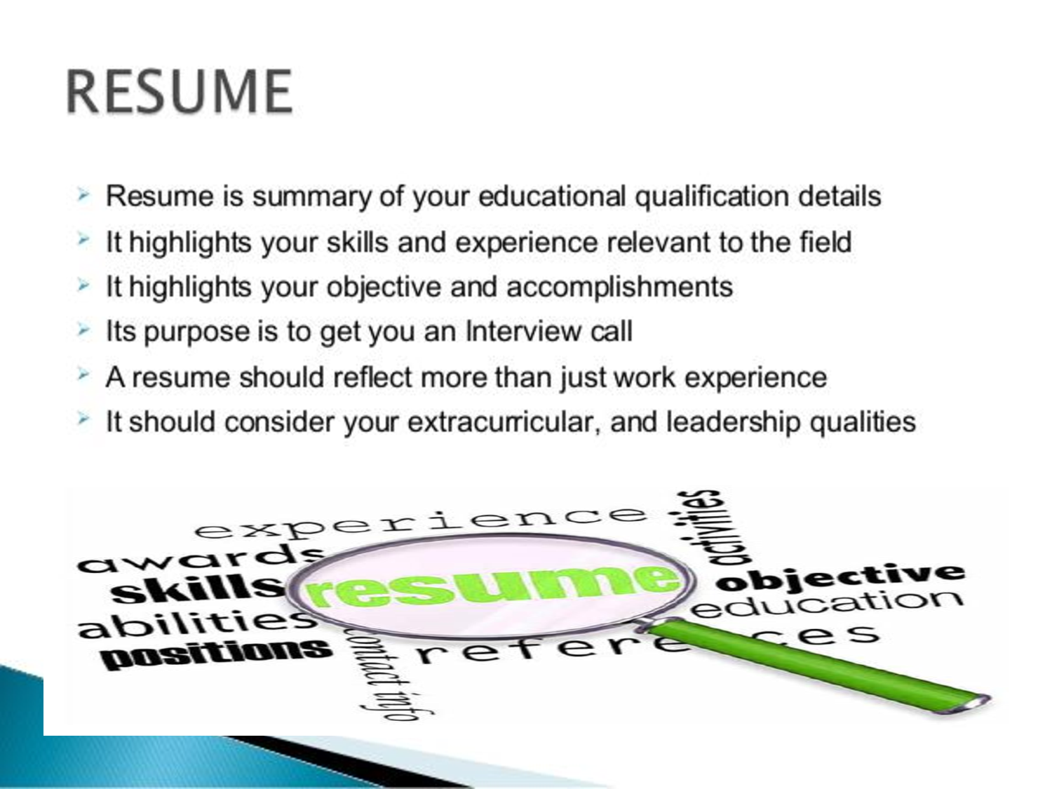

Slide 51
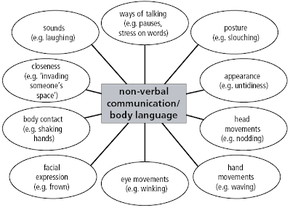
Nonverbal Communication

Slide 52
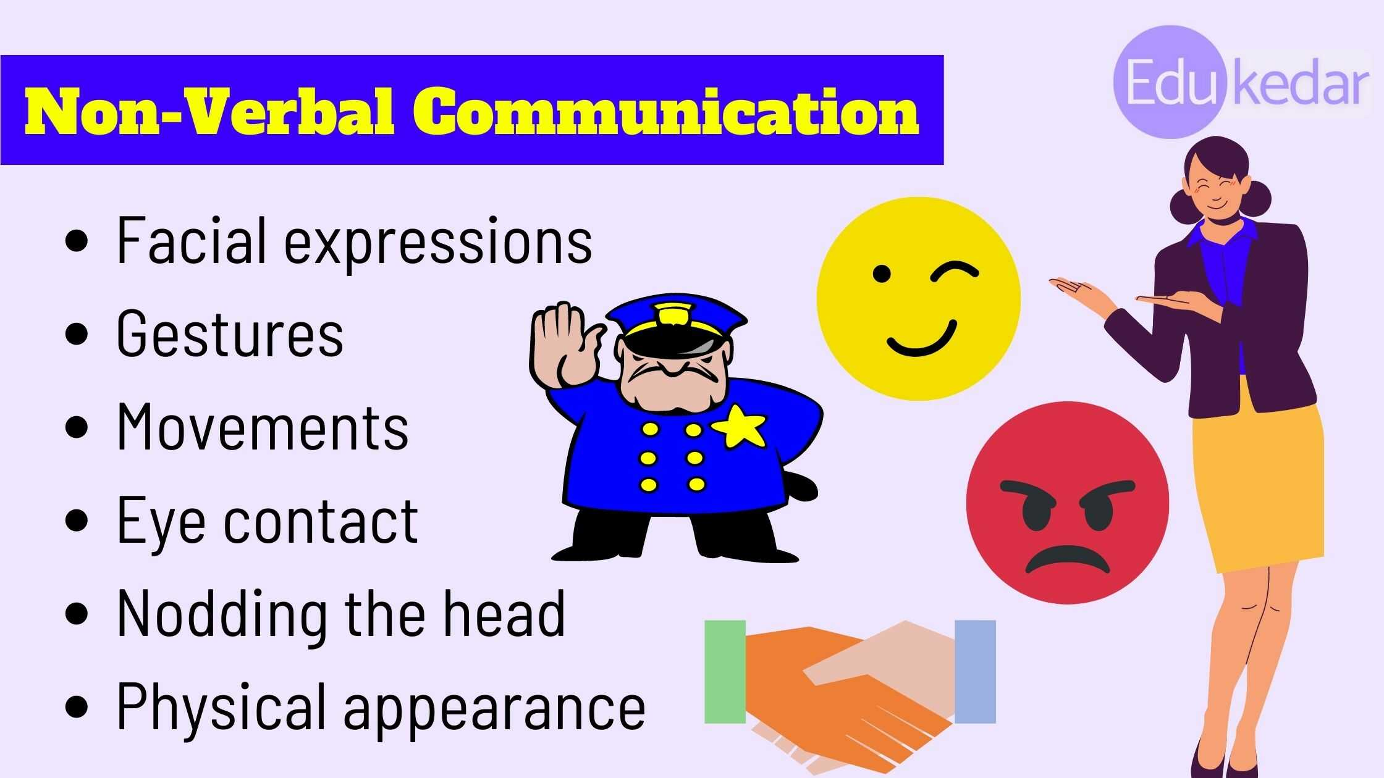

Slide 53
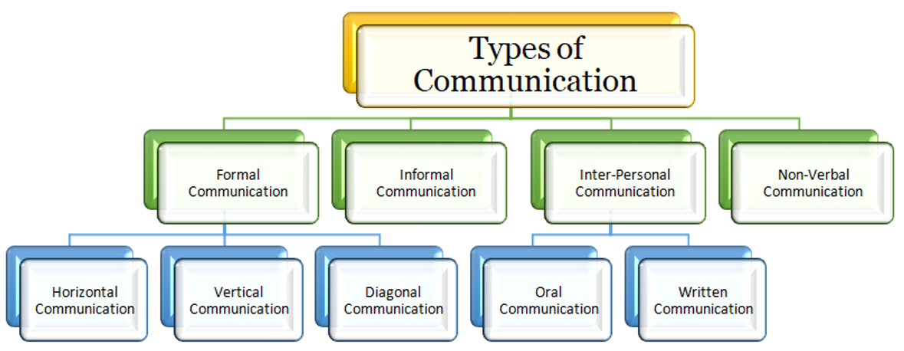

Slide 54
Numerical ability
Numerical aptitude defines an individual's ability to perform tasks that require working with data and numbers

Slide 55
Test of reasoning
A logical reasoning test is used measure a candidate's problem solving ability. They assess the ability to come to conclusions based on logic.

Slide 56
Assertion and reasoning
An assertion is a statement that is either true or false. In order to determine whether or not an assertion is true, you need to reason through it.

Slide 57
Logical Deduction
LD is the process of reasoning from one or more statements (premises) to reach a logical conclusion. The logical deduction goes in the same direction as that of the conditionals and links premises with conclusions.

Slide 58
? & discussions
Thank you

