Slide 1
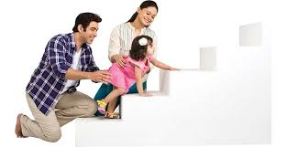
Personality Development Meaning and theories

Slide 2
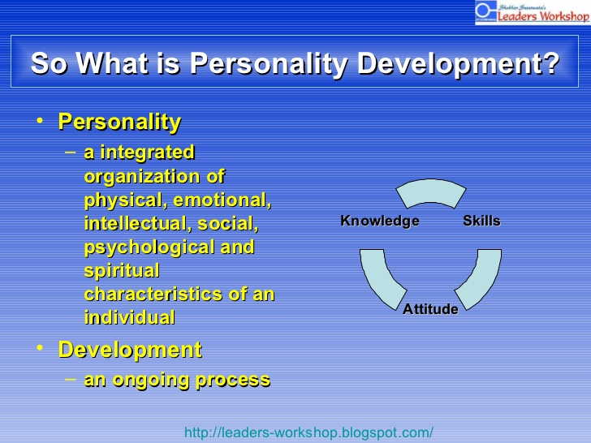

Slide 3
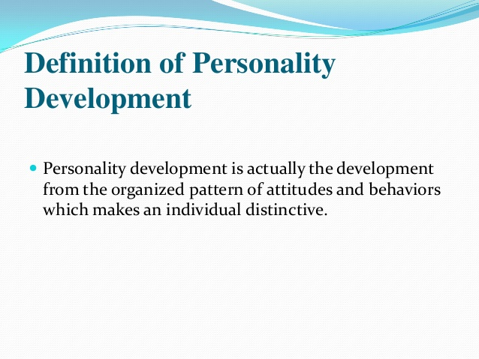

Slide 4
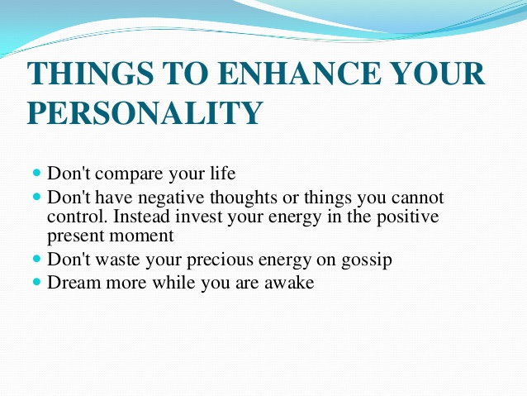

Slide 5
Who am I?
Self: A conceptual system made up of one’s thoughts and attitudes about one’s self, including one’s:
Body
Possessions
Thoughts
Psychological functioning

Slide 6
Self-Concept
Self-concept is an individual’s perception of self and is what helps make each individual unique.
Positive and negative self-assessments in the physical, emotional, intellectual, and functional dimensions change over time.
Self-concept affects the ability to function and greatly influences health status.

Slide 7
Dimensions of Self-Concept
Self-knowledge — “Who am I?”
Self-expectation — “Who or what do I want to be?”
Social self – How person perceived by others?
Self-evaluation — “How well do I like myself?”

Slide 8
Formation of Self-Concept
Infant learns physical self different from environment.
If basic needs are met, child has positive feelings of self.
Child internalizes others people’s attitudes toward self.
Child or adult internalizes standards of society.

Slide 9
Stages in Development of Self
Self-awareness (infancy)
Self-recognition (18 months)
Self-definition (3 years)
Self-concept (6 to 7 years)

Slide 10
Factors Affecting Self-Concept
Altered Health Status
Experience
Developmental considerations
Culture
Internal and external resources
History of success and failure
Crisis or life stressors
Aging, illness, or trauma

Slide 11
Self-Esteem…What is it?
Self-esteem refers to the way we see and think about ourselves.

Slide 12
Self-Esteem…What’s it made of?
Your self-esteem is made up of all the experiences and interpersonal relationships you’ve had in your life. Everyone you’ve ever met has added to or taken away from how you see yourself!

Slide 13
The Effects of High Self-Esteem
People with high self-esteem possess the following characteristics:
-They like to meet new people.
-They don’t worry about how others will judge them.
-They have the courage to express themselves.
-Their lives are enriched with each new encounter.

Slide 14
12 Steps to High Self-Esteem
Step 1:-Forgive yourself for past mistakes. | Step 2: -Focus on your positive attributes.
Step 3:-Follow the example of successful people. | Step 4:-Become a self talker.
Step 5:-Exhibit a good attitude. | Step 6:-Get plenty of rest
Step 7:-Make your work skills your own | Step 8:-Practice your talents
Step 9:-Become physically fit. | Step 10:-Learn new things
Step 11:-Improve your personal relationships. | Step 12:-Dress well!

Slide 15
Types of Personality
Psychodynamic perspective
2. Genetical perspective
Humanistic view
4. Behavioural view

Slide 16
Sigmund Freud’s theory
ID: the unorganized, inborn part of personality whose purpose is to immediately reduce tensions relating to hunger, sex, aggression, and other primitive impulses
EGO: Restrains instinctual energy in order to maintain the safety of the individual and to help the person to be a member of society.
SUPER EGO: The rights and wrongs of society and consists of the conscience and the ego-ideal.

Slide 17
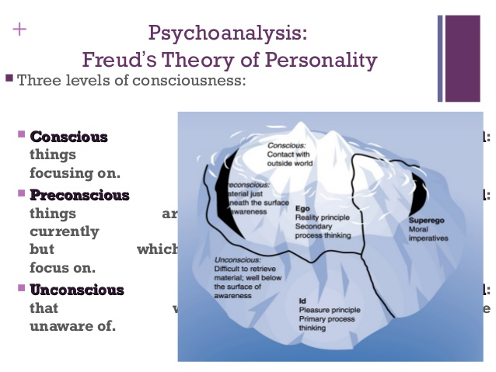

Slide 18
The ID
It uses most primitive thinking process
It operates pleasure Principle (what I want now)
It operates unconscious level or no direct contact with reality
Id has two instincts:
Life Instinct: Motivates people to focus on pleasure tendencies
Death instinct: Motivates people to use aggressive urges to destroy
It comes from the energy storehouse.

Slide 19
The Ego
It deals intelligently with reality
It acts as a mediator between the Id and super ego
It is partly conscious
Deals with the demands of reality
Makes rational decisions
It controls higher mental process( reasoning, problem solving
It maintains rational part of personality with reality

Slide 20
Superego
Moral part of personality
Internalized rules of parents and society
It consists of two parts:
1.Notions of right / wrong
2. How we ideally like to be
It is partly conscious and partly unconscious.
Our feeling, thoughts and behaviours are the result of the interaction of the id, the superego and the ego.

Slide 21
Thank you

