Slide 1

Disability and Rehabilitation
Facilitators and Barriers in Rural Communities
Presented by
Dr.M.Prabavathy
Director
Centre for Differently Abled Persons
Bharathidasan University
7200004044

Slide 2

Objective of this session
In this session, we are going to analyze
WHAT
WHY
HOW
Of Disability and inclusion

Slide 3


Disability and Diversity

Slide 4
Impairment and Disability
Impairment refers to a problem with a
structure or organ of the body;
Handicap refers to a functional limitation with regard to a particular activity and
Disability refers to a disadvantage in filling a role in life relative to a peer group.

Slide 5
What is a Disability?
Merriam-Webster Dictionary
the condition of being disabled
inability to pursue an occupation because of a physical or mental impairment;
World Health Organization
Any restriction or lack (resulting from an impairment) of ability to perform an activity in the manner or within the range considered normal for a human being.
Notes:
Different definitions of DA-dictionary-emphasizes inability to have “normal” life.
WHO and ADA have different criteria for defining

Slide 6
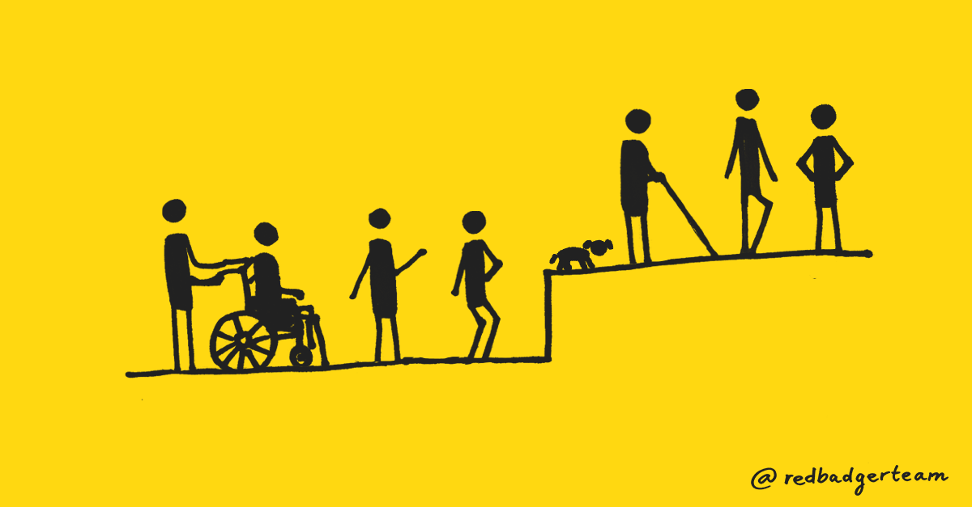
Models of Disability

Slide 7
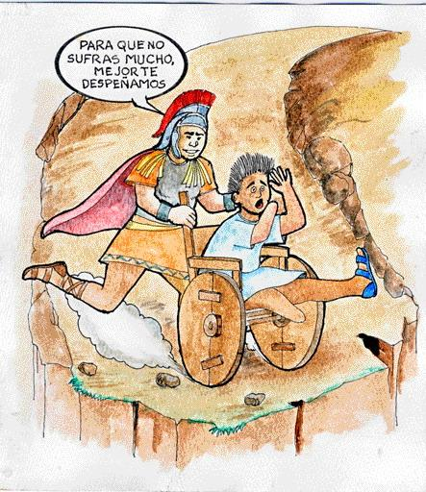
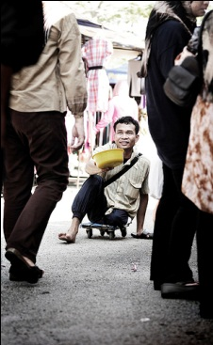
Traditional Model
I will kill you
so you stop
suffering
Disabilities as: - Will of God/test from God - Divine punishment
- More humane to end “life of pain/suffering”
Charity Model
People with disabilities considered:
inferior, useless, dependent
A burden to society, live on charity, lower social status
Families hide them out of shame
Objects of pity, humiliated in relationships with others

Slide 8
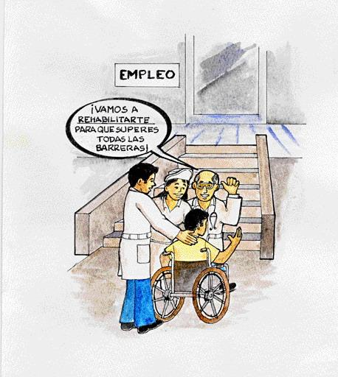
Medical or Biological Model -- Post WW II
Problem belongs to individual: disability results directly from impairment of the person.
Disability considered only a health problem, medical issue
Solutions decided by "experts”, based on diagnosis
Focus in elimination or cure of disability, “normalization”
(includes pre-natal genetic testing & selective abortion)
We will rehabilitate
you so you can overcome all barriers

Slide 9
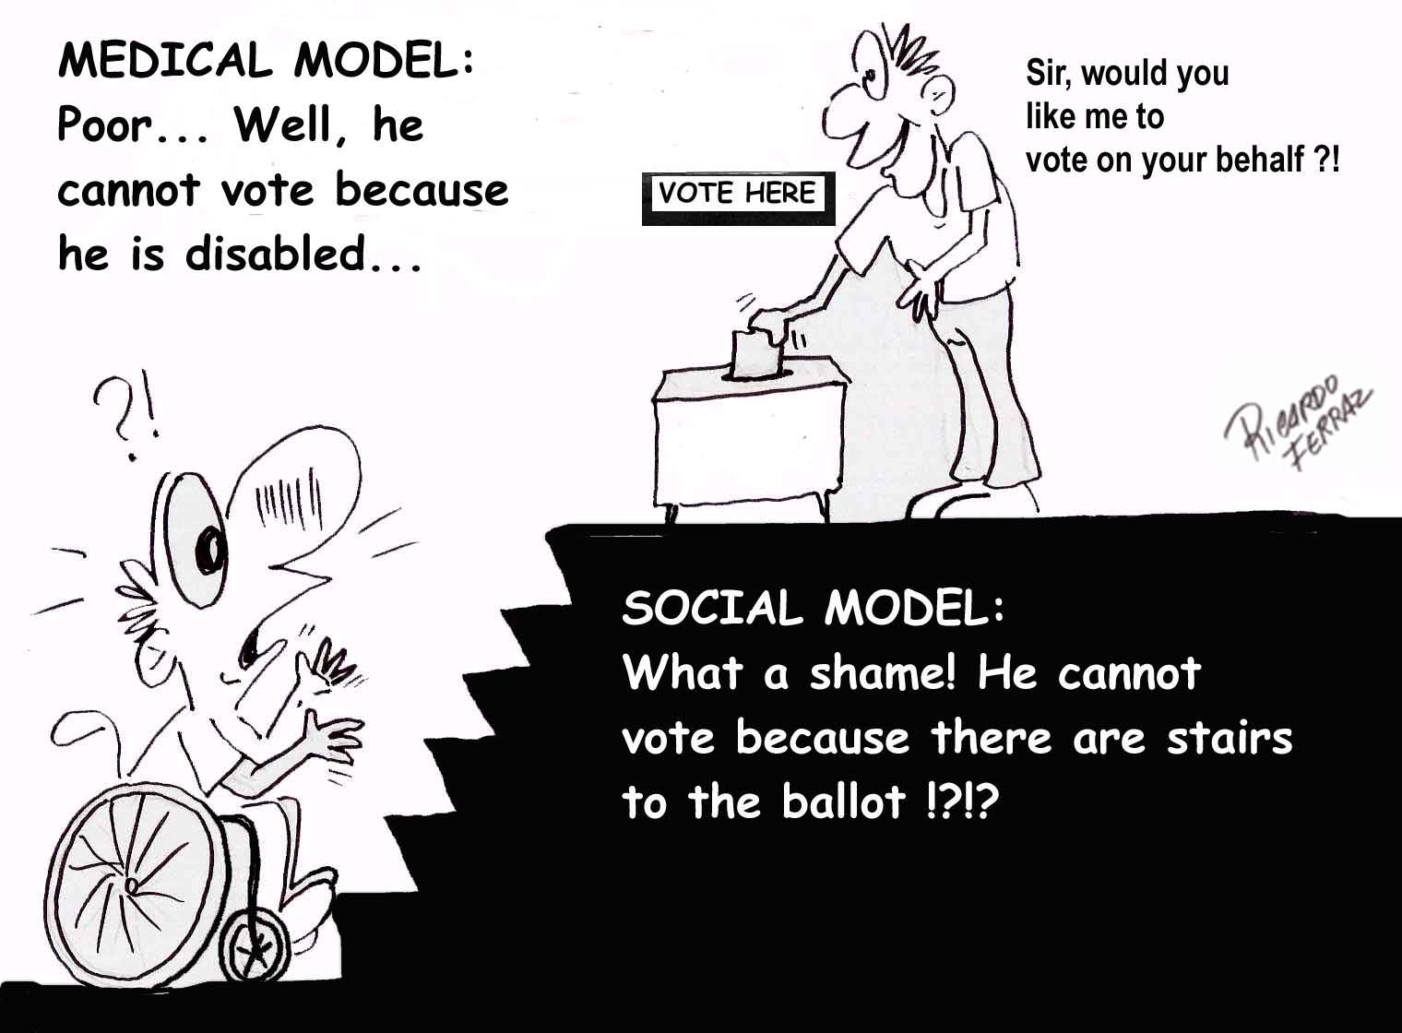
Disability Models
Biomedical/Rehabilitation Model
Disability viewed as a problem to be fixed
Society has no responsibility to accommodate
Environmental/Social Model
Disability caused/increased by environment
Society/Culture creates limitations
Minority/Human Variation Model
Disability viewed as difference without judgment value
Society accommodates differences
Notes:
Medical-”broken”, no longer fit into AB world, sorry.
Environmental- w/c-with ramp and elevator reduces impact of disability, ADHD-timed tests,
Minority-seen as diversity, DA as culture,

Slide 10

Human Rights Model
The main issue is in society rather than in the individual
Recognizes that disability is a part of society
More comprehensive and global. Considers:
- Civil and political rights (voting, freedom of expression )
- Economic, social and cultural rights (health, education ...)
- PwD and their families reclaim their place as PERSONS, with rights and duties.
Equal opportunities and full participation in political and social life.

Slide 11
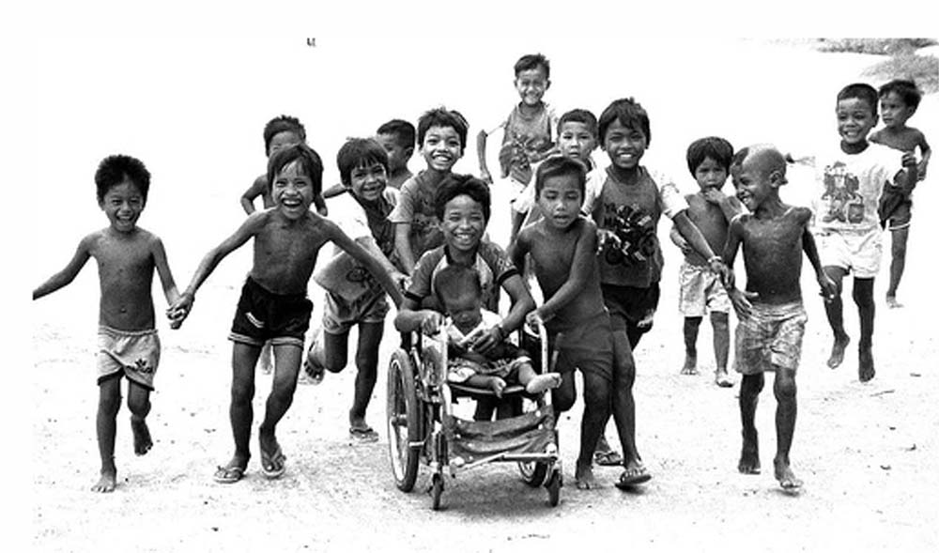
Poverty & Disability
WHO estimate approximately 15 percent of world’s population has a disability. This translates into over a million people, at least 200 million being children with disabilities (CWD), 80% of them living in developing countries.

Slide 12
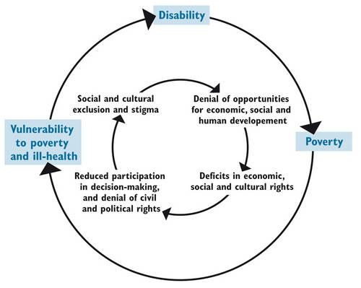
Vicious cycle between poverty and disability
Poverty not only from economic perspective, but social exclusion and powerlessness

Slide 13
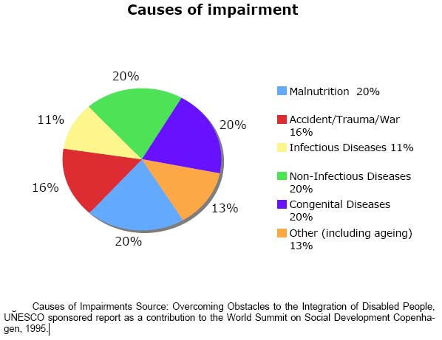
Causes of Impairments
About 80% of disabilities have causes associated to poverty. An estimated 130 million people globally acquired a disability due to malnutrition.

Slide 14
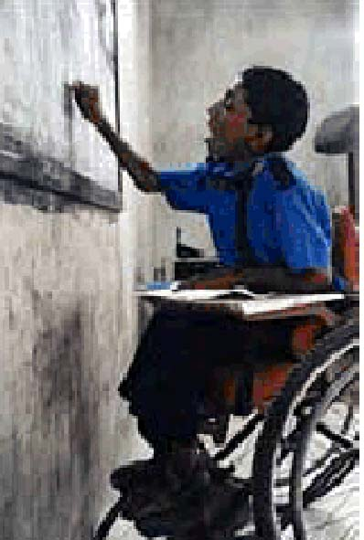
Disability and Education
Estimated 40 million of 115 million out-of-school children have disabilities.
UNESCO: 90% of children with disabilities in developing countries do not attend school; therefore absent in school data sets, and invisible on national policy agenda.
Estimated 30% of world’s children who live on the street are children with disabilities.

Slide 15
Disability related Laws

Slide 16
Prelude
India signed and ratified the UNCRPD in 2007, the process of enacting a new legislation in place of the Persons with Disabilities Act, 1995 (PWD Act, 1995) began in 2010 to make it compliant with the UNCRPD
Notes:
The Persons with Disabilities (Equal Opportunities, Protection of Rights and Full Participation) Act.1995. [Last accessed on 2017 Jan 27]. Available from:http://www.disabilityaffairs.gov.in/upload/uploadfiles/files/PWD_Act.pdf .

Slide 17
PWD ACT
The PWD (Equal Opportunities, Protection of Rights, and Full Participations) Act, 1995 was enacted to give an effect to the “Proclamation on the
“Full Participation and Equality of the People”
with Disabilities in the Asian and Pacific Region.
Notes:
Comparison of the Rights of Persons with Disabilities Bill, 2014, the Official Amendments and the Recommendations of the Standing Committee PRS Legislative Research. [Last accessed on 2017 Jan 27]. Available from: http://www.prsindia.org/uploads/media/Disability/Comparison .

Slide 18
The PWD Act listed seven conditions of disabilities, which were
blindness,
low vision,
leprosy cured,
hearing impairment,
locomotor disability,
mental retardation, and
mental illness

Slide 19
After series of consultation meetings and drafting process, the
Rights of PWD Act, 2016
(RPWD Act, 2016)
was passed by both the houses of the Parliament. It was notified on December 28, 2016 after receiving the presidential assent.

Slide 20

PARADIGM SHIFT
The principle reflects a paradigm shift in thinking about disability from a
social welfare concern to a human rights issue.

Slide 21

The Act lays stress on nondiscrimination, full and effective participation and inclusion in society,
respect for difference and acceptance of disabilities as part of human diversity and humanity, equality of opportunity,
accessibility, equality between men and women,
respect for the evolving capacities of children with disabilities, and respect for the right of children with disabilities to preserve their identities.

Slide 22
In the RPWD Act, 2016, the list has been expanded from 7 to 21 conditions

Slide 23
1. Locomotor disability
2. Muscular Dystrophy
3. Leprosy cured
4. Dwarfism
5. Cerebral Palsy
6. Acid attack Victim
7. Low vision
8. Blindness
9. Deaf
10. Hard of Hearing
11. Speech and Language disability
12. Intellectual Disability
13. Specific Learning Disability
14. Autism Spectrum Disorder
15. Mental illness
16. Chronic Neurological Conditions
17. Multiple sclerosis
18. Parkinson’s disease
19. Haemophilia
20. Thalassemia
21. Sickle Cell disease

Slide 24
Persons with benchmark disabilities are defined as those with at least 40% of any of the above disability. PWD having high support needs are those who are certified as such under section 58(2) of the Act.

Slide 25
The RPWD Act, 2016 provides that
the appropriate Government shall ensure that the PWD enjoy the right to equality, life with dignity, and respect for his or her own integrity equally with others.

Slide 26
The Government is to take steps to utilize the capacity of the PWD by providing appropriate environment.
It is also stipulated in the section 3 that no PWD shall be discriminated on the ground of disability,
unless it is shown that the impugned act or omission is a proportionate means of achieving a legitimate aim and no person shall be deprived of his personal liberty only on the ground of disability

Slide 27
Living in the community for PWD is to be ensured and steps are to be taken by the Government to ensure reasonable accommodation for them.
Special measures are to be taken to ensure women and children with disabilities enjoy rights equally with others.
Measures are to be taken to protect the PWD from being subjected to cruelty, inhuman, and degrading treatments and from all forms of abuse, violence, and exploitation.

Slide 28
Research
For conducting any research, free and informed consent from the PWD as well as a prior permission from a Committee for Research on Disability to be constituted in the prescribed manner.

Slide 29
Accessibilty
Accessibility in voting and access to justice without discrimination to the PWD are to be ensured. Public documents are to be made available in accessible formats.

Slide 30
PWD enjoy legal capacity on an equal basis with others in all aspects of life and has the right to equal recognition everywhere as any other person before the law and have the right, equally with others, to own and inherit movable and immovable property as well as control their financial affairs (Sec 13)

Slide 31
Inclusive education mandatory
The Bill provides for the access to inclusive education, vocational training, and self-employment of disabled persons without discrimination and buildings, campuses, and various facilities are to be made accessible to the PWD and their special needs are to be addressed.

Slide 32
Reservation in enrolment
All Government institutions of higher education and those getting aid from the Government are required to reserve at least 5% of seats for persons with benchmark disabilities.

Slide 33
Reservation in Employment
Four percent reservation for persons with benchmark disabilities is to be provided in posts of all Government establishments with differential quotas for different forms of disabilities. Incentives to employer in private sector are to be given who provide 5% reservation for persons with benchmark disability

Slide 34
Special Employment exchanges
Special employment exchanges for the PWD are to be set up. Awareness and sensitization programs are to be conducted and promoted regarding the PWD

Slide 35
Awareness and sensitization programs are to be conducted and promoted regarding the PWD.
Standards of accessibility in physical environment, different modes of transports, public building and areas are to be laid down which are to be observed mandatorily and a
5-year time limit is provided to make existing public building accessible.
Access to information and communication technology is to be ensured

Slide 36
Atrocities on PWD have been made punishable with imprisonment of 6 months extendable to 5 years and with fine.
Fraudulently availing of the benefits meant for PWD has also been made punishable.
Notes:
The Rights of Persons with Disabilities Act, 2016, Gazette of India (Extra-Ordinary); 28 December.2016. [Last accessed on 2017 Jan 27]. Available from:http://www.disabilityaffairs.gov.in/uploaad/uploadfiles/files/RPWD/ACT/2016.pdf .

Slide 37
Rights of Persons with Disabilities Rules, 2017 was published as required by sub-sections (1) and (2) of section 100 of the Rights of Persons with Disabilities Act, 2016 (49 of 2016)
MINISTRY OF SOCIAL JUSTICE AND EMPOWERMENT [Department of Empowerment of Persons with Disabilities (Divyangjan)]
Notes:
http://www.ccdisabilities.nic.in/content/en/docs/RPwDRule2017.pdf

Slide 38
CBR was defined as a strategy within community development for the rehabilitation, equalization of opportunities, and social integration of all peoples with disabilities.

Slide 39
CBR was defined as a strategy
within community development for the rehabilitation,
equalization of opportunities,
poverty reduction, and
social integration of all peoples with disabilities.

Slide 40
According to the World Health Organisation (WHO), REHABILITATION is one of the essential components of Universal Health Coverage (UHC), which features alongside “promotion of good health, prevention of diseases, treatment and palliative care”.
Thus, rehabilitation focuses on achieving functional independence in activities of daily living (ADL), participation in work, recreation and education, with individuals being able to achieve meaningful roles in daily life.

Slide 41
Clearly, rehabilitation is pivotal in achieving not only individual health benefits, but an overall universal health goal that permits the building of a healthy and functional global population.

Slide 42
Rehabilitation Elements

Slide 43
Preventative Rehabilitation
Occurs shortly after a new diagnosis or onset of new impairments.
The aim is to provide education, advice and interventions to prevent or slow onset of further impairments and maintain a person’s level of ability.

Slide 44
Restorative Rehabilitation
Restorative rehabilitation focuses on interventions that improve impairments such as muscle strength or respiratory function and cognitive impairment to get maximal recovery of function. This is a common form of rehabilitation after surgery, illness or acute events such as a major trauma or a stroke in order to maximise function.
Supportive Rehabilitation
Supportive rehabilitation increases a person’s self-care ability and mobility using methods such as providing self-help devices and teaching people compensatory strategies or alternative ways of doing things. This may include the provision of assistive equipment or environmental modifications. This is sometimes referred to as adaptive rehabilitation

Slide 45
Palliative Rehabilitation
Palliative rehabilitation enables people with life limiting conditions to lead a high quality of life physically, psychologically and socially, while respecting their wishes.

Slide 46
Rehabilitation Objectives
Rehabilitation objectives include:
Prevention of the loss of function
Slowing the rate of loss of function
Improvement or restoration of function
Compensation for loss of function (compensatory strategies)
Maintenance of current function

Slide 47
Barriers for People with Disabilities
Physical Barriers:
lack of ramps/ elevators, visual / auditory/ tactile signage, captioning
Instructional Barriers:
Inaccessible course packets and materials, timed tests etc..
Attitudinal Barriers:
discrimination, disbelief, prejudices,
stereotypes
Notes:
Discuss barriers specific to campus, but relevant in all areas of life. Barriers to DA-have ppl think of 2 examples for each category, then discuss.

Slide 48

Ready. Willing. ABLE.
As a disABILITY Advocate and rehabilitation Professional we will strive to:
Promote inclusion
Acknowledge and promote appropriate language use
Accept and accommodate different needs and abilities
See the person first, not the disability
Recognize that disability comes in many forms
Ensure that every human being gets their appropriate place in this Universe
Notes:
After completing this program hopefully you have a better idea of the face of disability at UT, gained more info about types of disabilities and the challenges facing PWD

Slide 49



THANK YOU !

