Slide 1


Reforms in Inclusive Education
Dr.M.Prabavathy
Director i/c
Centre for Differently Abled Persons
Bharathidasan University
cdapraba@bdu.ac.in
7200004044

Slide 2

Objective of this session
In this session, we are going to analyze
WHAT
WHY
HOW
Of Disability and inclusion

Slide 3


Disability and Diversity

Slide 4
The International Classification of Impairments, Disabilities, and Handicaps of WHO
Handicap
Impairment
Disability

Slide 5
Impairment and Disability
Impairment refers to a problem with a
structure or organ of the body;
Handicap refers tois a functional limitation with regard to a particular activity and
Disability refers to a disadvantage in filling a role in life relative to a peer group.

Slide 6
What is a Disability?
Merriam-Webster Dictionary
the condition of being disabled
inability to pursue an occupation because of a physical or mental impairment;
World Health Organization
Any restriction or lack (resulting from an impairment) of ability to perform an activity in the manner or within the range considered normal for a human being.
Notes:
Different definitions of DA-dictionary-emphasizes inability to have “normal” life.
WHO and ADA have different criteria for defining

Slide 7

Models of Disability

Slide 8
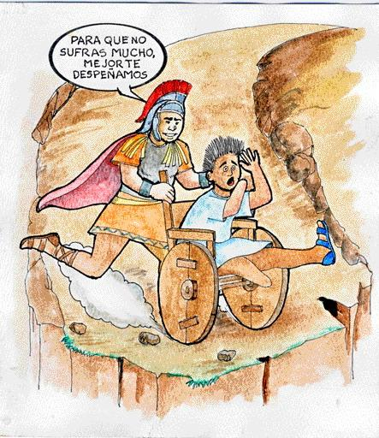
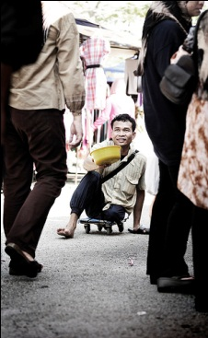
Traditional Model
I will kill you
so you stop
suffering
Disabilities as: - Will of God/test from God - Divine punishment
- More humane to end “life of pain/suffering”
Charity Model
People with disabilities considered:
inferior, useless, dependent
A burden to society, live on charity, lower social status
Families hide them out of shame
Objects of pity, humiliated in relationships with others

Slide 9
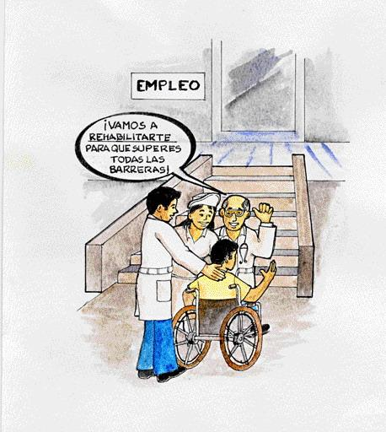
Medical or Biological Model -- Post WW II
Problem belongs to individual: disability results directly from impairment of the person.
Disability considered only a health problem, medical issue
Solutions decided by "experts”, based on diagnosis
Focus in elimination or cure of disability, “normalization”
(includes pre-natal genetic testing & selective abortion)
We will rehabilitate
you so you can overcome all barriers

Slide 10
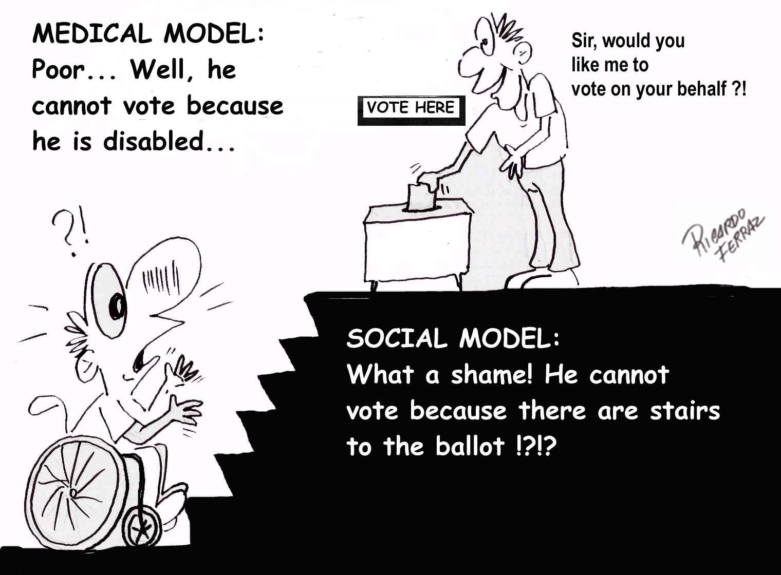
Disability Models
Biomedical/Rehabilitation Model
Disability viewed as a problem to be fixed
Society has no responsibility to accommodate
Environmental/Social Model
Disability caused/increased by environment
Society/Culture creates limitations
Minority/Human Variation Model
Disability viewed as difference without judgment value
Society accommodates differences
Notes:
Medical-”broken”, no longer fit into AB world, sorry.
Environmental- w/c-with ramp and elevator reduces impact of disability, ADHD-timed tests,
Minority-seen as diversity, DA as culture,

Slide 11

Human Rights Model
The main issue is in society rather than in the individual
Recognizes that disability is a part of society
More comprehensive and global. Considers:
- Civil and political rights (voting, freedom of expression )
- Economic, social and cultural rights (health, education ...)
- PwD and their families reclaim their place as PERSONS, with rights and duties.
Equal opportunities and full participation in political and social life.

Slide 12
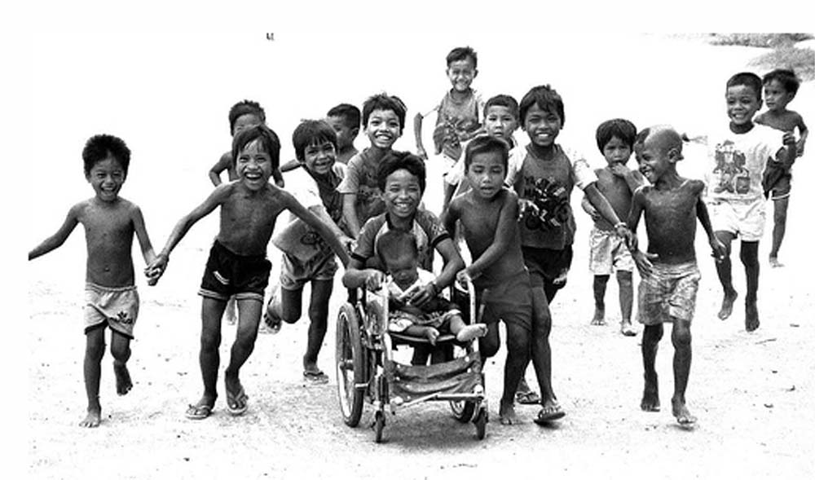
Poverty & Disability
WHO estimate approximately 15 percent of world’s population has a disability. This translates into over a million people, at least 200 million being children with disabilities (CWD), 80% of them living in developing countries.

Slide 13
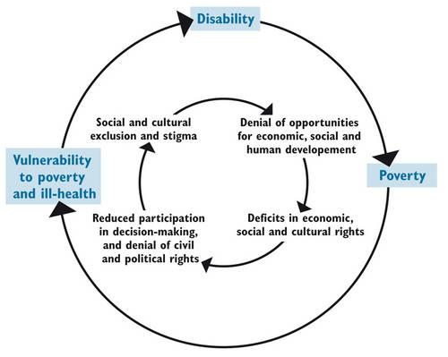
Vicious cycle between poverty and disability
Poverty not only from economic perspective, but social exclusion and powerlessness

Slide 14
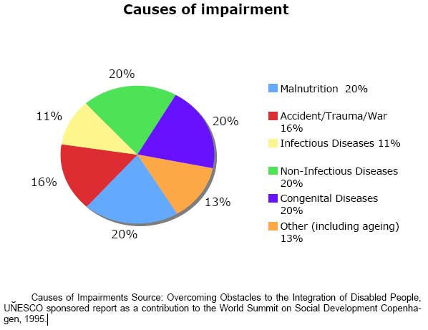
Causes of Impairments
About 80% of disabilities have causes associated to poverty. An estimated 130 million people globally acquired a disability due to malnutrition.

Slide 15
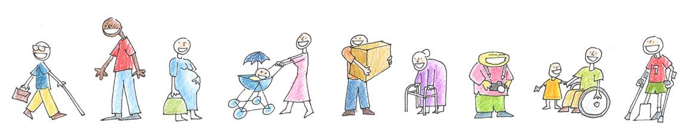
HOW IS DISABILITY DEFINED AFTER THE CRPD?
Interaction between persons with different levels of functioning and an environment that does not take those differences into consideration.
Disability= Functioning limitation x Environment
Note: we are using “functioning limitation” as a synonym of “impairment”.

Slide 16
Environment Impact in the relation between disability and functioning
FL 1 x E 0 => 0 Disability
FL 5 x E 0 => 0 Disability
FL 1 x E 1 = 1 Disability
FL 5 x E 5 = 25 Disability
FL: FUNCTIONING LIMITATION
E: ENVIRONMENT

Slide 17
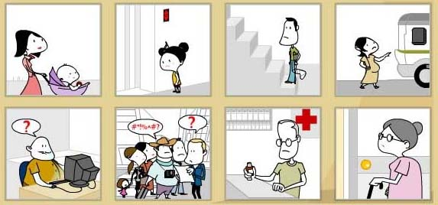
Disability is part of each and every individual’s life cycle
Beyond the typical areas of impairments (physical, sensory, intellectual and mental), people in general face ‘disabling’ conditions in a society that is unprepared for diversity.

Slide 18
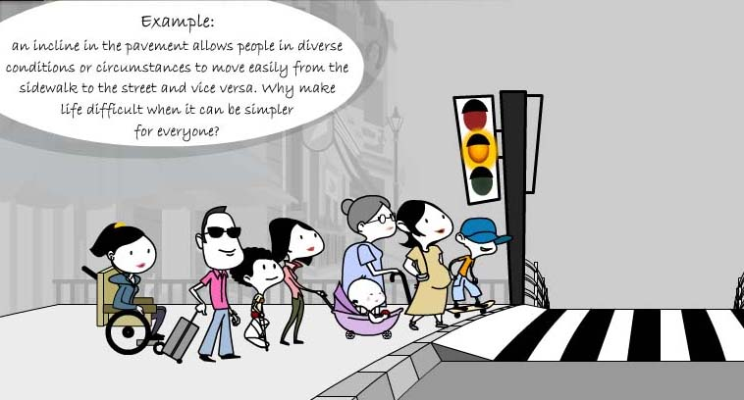
This could be the SAME person at different times of their life
Why not make life easier for all?

Slide 19

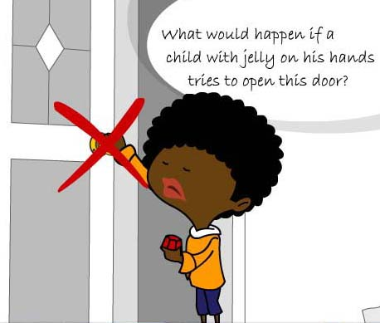
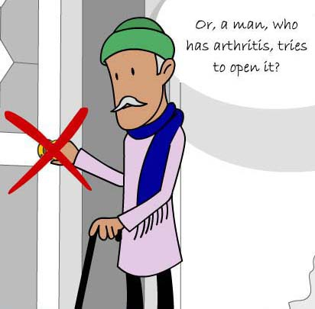
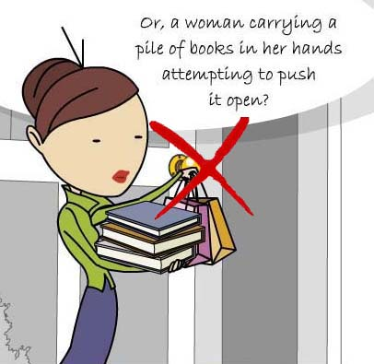
INCLUSIVE DESIGN
None of them would be able to open that door…

Slide 20
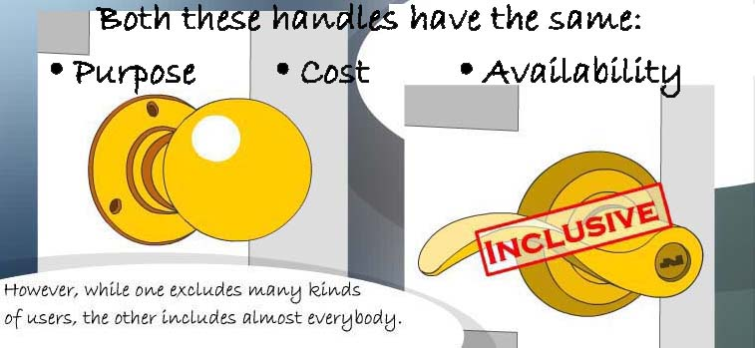

INCLUSIVE DESIGN
A HUMAN-CENTERED DESIGN

Slide 21
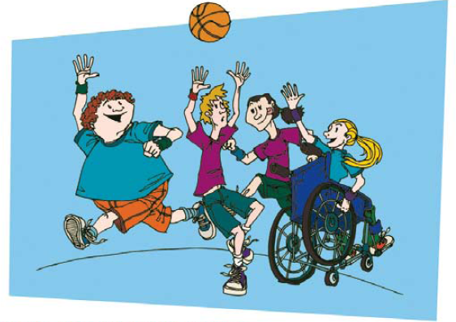
All principles, actions and components should be conceived under an inclusive approach, from design to implementation.
Persons with
disabilities
should be
visible and
actively engage
in all phases
Inclusive & Sustainable Public Policies

Slide 22
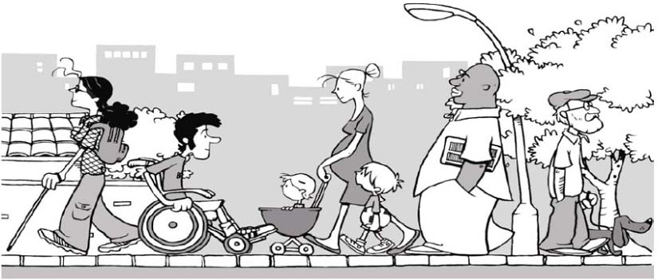
It is estimated that the additional costs to bring inclusive access to infrastructure is lower than 1% in the stage of designing and planning

Slide 23
Inclusive Education

Slide 24
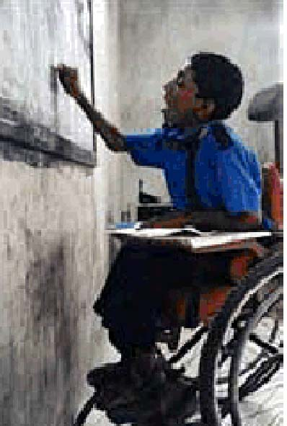
Disability and Education
Estimated 40 million of 115 million out-of-school children have disabilities.
UNESCO: 90% of children with disabilities in developing countries do not attend school; therefore absent in school data sets, and invisible on national policy agenda.
Estimated 30% of world’s children who live on the street are children with disabilities.

Slide 25
Prelude
India signed and ratified the UNCRPD in 2007, the process of enacting a new legislation in place of the Persons with Disabilities Act, 1995 (PWD Act, 1995) began in 2010 to make it compliant with the UNCRPD
Notes:
The Persons with Disabilities (Equal Opportunities, Protection of Rights and Full Participation) Act.1995. [Last accessed on 2017 Jan 27]. Available from:http://www.disabilityaffairs.gov.in/upload/uploadfiles/files/PWD_Act.pdf .

Slide 26
PWD ACT
The PWD (Equal Opportunities, Protection of Rights, and Full Participations) Act, 1995 was enacted to give an effect to the “Proclamation on the
“Full Participation and Equality of the People”
with Disabilities in the Asian and Pacific Region.
Notes:
Comparison of the Rights of Persons with Disabilities Bill, 2014, the Official Amendments and the Recommendations of the Standing Committee PRS Legislative Research. [Last accessed on 2017 Jan 27]. Available from: http://www.prsindia.org/uploads/media/Disability/Comparison .

Slide 27
The PWD Act listed seven conditions of disabilities, which were
blindness,
low vision,
leprosy cured,
hearing impairment,
locomotor disability,
mental retardation, and
mental illness

Slide 28
After series of consultation meetings and drafting process, the
Rights of PWD Act, 2016
(RPWD Act, 2016)
was passed by both the houses of the Parliament. It was notified on December 28, 2016 after receiving the presidential assent.

Slide 29

PARADIGM SHIFT
The principle reflects a paradigm shift in thinking about disability from a
social welfare concern to a human rights issue.

Slide 30

The Act lays stress on nondiscrimination,
full and effective participation and inclusion in society,
respect for difference and acceptance of disabilities as part of human diversity and humanity, equality of opportunity,
accessibility, equality between men and women,
respect for the evolving capacities of children with disabilities,
and respect for the right of children with disabilities to preserve their identities.

Slide 31
SALIENT FEATURES OF THE RIGHTS OF PERSONS WITH DISABILITIES ACT, 2016

Slide 32
In the RPWD Act, 2016, the list has been expanded from 7 to 21 conditions

Slide 33
12. Intellectual Disability
13. Specific Learning Disability
14. Autism Spectrum Disorder
15. Mental illness
16. Chronic Neurological Conditions
17. Multiple sclerosis
18. Parkinson’s disease
19. Haemophilia
20. Thalassemia
21. Sickle Cell disease
1. Locomotor disability
2. Muscular Dystrophy
3. Leprosy cured
4. Dwarfism
5. Cerebral Palsy
6. Acid attack Victim
7. Low vision
8. Blindness
9. Deaf
10. Hard of Hearing
11. Speech and Language disability

Slide 34
The nomenclature
Mental Retardation
is replaced by
Intellectual Disability

Slide 35
Persons with benchmark disabilities are defined as those with at least 40% of any of the above disability. PWD having high support needs are those who are certified as such under section 58(2) of the Act.

Slide 36
The RPWD Act states that appropriate Government shall ensure that the PWD enjoy the
right to equality,
life with dignity, and
respect for his or her own integrity equally with others.

Slide 37
The Government is to take steps to utilize the capacity of the PWD by providing appropriate environment.
It is also stipulated in the section 3 that no PWD shall be discriminated on the ground of disability,
unless it is shown that the impugned act or omission is a proportionate means of achieving a legitimate aim and no person shall be deprived of his personal liberty only on the ground of disability

Slide 38
Living in the community for PWD is to be ensured and steps are to be taken by the Government to ensure reasonable accommodation for them.
Special measures are to be taken to ensure women and children with disabilities enjoy rights equally with others.
Measures are to be taken to protect the PWD from being subjected to cruelty, inhuman, and degrading treatments and from all forms of abuse, violence, and exploitation.

Slide 39
Research
For conducting any research, free and informed consent from the PWD as well as a prior permission from a Committee for Research on Disability to be constituted in the prescribed manner.

Slide 40
Accessibilty
Accessibility in voting and access to justice without discrimination to the PWD are to be ensured. Public documents are to be made available in accessible formats.

Slide 41
PWD enjoy legal capacity on an equal basis with others in all aspects of life and has the right to equal recognition everywhere as any other person before the law and have the right, equally with others, to own and inherit movable and immovable property as well as control their financial affairs (Sec 13)

Slide 42
Inclusive education mandatory
The Bill provides for the access to inclusive education, vocational training, and self-employment of disabled persons without discrimination and buildings, campuses, and various facilities are to be made accessible to the PWD and their special needs are to be addressed.

Slide 43
Reservation in enrolment
All Government institutions of higher education and those getting aid from the Government are required to reserve at least 5% of seats for persons with benchmark disabilities.

Slide 44
Reservation in Employment
Four percent reservation for persons with benchmark disabilities is to be provided in posts of all Government establishments with differential quotas for different forms of disabilities. Incentives to employer in private sector are to be given who provide 5% reservation for persons with benchmark disability

Slide 45
Special Employment exchanges
Special employment exchanges for the PWD are to be set up. Awareness and sensitization programs are to be conducted and promoted regarding the PWD

Slide 46
Awareness and sensitization programs are to be conducted and promoted regarding the PWD.
Standards of accessibility in physical environment, different modes of transports, public building and areas are to be laid down which are to be observed mandatorily and a
5-year time limit is provided to make existing public building accessible.
Access to information and communication technology is to be ensured

Slide 47
Atrocities on PWD have been made punishable with imprisonment of 6 months extendable to 5 years and with fine.
Fraudulently availing of the benefits meant for PWD has also been made punishable.
Notes:
The Rights of Persons with Disabilities Act, 2016, Gazette of India (Extra-Ordinary); 28 December.2016. [Last accessed on 2017 Jan 27]. Available from:http://www.disabilityaffairs.gov.in/uploaad/uploadfiles/files/RPWD/ACT/2016.pdf .

Slide 48
Rights of Persons with Disabilities Rules, 2017 was published as required by sub-sections (1) and (2) of section 100 of the Rights of Persons with Disabilities Act, 2016 (49 of 2016)
MINISTRY OF SOCIAL JUSTICE AND EMPOWERMENT [Department of Empowerment of Persons with Disabilities (Divyangjan)]
Notes:
http://www.ccdisabilities.nic.in/content/en/docs/RPwDRule2017.pdf

Slide 49
Psychological Disabilities
Stigma associated with psychological disabilities is often greater than physical disability
Majority of psychological/mood disorders first appear in late adolescence or early adulthood
Depression
Generalized Anxiety and Panic Disorder
BiPolar Disorder
Obsessive Compulsive Disorder (OCD)
Post Traumatic Stress Disorder (PTSD)
Schizophrenia
Eating Disorder
Adjustment Disorder
Notes:
Onset is typically 18-24, usually during college years. Psych may have physical effects-unable to get out of bed, difficulty sleeping, side effects of meds. Stigma causes ppl to “pass” as non-disabled/member of majority group

Slide 50
Language reflects Attitude
Preferred Terms
Outdated Terms
Person First Language mentions the person before the disability:
A person with a disability
A woman with epilepsy
Living with lupus
Stroke survivor
Uses a wheelchair
Accessible parking/seating
Able-bodied/without a disability
Accommodations
Emphasizes the disability first/Sees disability as tragic:
Disabled person
An epileptic woman
Suffering from lupus
Stroke victim
Wheelchair bound/confined to a wheelchair
Handicap parking/seating
Normal
Special accommodations
Notes:
A disability is only a part of a person, focus on the fact that they are a professor, administrator, mother, student, professional, athlete…with a disability. Intent: most PWD are not offended if you innocently use the “wrong” word. Try to be proactive and change your language, but don’t be so wrapped up in the right word that it makes you tongue-tied or awkward when talking to a PWD.

Slide 51
Barriers for People with Disabilities
Physical Barriers:
lack of ramps/ elevators, visual / auditory/ tactile signage, captioning
Instructional Barriers:
Inaccessible course packets and materials, timed tests etc..
Attitudinal Barriers:
discrimination, disbelief, prejudices,
stereotypes
Notes:
Discuss barriers specific to campus, but relevant in all areas of life. Barriers to DA-have ppl think of 2 examples for each category, then discuss.

Slide 52

What is inclusion?
Inclusion is about transforming systems to be inclusive of everyone and not about inserting disadvantaged population into existing structures
(UNICEF, 2009).

Slide 53
Why do we need inclusion?
Human Rights perspective
Economic Perspective
Societal Perspective

Slide 54
“Children that learn together,
learn to
live together”

Slide 55
Inclusive Education What does it mean?
Inclusive education is about embracing all, making a commitment to do an inalienable right to belong, not to be excluded.
Inclusion assumes that living and learning together is a better way that benefits everyone, not just children who are labeled as having a difference

Slide 56

What is Inclusive Education?
Persons with and without disabilities educated together in their neighborhood school, college ,University and community
All students in general education classes; having instruction in the core curriculum content and participating in extracurricular activities
General and special education teacher consultation and collaboration to incorporate special supports and services into age-appropriate school and community environments
Flexible and individualized decision making about services, supports, and locations for instruction (

Slide 57

What is Inclusive Education?
Opportunities for building social networks and friendships and having planned and facilitated social network and relationship building
Instruction in schools and in the community
Students are active participants and learn from each other
ZERO exclusion
An ongoing process

Slide 58
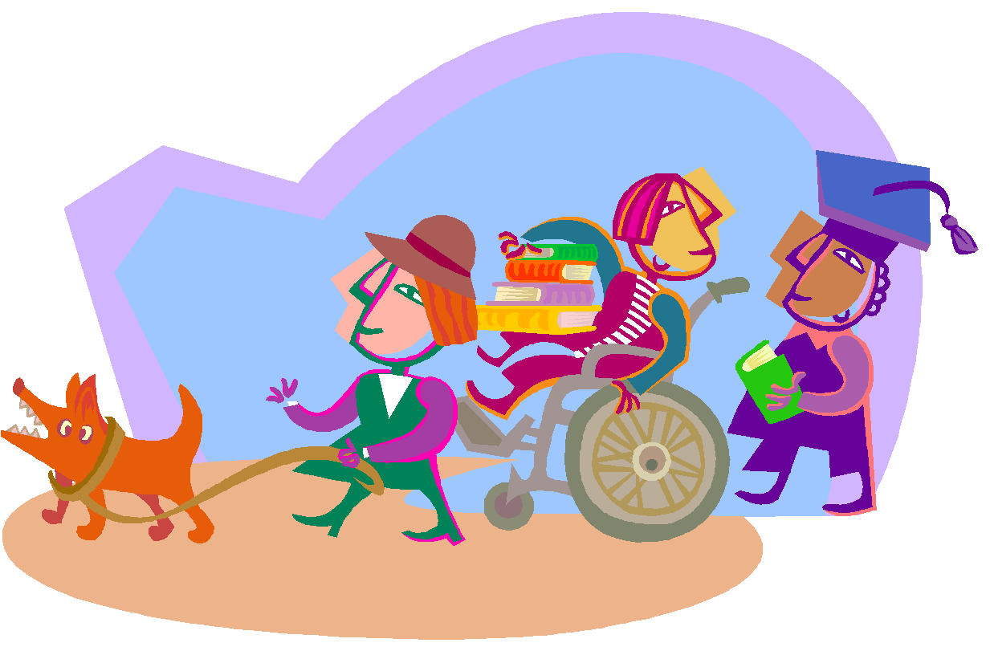



ACADEMIC
SOCIAL
INCLUSION
ENVIRONMENTAL

Slide 59
Why Inclusive Education?
Values
Educational
Practices
And
Outcomes
Laws
Notes:
See Trainer Background Page # ___ for more information on each of these topics.

Slide 60
Developing Inclusive Education as the core of a refined EFA agenda
Broadening Inclusive Education to address diversity of learners
“Inclusion is a process of addressing and responding to the diversity of needs of all learners through increasing participation in learning, cultures and communities, and reducing exclusion within and from education.
It involves changes and modifications in content, approaches, structures and strategies, with a common vision which covers all children of the appropriate age range and a conviction that it is the responsibility of the regular system to educate all children.”

Slide 61
Key thèmes Linking inclusive Education and EFA
1. Emphasis on equity and quality
long-term policy visions and objectives
Support to International conventions with a focus on the CRPD - (Art. 24, 2006)
Curricula seen as a key tool for inclusion
Greater focus on teachers’ role, profile and competencies
Primary, secondary and higher education incorporated, through a lifelong perspective
Global, national and local needs, responsibilities and roles better considered in a balanced way (glo-local approach)
new learning and teaching tools and strategies for diverse learner profiles and characteristics

Slide 62
Key dimensions of Inclusive Education as the core of a refined EFA agenda
Transversal approach under a common vision to all dimensions and levels of lifelong learning opportunities
Understanding diversity as cost-effective and as a strong sign of societal cohesion
Restructuring cultures, policies and practices to respond to the diversity
Understanding, addressing and responding to the diverse needs of all learners through personalized learning
Understanding, identifying and removing barriers of the education system
Aiming at the presence (access and attendance), participation (quality learning) and achievement (quality outcomes)

Slide 63
Key interventions for
Inclusive Education as the core
of a refined EFA agenda
Across the education system:
Guides clear, common and participatory policy planning, implementation and monitoring
Visualizes the interfaces and synergies between social and educational inclusion
Orientates the design and implementation of inclusive curricula and schools to address all learners’ needs
Re-conceptualizes the role, profile and competencies of an inclusive teacher i.e. promotes the diversification of teaching practices for engaging the students effectively in the learning process.

Slide 64
PARADIGMS OF INCLUSIVE EDUCATION
relationships between individuals with disabilities and their environments.
Three most dominant paradigms:
(a) the psycho-medical paradigm, which focuses on the assumption that deficits are located within individual students,
(b) the socio-political paradigm, which focuses on structural inequalities at the macro-social level being reproduced at the institutional level, and
(c) the organisational paradigm, in which special education is seen as the consequence of inadequacies in mainstream schools.

Slide 65
Definitions, Categorisation and Terminology
Disabilities are perceived as a function of the interaction between individual and their physical, social and psychological environments.
Category A: Disabilities: Students with disabilities or impairments viewed in medical terms as organic disorders attributable to organic pathologies; their educational need is considered to arise primarily from problems attributable to these disabilities.

Slide 66
Category B: Difficulties: students with behavioural or emotional disorders, or specific difficulties in learning, arising primarily from problems in the interaction between the student and the educational context.
Category C: Disadvantages: students with disadvantages arising primarily from socio-economic, cultural, and/or linguistic factors, and whose educational need is to compensate for the disadvantages attributable to these factors.

Slide 67
Gender Imbalance in
Inclusive Education
There is clear international evidence of a gender imbalance in the incidence of disabilities, special education enrolments and academic achievement.
range of reasons for GI
a biological factors
b unacceptable behaviour patterns
c peer influences
d learning strategies
e under-identification of girls
f school factors
g ethnicity
h students’ age

Slide 68
Inclusive Education
Inclusive education goes far beyond the physical placement of SWSEN in general classrooms, but requires nothing less than transforming regular education by promoting positive school/classroom cultures and structures, together with evidence-based practices.
.

Slide 69
In almost every country,
inclusive education has emerged as one of the most the dominant issues in the education of SWSEN.
In the past 40 years the field of special needs education has moved from a segregation paradigm through integration to a point where INCLUSION IS CENTRAL TO CONTEMPORARY DISCOURSE

Slide 70
Inclusive education is an ongoing process aimed at offering quality
education for all while respecting diversity and the different needs and abilities,characteristics and learning expectations of the students and communities, eliminating all forms of discrimination’ (UNESCO, 2009)

Slide 71
Advocacy for inclusive education revolves around three main arguments:
a. inclusive education is a basic human right;
b . in designing educational programmes
c. support for the contention that specific categories of students learn differently

Slide 72
Evidence-based Pedagogy
Strategies that have a strong evidential base for use with SWSEN (and other students) include
(a)cooperative group teaching,
(b) peer tutoring,
(c) formative assessment,
(d) feedback,
(e) cognitive
strategy instruction, and
(f) instruction in memory strategies.

Slide 73
International Commission on Education for the Twenty-first Century
Four Pillars of Quality Education
• learning to know:
• learning to do:
• learning to be:
• learning to live together:

Slide 74
Universal Design for Learning
the design of products and environments to be usable by all people, to the greatest extent possible, without the need for subsequent adaptation or specialised design’.
UDL involves planning and delivering programmes with the needs of all students in mind from the outset. It applies to all facets of education: from curriculum, assessment and pedagogy to classroom and school design.

Slide 75
UDL requires that the following criteria be met
(a) equitable use,
(b) flexible use,
(c) simple and intuitive use,
(d) perceptible information,
(e) tolerance for error, and
(f) low physical and cognitive effort.

Slide 76
“Children that learn together,
learn to
live together”

Slide 77


Need for Inclusive Higher Education

Slide 78
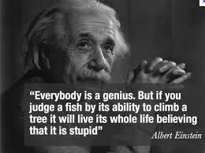

Slide 79
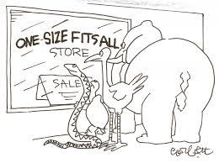

Slide 80
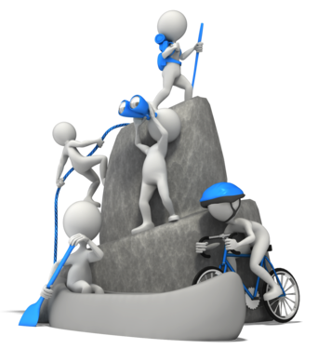


Slide 81
Inclusion is about transforming systems to be inclusive of everyone and not about inserting persons with disabilities into existing structures (UNICEF, 2009).

Slide 82
UNCRPD (2006), Article 1, (2006), persons with disabilities include those who have long-term
physical, mental, intellectual, or sensory impairments which in interaction with various barriers may hinder
their full effective participation in the society on equal basis with others.

Slide 83
In this regard, disability is seen as a socially created problem

Slide 84
Persons with disabilities are unable to access higher education due to barriers outside the institutions and those within.
Such barriers include narrowly-defined set of
legibility criteria,
negative attitude, and
inaccessible environments.

Slide 85
Barriers that limit a person’s full participation include;
negative attitude,
discriminative policies and practices, and inaccessible
environments as a result of these barriers,
And as a result students with disabilities are being excluded from accessing higher education.

Slide 86
Our institutes of higher learning lack policy on inclusive education and are hardly prepared to enroll students with disabilities.
There are no transitional systems in place for students with disabilities when they move from high school to higher education.

Slide 87
Barriers faced by students before enrolling into higher education include;
Social exclusion and stigmatisation by the society
Higher education institutions catering for those with disabilities are not available in every community.
Environments where higher education institutions are situated are not disability friendly and the
facilities within the community that they are expected to use are also inaccessible.

Slide 88
Barriers within higher education institutions after admission
Rigid curriculum and examination systems
Lack of appropriate teaching methodology
Feeling of inadequacy by teachers
Content based teaching
Rote and memorisation learning

Slide 89
Our system of higher learning lack in-service or pre-service training programmes for teachers for acquiring knowledge in instructional methods for students with disabilities.
In institutions of higher learning where inclusion is being practiced, there are biases on the inclusion of some categories of disabilities, such as those with intellectual impairments.

Slide 90
Higher education policy should recognise and appreciate differences among students who enroll or intend to get into higher education programmes and such formulation of such policy ought to involve people with disability in planning, implementation and evaluation.

Slide 91
Higher education has a responsibility to restructure its programmes to include;
provision of assistive devices,
accommodation of academic flexibility,
supporting aids and services,
modification of the classroom environment,
sign language interpreters and
note takers etc..

Slide 92
Inclusive education approach is instrumental in addressing these barriers in order to open higher education for students with disabilities and all those who are currently denied access on any grounds.

Slide 93
Use and Application of Assistive Technology in Education

Slide 94
CATEGORY/ AREA OF FUNCTION | ASSISTIVE TECHNOLOGY APPLICATIONS | NEED AND RELEVANCE IN CLASS- ROOM LEARNING
Reading | Electronic books, Book, adapted for page turning, Single word scanners, Predictable texts, Tabs, Talking electronic devices/software, Speech Software | For students having difficulty in reading and understanding written text and in paying attention to the reading assigned.
Writing | Pen/Pencil grips, Templates, Word processors, Word card/book/wall, software, Spelling/Grammar checker, Adapted papers | For students having problem in writing or composition
Math | Calculators, Talking Clocks, Enlarged Worksheets, Voice Output Measuring Devices, Scientific Calculators | For students having computational problems and confusions, and finding it difficult to perform well in Math lessons
Vision | Eye glasses, Magnifier, Screen Magnification, Screen Reader, Braille Large Print Books, CCTV, Audio Lesson Tapes | For students who have difficulty in seeing or lack complete vision

Slide 95
CATEGORY/ AREA OF FUNCTION | ASSISTIVE TECHNOLOGY APPLICATIONS | NEED AND RELEVANCE IN CLASS- ROOM LEARNING
Hearing | Hearing Aids, Pen and paper, Signaling Devices, Closed Captioning | For students who have difficulty in hearing or are absolute hearing impaired
Computer | Access Word prediction, Alternative Keyboards, Pointing Option, Switches, Voice recognition software | For students finding it difficult to access the computer in its standard form and have difficulty in performing academic Tasks
Augmentative/ Alternative Communication | Communication Board, Device with speech synthesis for typing, Eye gaze board/ frame, Voice output device | For students having problems in comprehension of language, and lacking the ability to express it, or are unclear in speech and demonstrate delayed expressive language

Slide 96
CATEGORY/ AREA OF FUNCTION | ASSISTIVE TECHNOLOGY APPLICATIONS | NEED AND RELEVANCE IN CLASS- ROOM LEARNING
Learning Disability and Attention Deficit Hyperactivity Disorder (ADHD) | Use of applications/devices depending upon the degree of disability/diculty, in the area of reading and writing (Dyslexia), handeye coordination, written expression and composition (Dysgraphia), diculty in ne motor skills, Coordination (Dyspraxia), Math (Dyscalculia) and Attention (ADHD) like - Talking electronic devices, Calculators, Electric Organizers, Highlighters, Pencil Grips, Post-its, Computers, Spelling/Grammar Checker, Electronic Organizers, Recorded materials, Hand held Scanners, Print or picture schedule, Electronic Diaries etc. | For Students having problem in language development, reading and writing (Dyslexia), hand-eye coordination, written expression and composition (Dysgraphia), diculty in ne motor skills, Coordination (Dyspraxia), Math (Dyscalculia), and ADHD.

Slide 97

Ready. Willing. ABLE.
As a disABILITY Advocate and rehabilitation Professional we will strive to:
Promote inclusion
Acknowledge and promote appropriate language use
Accept and accommodate different needs and abilities
See the person first, not the disability
Recognize that disability comes in many forms
Ensure that every human being gets their appropriate place in this Universe
Notes:
After completing this program hopefully you have a better idea of the face of disability at UT, gained more info about types of disabilities and the challenges facing PWD

Slide 98



THANK YOU !

