Slide 1
UNIT – I - Introduction to KM
Meaning and Concept of KM Knowledge-Knowledge continuum - Knowledge society- Knowledge access and Knowledge Mapping- The foundations of knowledge management - Data, information, knowledge, wisdom- KM-Intellectual capital and KM-KM advantages Key Challenges for KM, Ethics for Knowledge Management.

Slide 2
Meaning and Concept of KM
Knowledge management (KM) is the collection of methods relating to creating, sharing, using and managing the knowledge and information of an organization. It refers to a multidisciplinary approach to achieve organisational objectives by making the best use of knowledge.

Slide 3
Meaning and Concept of KM
What are the concepts of knowledge management?
Knowledge management is the conscious process of defining, structuring, retaining, and sharing the knowledge and experience of employees within an organization.
...
Knowledge management can be separated into three main areas:
Accumulating knowledge.
Storing knowledge.
Sharing knowledge.

Slide 4
Definition of KM
Knowledge management is the creation, transfer, and exchange of organizational knowledge to achieve a [competitive] advantage.
John Girard & JoAnn Girard
Knowledge management is the explicit and systematic management of vital knowledge and its associated processes of creating, gathering, organizing, diffusion, use and exploitation.
David Skyrme

Slide 5
Definition of KM
"If only HP knew what it knows it would make three times more profit tomorrow"
Lew Platt, ex CEO Hewlett Packard
The process of connecting people to people and people to information to create a competitive advantage.
Jae K. Shim, Joel G. Siegel
s

Slide 6
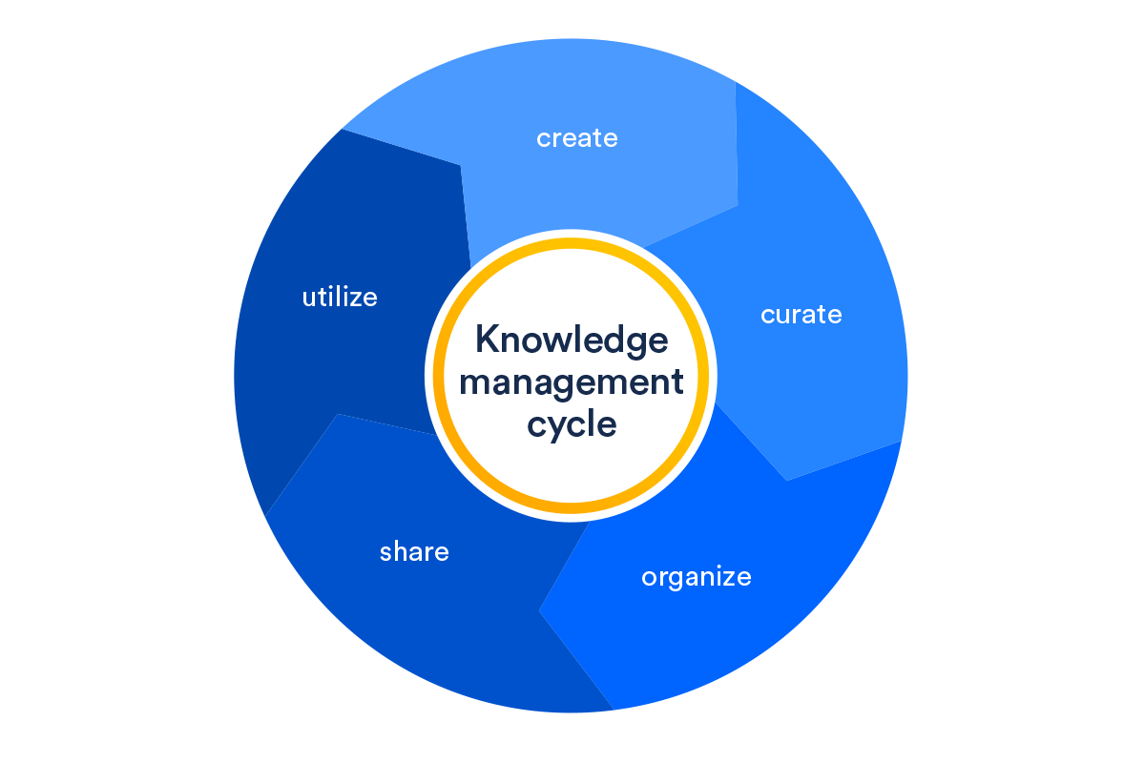

Slide 7
KMS
A knowledge management system (KMS) is a platform that helps you get the right knowledge to the right people, at the right time. Knowledge management is a complete practice that involves categorizing information to achieve specific goals — and knowledge management systems help you do it more efficiently

Slide 8
Important benefits of KMS
Improve your organization’s efficiency: save time and money by helping your team find solutions by themselves
Make smarter decisions: with knowledge at your disposal, you’re able to make decisions faster and better
Foster innovation: invite your team members and stakeholders to contribute and build a culture of innovation
Help your employees grow: train your employees and help them develop their skills in a standardized way
Improve customer satisfaction: build a better product or service with a more trained team
Communicate better: keep everyone informed and on the same page
Improve your workflows and processes: streamline your workflows and improve operational efficiency

Slide 9
Different perspectives
KM is about systems and technologies
KM is about people and learning organisations
KM is about processes, methods and techniques
KM is about managing knowledge assets
KM is a holistic initiative across the entire organisation
KM is not a discipline, as such, and should be an integral part of every knowledge workers daily responsibilities

Slide 10
Continuum
a continuous sequence in which adjacent elements are not perceptibly different from each other, but the extremes are quite distinct
An example of a continuum is a range of temperatures from freezing to boiling.
A continuum is something that keeps on going, changing slowly over time, like the continuum of the seasons.

Slide 11
Knowledge continuum
DIKW Continuum also knows as the DIKW(Data, Information, Knowledge & Wisdom) hierarchy, wisdom hierarchy, knowledge hierarchy, information hierarchy, and the data continuum. DIKW Continuum that represents how data provides the foundation of the upper levels

Slide 12
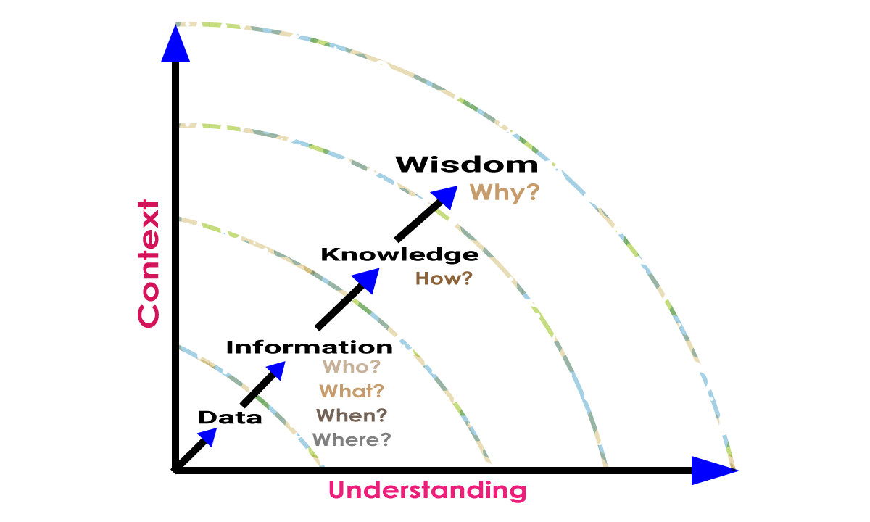

Slide 13
Knowledge Society KS
It is a society where the production, diffusion, and utilization of the knowledge are significant economic, cultural, political and social activities. In these societies, knowledge is recognized as the driver of social, cultural and economic growth. It is a society that enables people to develop without limits.

Slide 14
Four pillars of KS
Knowledge societies must build on four pillars: freedom of expression; universal access to information and knowledge; respect for cultural and linguistic diversity; and quality education for all.

Slide 15
Factors contributing to KS
Technological progress,
globalisation of the world economy,
increased importance of specialised knowledge,
increased awareness of the importance of knowledge for country´s economic development and creation of new jobs.

Slide 16
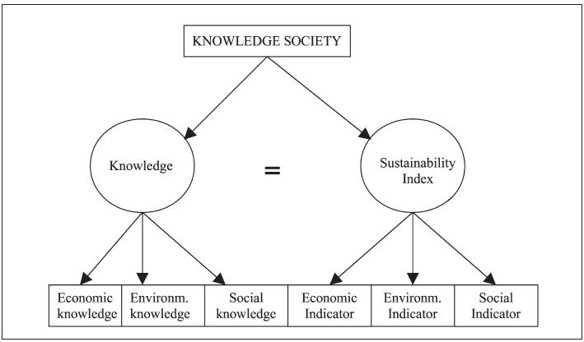

Slide 17
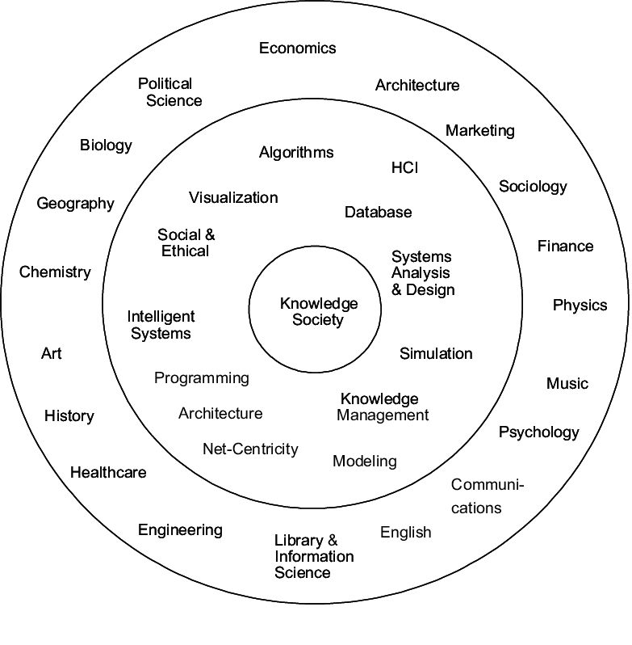

Slide 18
Knowledge Mapping
A knowledge map is a visual aid that shows where knowledge can be found within a group or organization, and how to find those with the most expertise. Often referred to as an “inventory of knowledge”.
A knowledge map is a visual representation of the organization's intellectual capital.

Slide 19
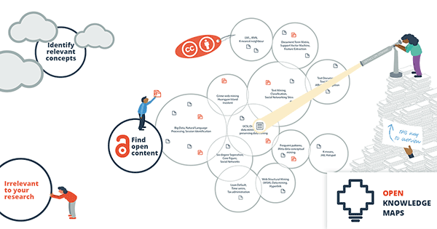

Slide 20
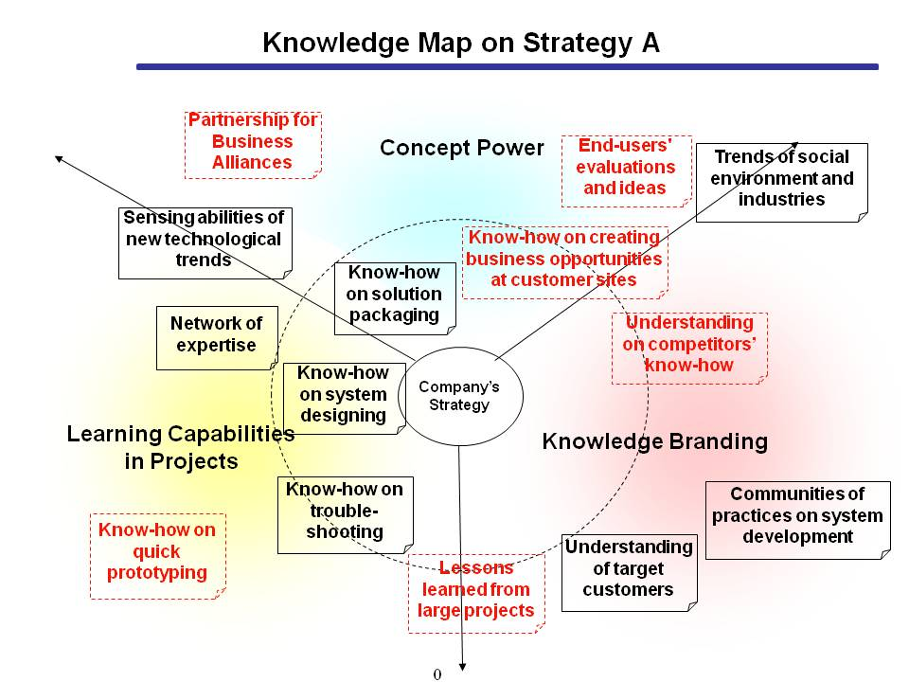

Slide 21
The foundations of KM
people, processes, technology, structure and culture.
Data, information, knowledge, wisdom
Data is numbers and facts.
The data is what it all starts with, it is undeniable and deprived of the context. The data doesn’t make much sense on its own. Look at the following DIKW examples with the rainy weath

Slide 22
The foundations of KM
Information is the data enhanced with context, the purpose of analysis and analytical methods.
Think of stock exchanges’ quotes tables. The numbers alone show as much as nothing, right? However, if you know units and reporting time frames, you’ll probably be able to make some calculations and draw conclusions about biddings:
who lead the stock market
who was the market outsider
who had the highest growth ratio
and who stagnated.

Slide 23
The foundations of KM
Knowledge comes up from the information that has been accumulated over time. These are axioms, theories, concepts, or definitions.
such as the supply-and-demand model
Wisdom is what the subject eventually comes to after having worked with information for a long time and having received a sufficient amount of knowledge.
Being aware of, comprehensive, mindful – these are all synonyms of being wise. Wisdom gives an ability to predict some events’ scenarios, based on past experience. Referring to the example with the stock exchange: outstanding investors, like Warren Buffett or Peter Lynch, turned out to be more successful thanks to both the colossal experience and bidding wisdom, in a sense.

Slide 24
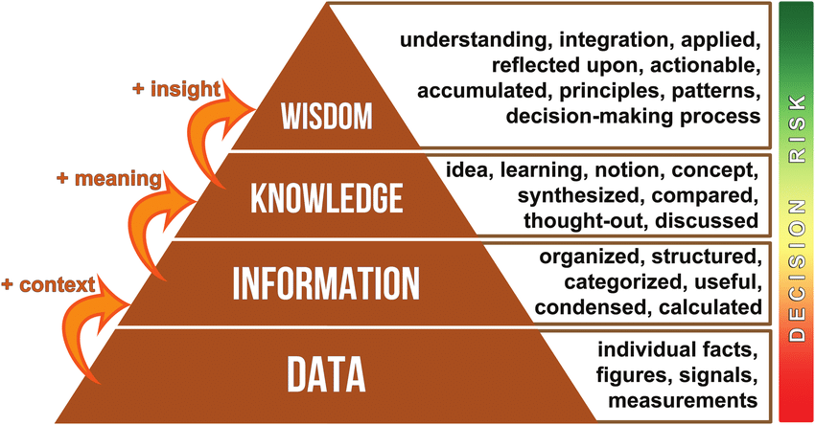

Slide 25
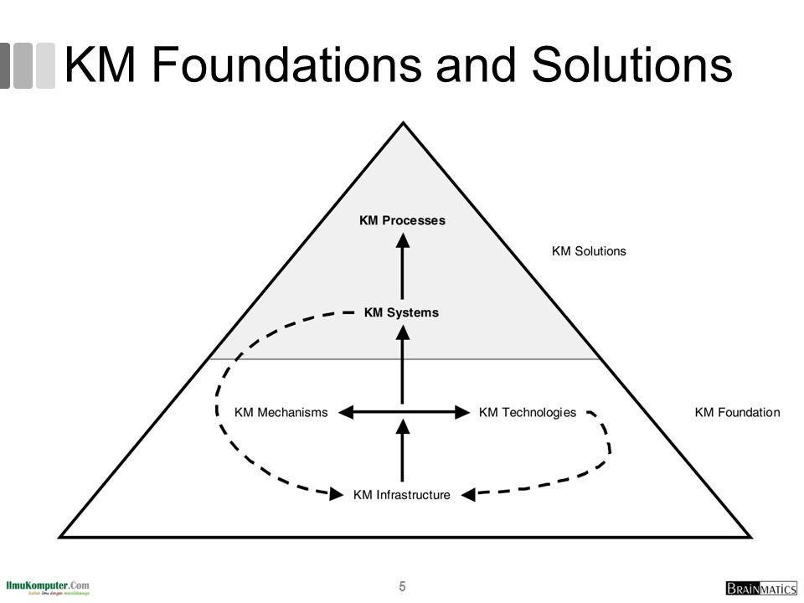

Slide 26
Intellectual capital and KM
Intellectual capital is considered the next step in knowledge management. IC is the organizational value added when the organization's knowledge assets are leveraged. It is considered the stock of the available knowledge assets (Seleim & Khalil, 2011)
Intellectual capital has a positive effect on knowledge management. S

Slide 27
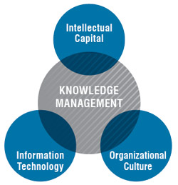

Slide 28
KM advantages
improved organisational agility.
better and faster decision making.
quicker problem-solving.
increased rate of innovation.
supported employee growth and development.
sharing of specialist expertise.
better communication.
improved business processes.

Slide 29
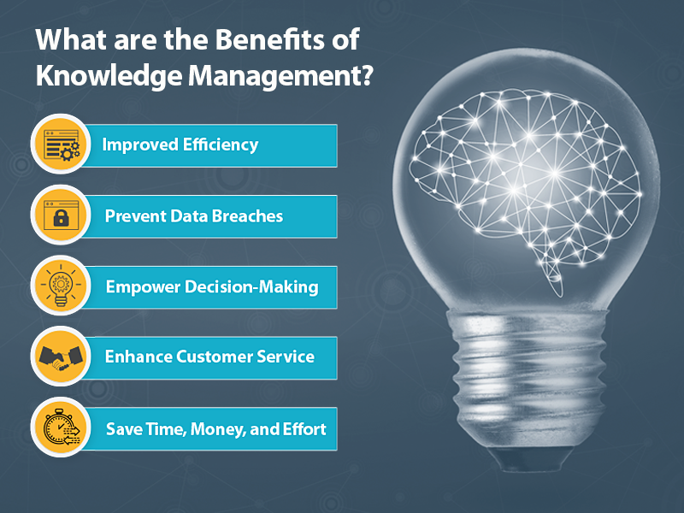

Slide 30
Key Challenges for KM
Getting and Keeping People Motivated. ...
Keeping up with Ever-Changing Technology. ...
Measuring Knowledge Contribution. ...
Security. ...
Keeping Shared Information up to Date and Accurate. ...
Interpreting Data Effectively. ...
Ensuring Relevancy. ...
Rewarding Active Users.

Slide 31
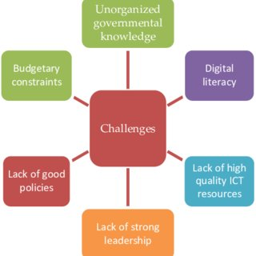

Slide 32
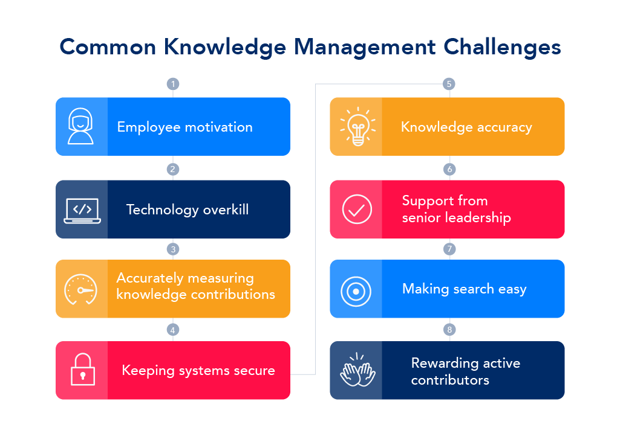

Slide 33
Ethics for Knowledge Management
The ethical approach aims to decrease the sharing of certain information, protect privacy, protect employee power/intellectual capital and avoid applying knowledge to the detriment of any stakeholders.
freedom of information, privacy of data, and the protection of intellectual property of the individual.

Slide 34
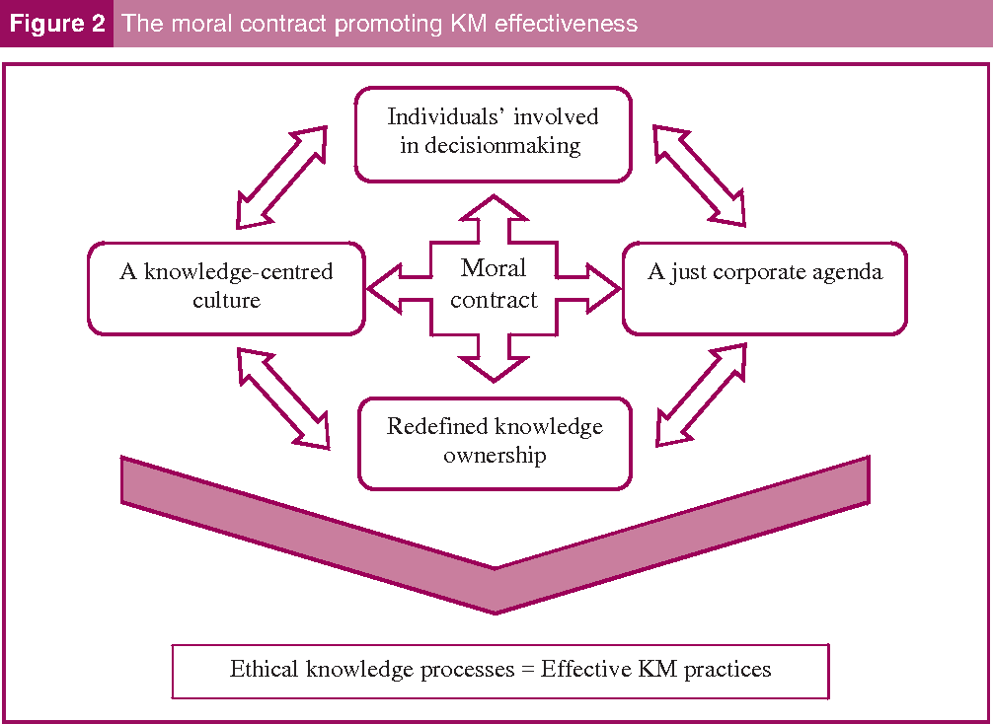

Slide 35
? & doubts
Thank you

