Slide 1
UNIT–III-COMMUNICATION Skills
Communication Skills – Definition – Types of Communication and its Relevance to Different Situations–Active Listening and Oral Communication Skill-Non–verbalcommunication,Numericalability,Testofreasoning,Logicaldeduction.

Slide 2
Communication Skills
Communication Skills means how do we communicate with each other. The way of presenting our information is very important. Communication Skills include those areas which deal with our talking, writing, expressing our views.

Slide 3
Communication Skills
Communication is defined as the ability to convey or share ideas and feelings effectively.
Effective communication in the workplace is the ability to effectively exchange and create a free flow of information with and among various stakeholders at all organizational levels to produce impactful outcomes.
Some of the most important communication skills for any job are presentation, active listening, nonverbal communication, giving/taking feedback, and others.Improve your communication skills by learning how to listen, noticing nonverbal cues, and practicing oral communication.

Slide 4


Slide 5
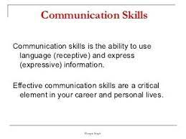

Slide 6
Definition
the ability to convey or share ideas and feelings effectively
According to Newman and Summer,•“communication is an exchange of facts, ideas, opinions or emotions by two or more
According to Leland Brown•, “communication is the transmission and interchange of facts, ideas, feelings or course of action”
According to Allen Louis•“communication is the sum of all the things one person does; when he wants to create understanding in the mind of another. It involves a systematic and continuous process of telling, listening and understanding

Slide 7
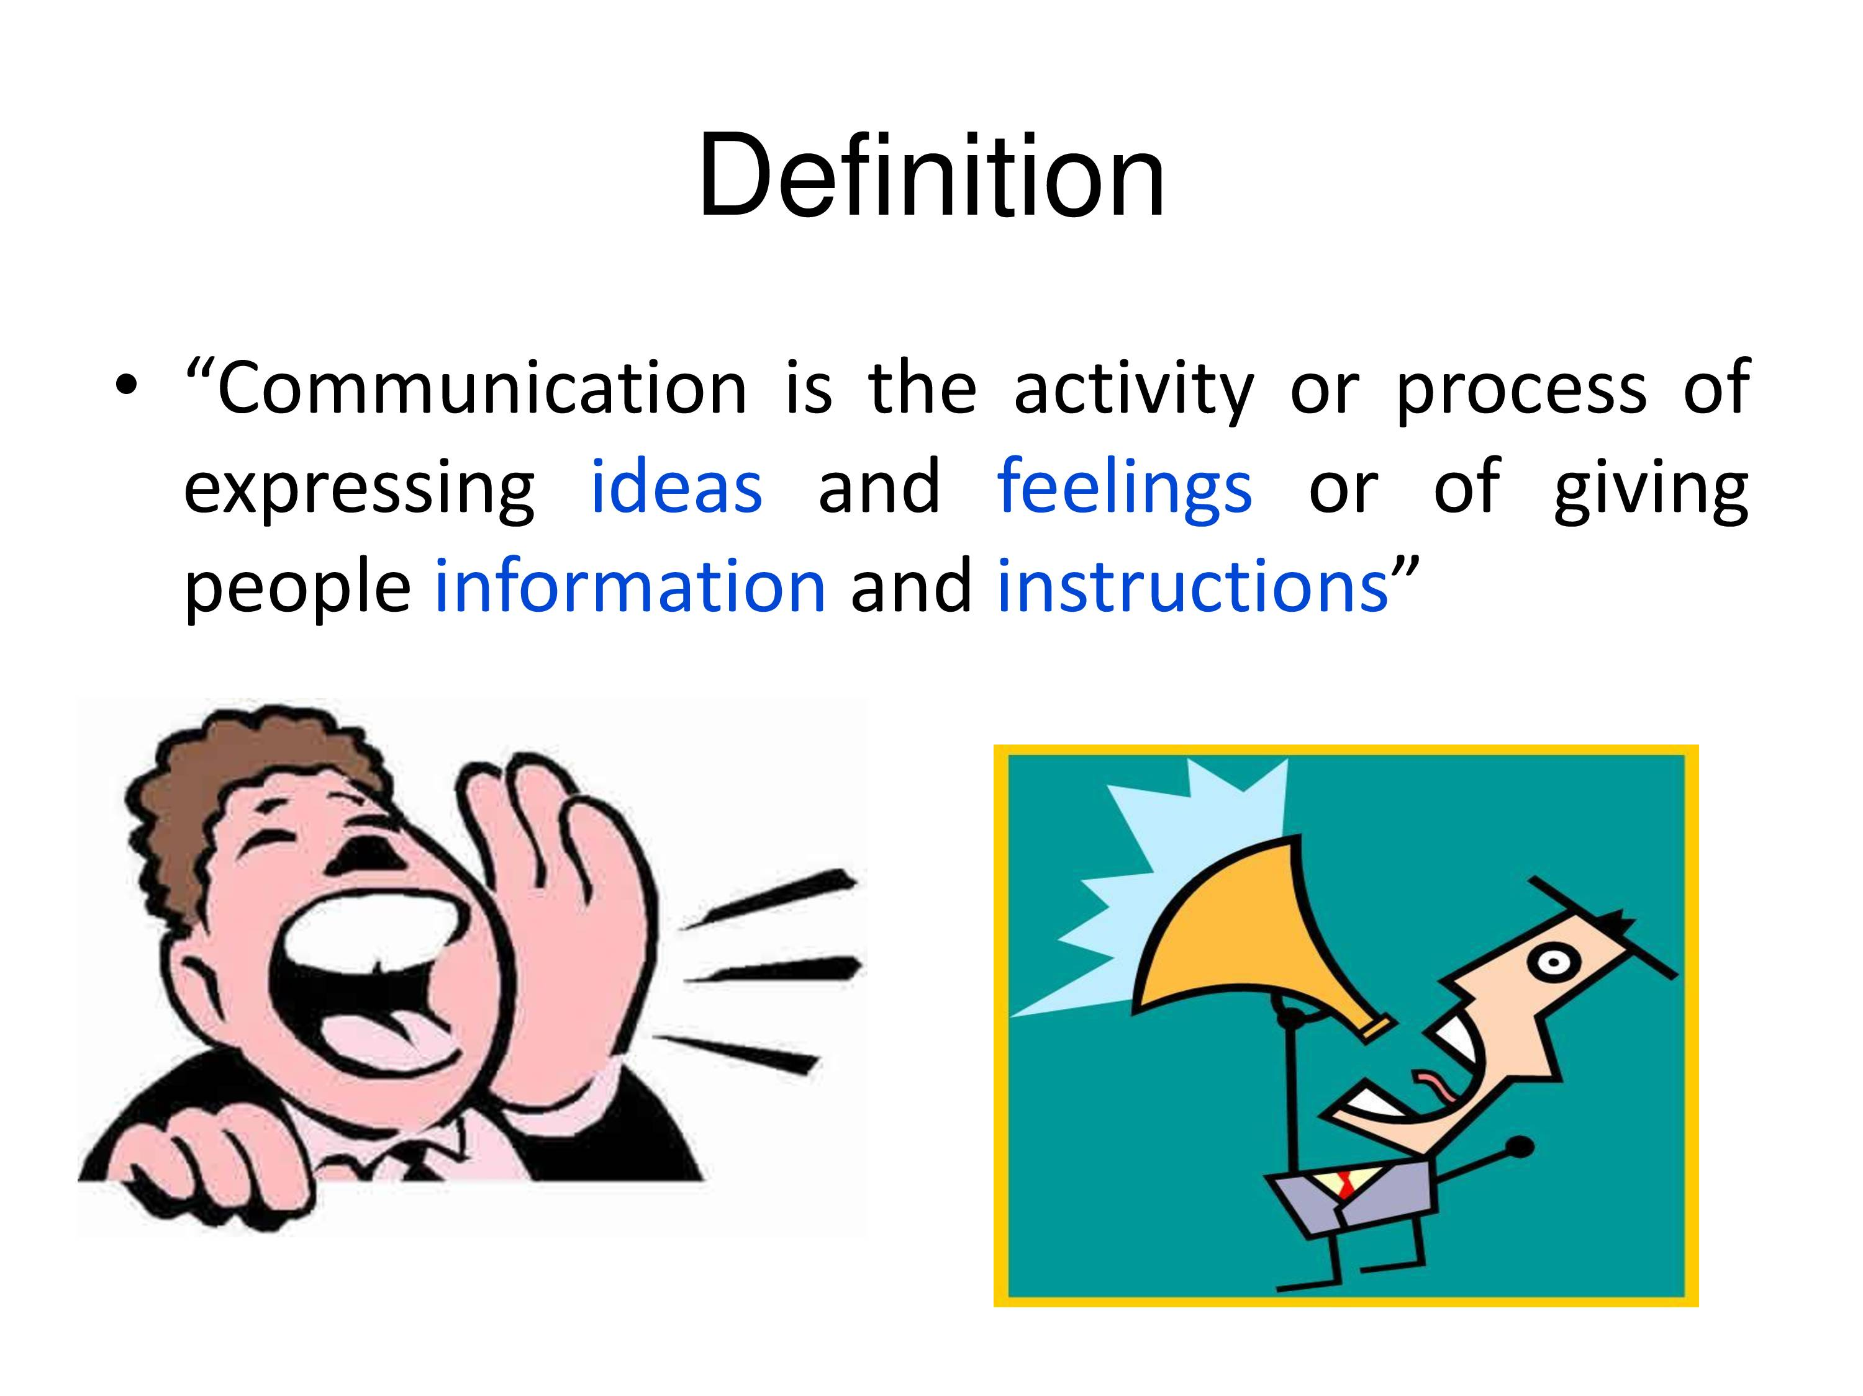

Slide 8
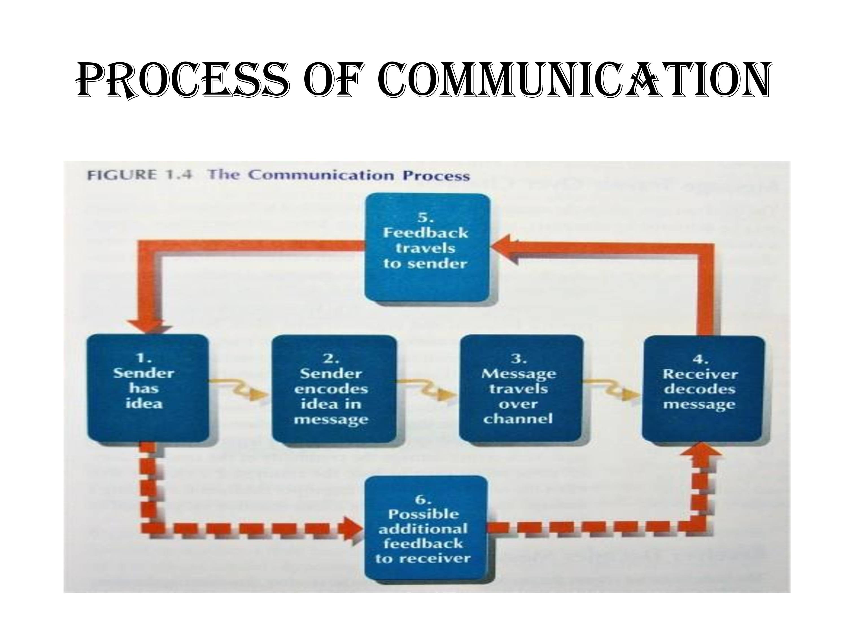

Slide 9
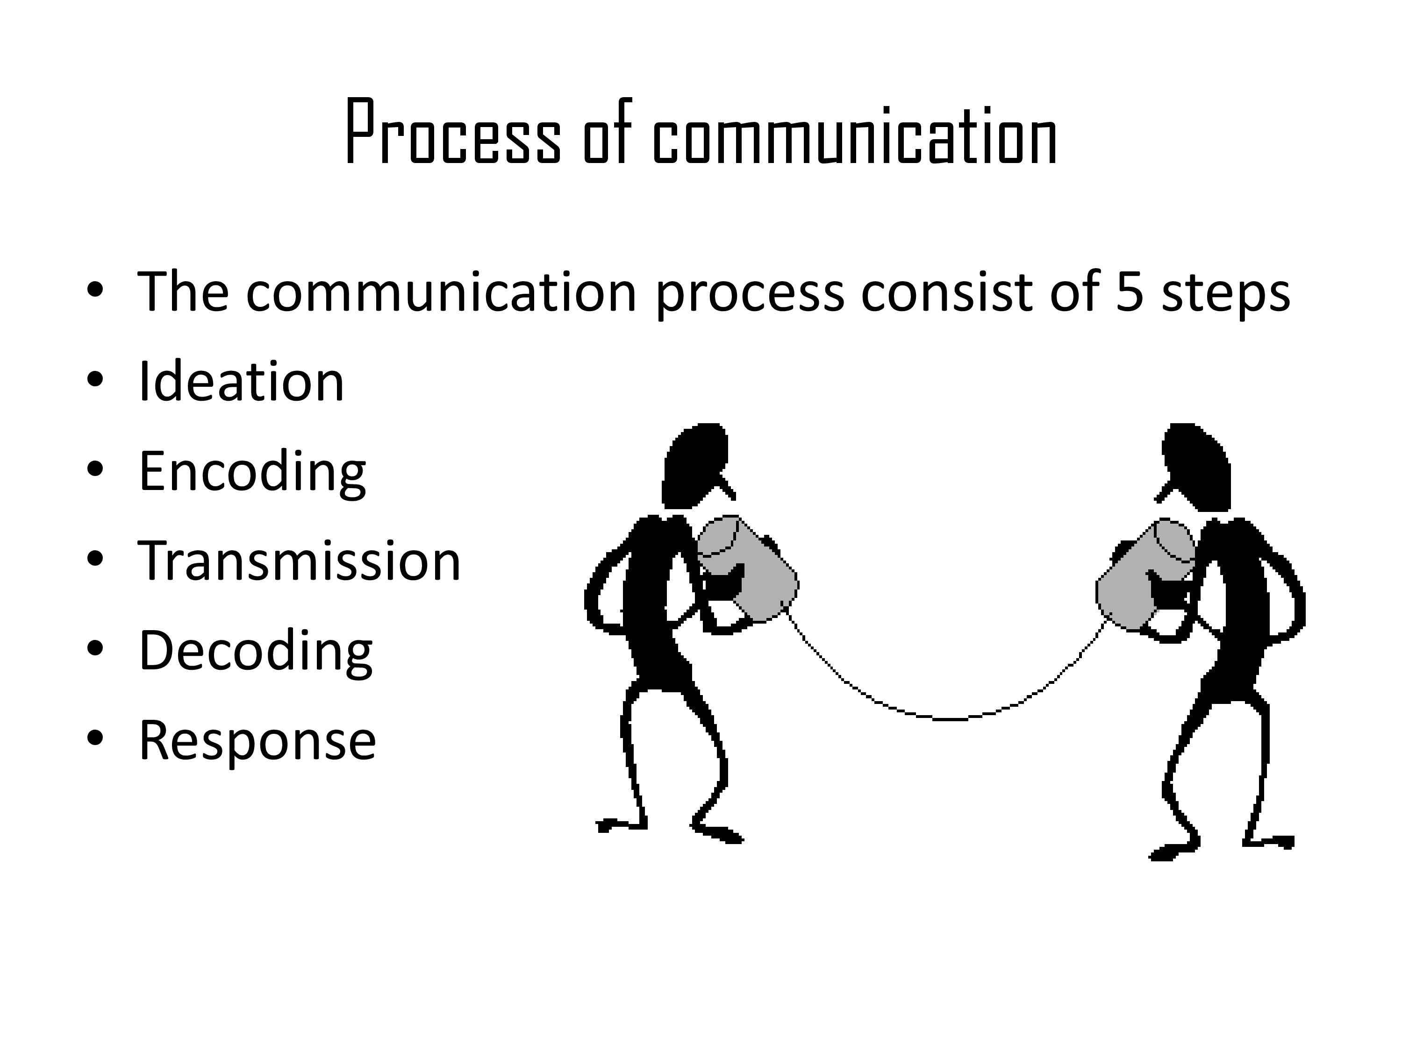

Slide 10
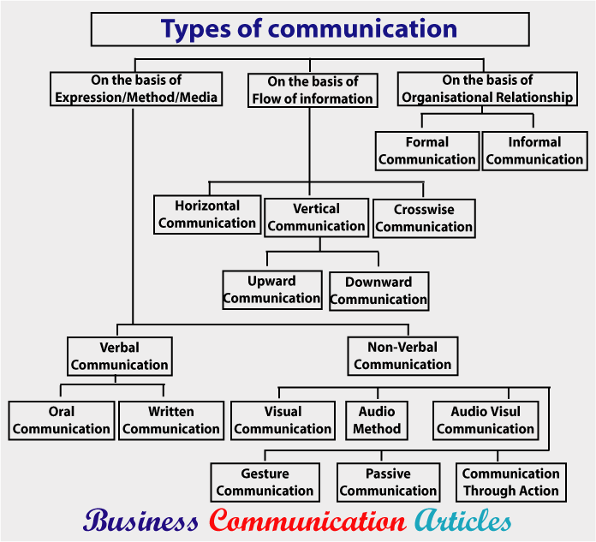
Types of Communication

Slide 11
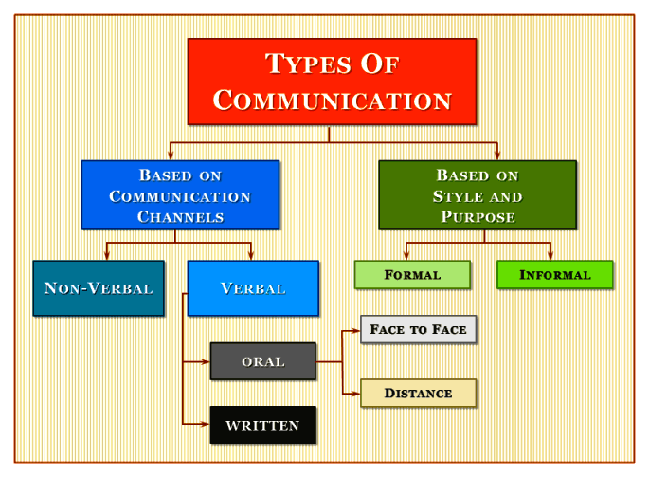

Slide 12
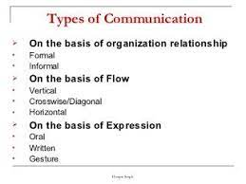

Slide 13
its Relevance to Different Situations
Personal situations – happy, sad
Formal Situations
Emergency situations
Emotional situations
Demand Situations
Excessive situations etc.,

Slide 14
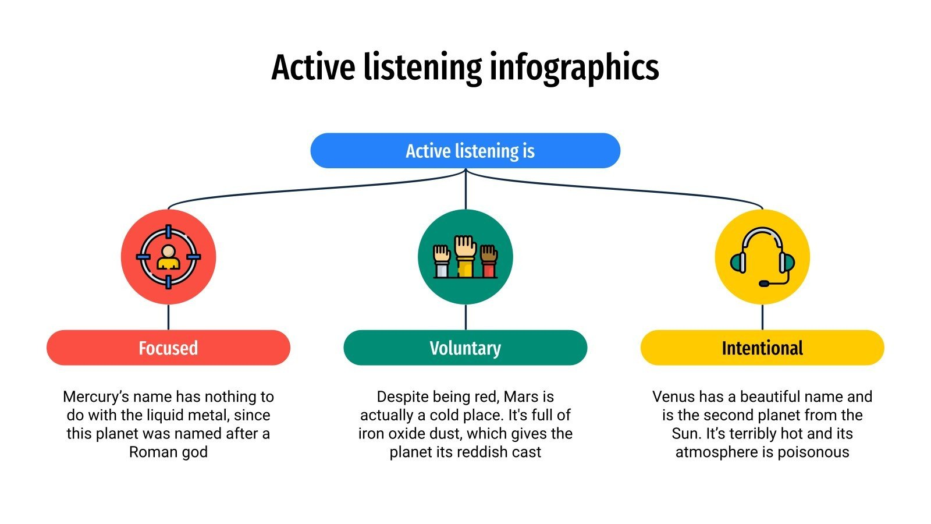
Active Listening

Slide 15


Slide 16
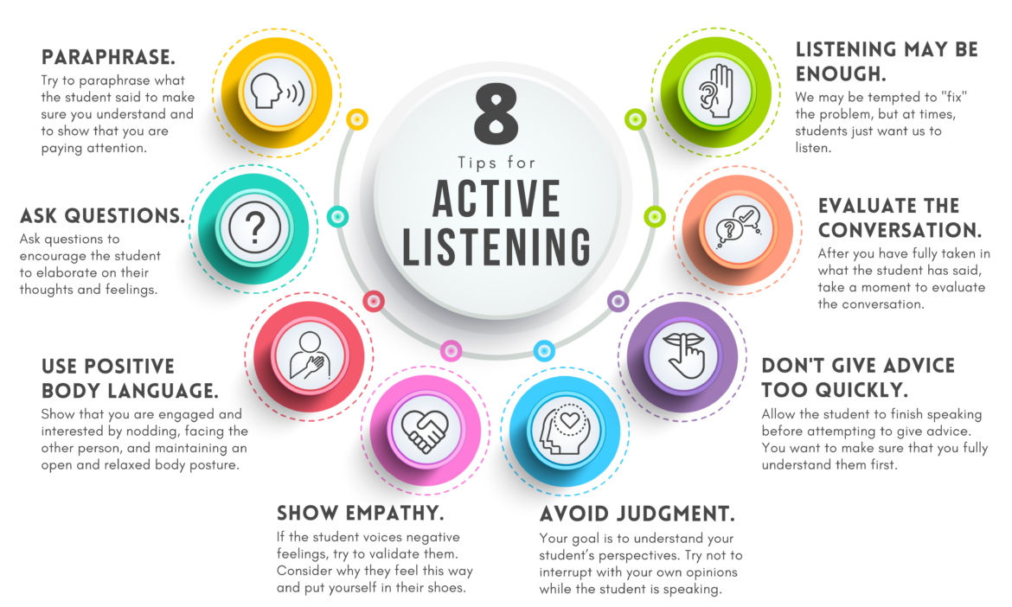

Slide 17
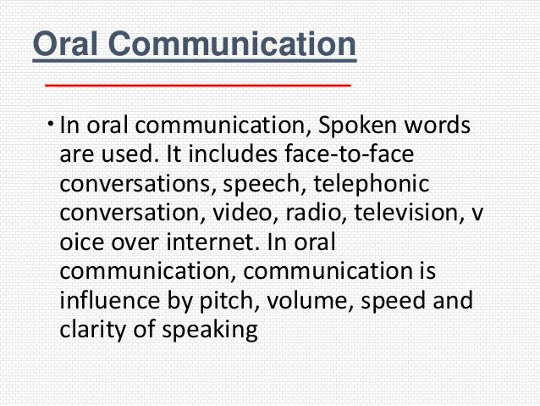

Slide 18
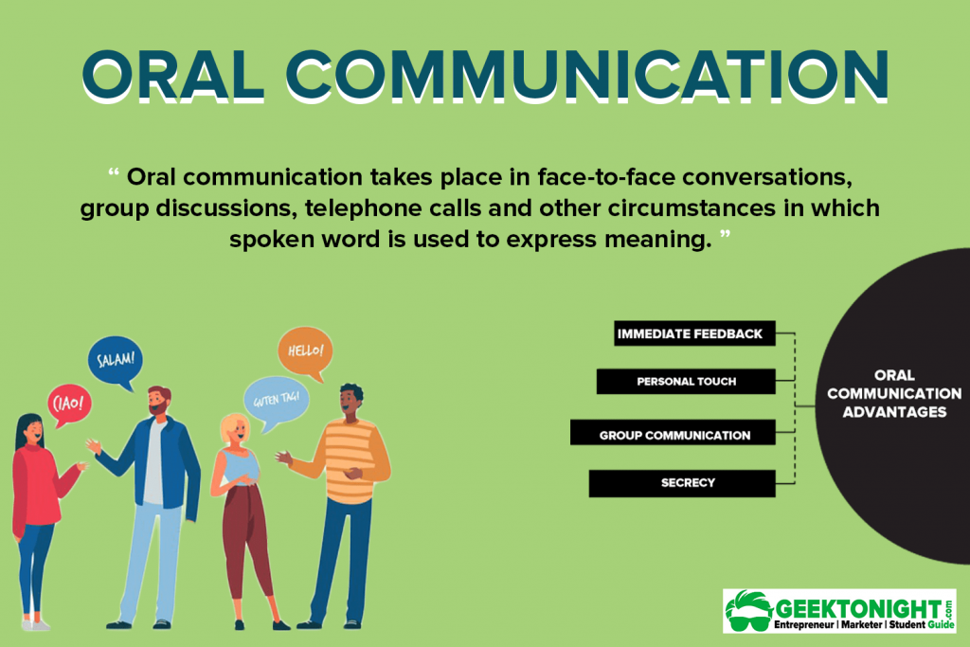
Oral Communication Skills

Slide 19
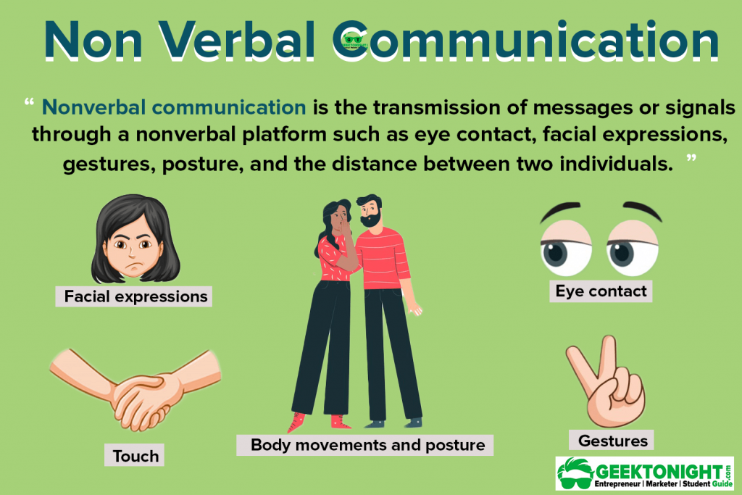
Non–verbal communication

Slide 20
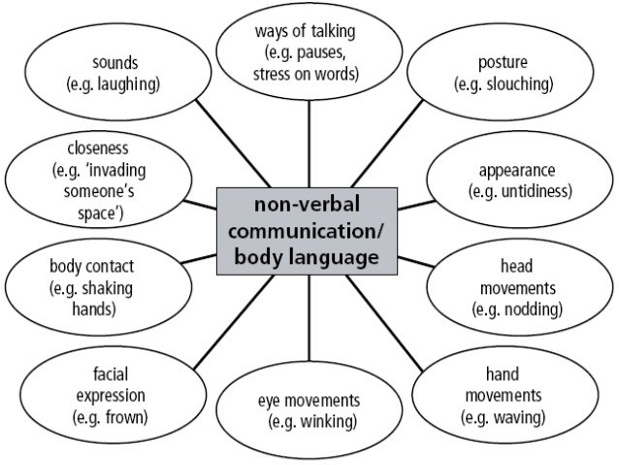

Slide 21


Slide 22
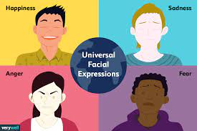

Slide 23
Numerical ability
Numerical ability involves solving problems through application of basic formula or standard rules. Few examples are ratios, percentages, simple/ compound interest etc., use predefined formula to arrive at the answer.
Order of Operation
Fractions
Decimals
Percentages
Square roots
Powers and exponents
Conversions
Measurement, including money, distance, area, and volume

Slide 24
Numerical ability
Numerical ability is all about calculation of numbers.
The questions in this section require simple arithmetic calculations or usage of direct formula to arrive at solutions.
If you know the basics of solving maths problems, then its quite easy to crack numerical ability paper.
The main purpose of numerical ability is to find out how fast you arrive at the correct answer.

Slide 25
Test of reasoning
A logical reasoning test measures your ability or aptitude to reason logically. Generally, logical reasoning tests measure non-verbal abilities.

Slide 26
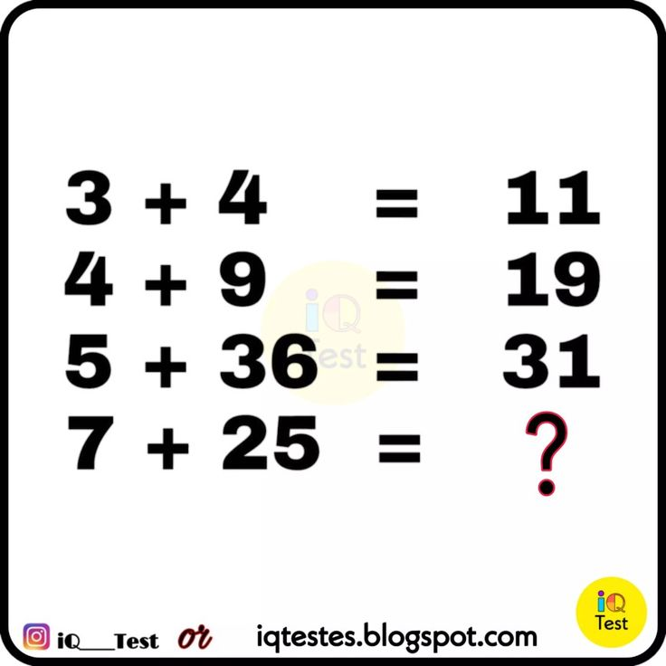

Slide 27
Logical deduction
Logical deduction is the process of reasoning from one or more statements (premises) to reach a logical conclusion.

