Slide 1
22HRM2CC6 -(Core Course)
INDUSTRIAL RELATIONS AND COLLECTIVE BARGAINING
UNIT – II : Trade Unions in India
History and growth of trade Union-purpose and functions-Trade Unions and Economic Developments-Pitfalls and suggestions to improve- Indian Trade Union Act, 1926.

Slide 2
Trade Unions are:
A trade union can be defined as an organised association of workers in a trade or profession, formed to further their rights and interests. In India, Trade Unions in India are registered under the Trade Union Act (1926).

Slide 3
Trade Unions are:
Trade unions are interested in the economic and social welfare of the workers. Labour unions may also have political interests in the larger society.
In India, now there are more than 16,000 trade unions with a collective membership of around 1 crore (10 million) labourers.

Slide 4
Pre-1918: The genesis of the labour movement in India
After the setting up of textile and jute mills coupled with the laying of railways in the 1850s, worker atrocities started to come to light.
Though the origin of labour movements was traced in the year 1860s, first labour agitation in the history of India occurred in Bombay, 1875. It was organised under the leadership of S.S Bengalee.
It concentrated on the plight of workers, especially women and children. This led to the appointment of the first Factory commission, 1875. Consequently, the first factories act was passed in 1881.
In 1890, M.N Lokhande established Bombay Mill Hands Association. This was the first organised labour union in India.

Slide 5
1918-1924: The early trade union phase
This period marked the birth of true trade union movement in India.
It was organised along the lines of unions in the industrialised world.
The deteriorated living conditions caused by the first world war and the exposure with the outside world resulted in heightened class consciousness amongst the workers. This provided fertile ground to the development of the movement. This period is known as the early trade union period.
Important unions: Ahmedabad Textile Labour Association (1917) led by Smt. Anasuyaben Sarabhai, All India Postal and RMS Association, Madras Labour Union led by B.P Wadia etc.
AITUC, the oldest trade union federation in India was set up in 1920. It was founded by Lala Lajpat Rai, Joseph Baptista, N.M Joshi and Diwan Chaman Lall. Lajpat Rai was elected the first president of AITUC.

Slide 6
Factors that influenced the growth of the movement:
Spiralling prices during War and the mass entrenchment of workers that followed it led to low living standards. Also, the wretched working conditions added to their woes. Hence, they sought collective bargaining power through unionisation.
Development of Home Rule, the emergence of Gandhian leadership and the socio-political conditions led to the nationalist leadership taking interest in the worker’s plight. Workers, in turn, was looking for professional leadership and guidance.
Russian revolution and other international developments (like setting up of International Labour Organisation in 1919) boosted their morale.

Slide 7
1925-1934: Period of left-wing trade unionism
This era was marked by increasing militancy and a revolutionary approach. It also saw multiple split-ups in the movement.
Leaders like N.M Joshi and V.V Giri was instrumental in moderating the movement and further integrating it with the nationalist mainstream.
AITUC split up multiple times paving way for the formation of organisations like National Trade Union Federation (NTUF) and All India Red Trade Union Congress (AIRTUC). However, the need for unity was felt and they all merged with the AITUC in the next phase.
The government was also receptive to the trade union movement. Legislations like the Trade Unions Act, 1926 and the Trade Disputes Act, 1929 gave a fillip to its growth. It bestowed many rights to the unions in return for certain obligations.
This period was marked by the dominance of the left. Hence, it may be referred to as the period of left-wing trade unionism.

Slide 8
1935-1938: The Congress interregnum
This phase was marked by greater unity between different unions.
Indian National Congress was in power in most of the provinces by 1937.
This led to more and more unions coming forward and getting involved with the nationalist movement.
In 1935, AIRTUC merged with AITUC.
Different legislations were passed by provincial governments that gave more power and recognition to the trade unions.
The approach of Congress ministries was that of promoting worker interests while protecting industrial peace.
Reconciliation of labour with capital was seen as an aim, with ministries working towards securing wage rise and better living conditions.
However, many ministries treated strikes as law and order issues. They used colonial machinery to suppress it.
This led to considerable resentment from the unions.

Slide 9
1939-1946: Period of labour activism
The Second World War lowered standard of living for the workers further and this led to the strengthening of the movement.
The question of war effort created a rift between the Communists and the Congress.
This, coupled with other issues, led to further split in the movement.
However, the movement as a whole got stronger due to the compounding issues. This included mass entrenchment post-war and the massive price rise that accompanied it.
Legislations like Industrial Employment Act, 1946 and Bombay Industrial Relations Act, 1946 contributed to strengthening the trade union movement.
In general, the movements got more vocal and involved in the national movement.

Slide 10
1947-present: Post-independence trade unionism
INTUC was formed in May 1947 under the aegis of Sardar Vallabhbhai Patel.
the crippling railway strike of 1974
Great Bombay textile strike, 1982.
However, such strikes are seen to get less public support post-1991.

Slide 11
Trade Unions in India
The Indian workforce consists of 430 million workers, growing 2% annually. The Indian labour markets consist of three sectors:
The rural workers, who constitute about 60 per cent of the workforce.
Organized sector, which employs 8 per cent of workforce, and
The urban informal sector (which includes the growing software industry and other services, not included in the formal sector) which constitutes the rest 32 per cent of the workforce.

Slide 12
Problems faced by the labour movements
Uneven growth: They are concentrated in the metropolises, largely catering to organised sector. Rural Agricultural labour and small scale labour are grossly underrepresented.
Low membership: Trade union membership is growing, but the vast majority of India’s labour is not part of any trade unions. This reduces their collective bargaining power.
Weak financial position: Membership fees are set too low (25 paise) by the Trade Union Act, 1926. They are particularly disadvantaged against corporate lobbying groups that are flush with cash.
Political leadership: Careerist politicians and vested political agenda mean that worker interests are sidelined. Since the leadership may not be from the labour force, they are held captive to party politics. This lead to further exploitation.
The multiplicity of unions: Bargaining power is diluted and it is easy for employers to divert the attention of the labour.
Inter-union rivalry: There are conflicts of interest and party politics between the unions.
The problem of recognition: Employers are under no obligation to give them recognition. This means that docile unions get recognition and genuine ones may be sidelined.
Diverse nature of labour: Most unions don’t have properly differentiated organisational structure to cater to different classes of labour. Eg: Differences between agricultural, formal and informal labour.
Lack of public support: Especially post 1991, trade unionism is looked down as an impediment to growth and development. This has led to a general ebbing of the movement across the country.

Slide 13
Major Labour Unions and their Political Affiliation
All India Trade Union Congress – Communist Party of India.CPI
Indian National Trade Union Congress – Indian National Congress.
Bhartiya Mazdoor Sangh – Bharatiya Janata Party.
Centre for Indian Trade Unions – CPM.
Hind Mazdoor Sabha – Samajwadi Party.

Slide 14
Current Unions
All India Trade Union Congress (AITUC)
Bharatiya Mazdoor Sangh (BMS)
Centre of Indian Trade Unions (CITU)
Hind Mazdoor Kisan Panchayat (HMKP)
Hind Mazdoor Sabha (HMS)
Indian Federation of Free Trade Unions (IFFTU)
Indian National Trade Union Congress (INTUC)
National Front of Indian Trade Unions (NFITU)
National Labor Organization (NLO)
Trade Unions Co-ordination Centre (TUCC)
United Trade Union Congress (UTUC) and
United Trade Union Congress - Lenin Sarani (UTUC - LS)

Slide 15
Trade Union-functions
Increasing Co-operation and Well-being among Workers
Securing Facilities for Workers
Establishing Contacts between the Workers and the Employers
Progress of the Employees
Safeguarding the Interests of the Workers

Slide 16
Trade Union-functions
1. Members
Safeguard the workers’ rights and privileges from management encroachment.
Ensure a healthy and sound working environment.
Fight for the performance-linked bonus for workers.
Negotiate for insurance, housing, healthcare, education, and cooperative societies for the workers from the management.
To help workers financially in times of emergency through union funds and management corpus.

Slide 17
Trade Union-functions
2. Organization
To improve the production and worker efficiency as per the requirement of the firm through discussions with the management.
To act as a bridge between the worker and the management for all types of communication.
To convince management to act as a motivator and not as punitive toward workers.
To guide management in formulating and implementing employees’ welfare schemes and activities.
Impress the management with pressure tactics to avoid illegal termination and punishment, and treat every worker justly.
To conduct elections for various posts of the union.

Slide 18
Trade Union-functions
3. Union Activities
To maintain records of all the worker members of the union
To organize various events to promote unity amongst members
Act as a mediator between the aggrieved worker and the member superior.
To collect funds for strengthening the union.
To bring a culture of leadership amongst the members
To help new members of the organization and the union to settle down easily.
4. Society
To undertake social upliftment works for the poor like free books, rations, and scholarships to needy students.
To raise voices against anti-social policies of the government and management of the related sector by the trade unionist.
To be a role model for society in terms of social work.

Slide 19
Trade Union-purpose
Improving working conditions for workers
Improving the economic status of workers
Provide bonuses to employees out of company/organization profits.
Oppose management plans that make aim at unstable employment of workers and limit employment opportunities.
Legal assistance to workers
To protect workers from employment cuts, layoffs, etcetera.
To ensure that workers receive subsidies, pensions, and other benefits in accordance with regulations.

Slide 20
Trade Union-purpose
Provide workers with better safety and health care systems
Ensure employee participation in corporate governance
To instill discipline, self-respect, and dignity in workers.
To secure promotion and training opportunities.
Ensure organizational efficiency and high productivity.
Ensuring stable employment of workers and resisting employers’ incentives to replace them with automated machines.
To give employees the opportunity to participate in the management of the company and to oppose decisions that adversely affect them

Slide 21
TU and ED
During a lockout or strike or in medical need, Trade unions also help in providing financial and non-financial aid to workers.
Trade unions play an imperative role in increasing the wages of workers.
Bargaining, Utilization of Power, and Stopping the supply of labour are some of the methods used by Trade unions in increasing the wages of the workers.
Trade unions provide job security to workers through peaceful measures.
They also protect workers from hikes in wages.

Slide 22
Pitfalls of Indian Trade Unions
The evil effects of outside leadership
Most of the leaders cannot understand the worker’ problems e leadership
Internal leadership has not been developed fully
slow growth of Trade Unions
Attitude and policies of the management,
Multiple unions
Union Rivalry
Finance
Low membership
Heterogeneous nature of labour
Lack of Interest
Absence of paid office bearers
Illiteracy

Slide 23
suggestions to improve-Indian Trade Unions
Management should assure that the victimisation will be at zero level, even if the
trade unions are led by insiders;
Extensive training facilities in the areas of leadership skills, management
techniques and programmes should be provided to the workers;
Special leave should be sanctioned to the office bearers.

Slide 24
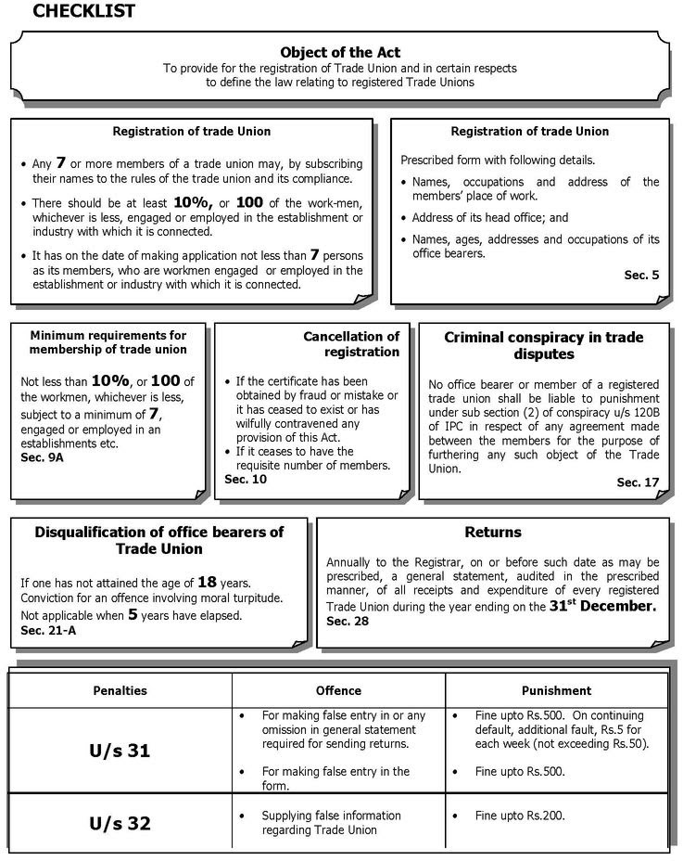
Indian Trade Union Act, 1926

Slide 25
4 Labour code
The new 4 codes will deal with wages, social security, industrial safety and welfare, and industrial relations. 44 labour laws into four labour codes
Labour Code on wages
Code on wages will subsume legislations like The Minimum Wages Act, the Payment of Wages Act, the Payment of Bonus Act, the Equal Remuneration Act. It aims to provide a national floor for minimum wage. It also has provisions to consider regional variations like geography, economy etc.
Labour Code on Occupational Safety, Health and Working Conditions
Code on Industrial safety and welfare will replace legislations like the Factories Act, the Mines Act and the Dock Workers (Safety, Health and Welfare) Act. This will put in place a uniform regime across the nation to ensure industrial safety.
Labour Code on Industrial Relations
The Labour Code on Industrial Relations will combine the Trade Unions Act, 1926, the Industrial Employment (Standing Orders) Act, 1946, and the Industrial Disputes Act, 1947. The focus here is to set the stage for the way labour unions can protect labour interests. It also seeks to abolish deadlocks and promote worker welfare while promoting investment.
Labour Code on social security
Code on social security will merge important legislations like Employees’ Provident Fund and Miscellaneous Provisions Act, Employees’ State Insurance Corporation Act, Maternity Benefits Act, Building and Other Construction Workers Act and the Employees’ Compensation Act

Slide 26
Thank you
Doubts and Questions

